Slide 1
Foundation for Assistance to Small Innovative Enterprises (FASIE) 2014
State Activities to Support Innovations in Russia

Slide 2
Definition of a “small innovative enterprise (SIE)” in Russia
Company with a commercial legal status
Company carrying out R&D with the further and producing product based on Intellectual Property Rights belonging to a company
Company with a number of employees not exceeding 100 people
Turnover less than 14 mln USD
Share capital: less than 25% belonging to foreign companies and individuals, state and large businesses (exception- spin offs)

Slide 3
FASIE’s MISSION
To develop and carry out activities of the State assistance to commercialization of new knowledge into products and services by small companies:
early stage financing

Slide 4
FASIE, main facts
Set up by
- The government of Russia, 03.02.1994
Financed through
1,5% of federal budget for R&D
(5,0 billion Rubles for 2012 or 120 mln EUR)
Form of assistance
- The state contract for R&D
Policy and control by
- The Supervisory Board
Expertise
- Independent experts

Slide 5
Interaction with development institutes
FASIE
Seed Investment Fund
Russian Venture Company (RVC)
FASIE
GC VEB, GC RUSNANO, RVC, RAS, Its
Foundation for Development of the Center of Research and Commercializing of New Technologies in Skolkovo
GC VEB, GC RUSNANO, RVC, RAS, Opora Russia.
FASIE
Continuous financing of projects at all stages of an innovative cycle
FASIE
The agreement on an information exchange and additional review of projects
GC RUSNANO

Slide 6
Fund results 1994-2012
Applications submitted and reviewed | over 35 000
Projects supported | over 11 000
New innovative SMEs created | over 4 500
New workplaces created | Over 25 000

Slide 7
Export support, bilateral
Internationalization
FASIE
Target programs
Growth
FASIE
Seed
START
FASIE
Pre-seed
UMNIK

Slide 8
(pre-seed stage)
UMNIK Program
The aim:
Stimulation of mass participation of young scientists in scientific and technical innovative activity by organizational and financial support.
A nominee should be a physical person from 18 to 28 years
good scientific background behind each idea is an important criteria
Each winner of the Program receives 200 thousand rubles a year
No need to organize enterprise for first two years
Since 09/2006 till 05/2012 870 conferences were organized and 6688 winners chosen.

Slide 9
(Seed stage) START Program
Results of R&D
S&T Concept
Business plan
New product
Small Innov. company:
R&D implementation to reduce risks for off-budget (private) investors
Small Innov. company:
Attracting off-budget (private) investments or beginning of product manufacturing
Small Innov. company:
Achieving the indicators of the business plan; product manufacturing
Up to 1,0 mln. Roubles
Up to 2,0 mln. Roubles, parity co-financing
Up to 3,0 mln. Roubles
Investor
FASIE
Investor
FASIE
FASIE
1st year
seed stage
2nd year
3rd year

Slide 10
“ START” Results 2004-2013
4 500 projects were supported
4 500 new innovative SME’s
17 000 applications
660 innovative SME’s passed on to the second year;
170 passed on to the third year;

Slide 11
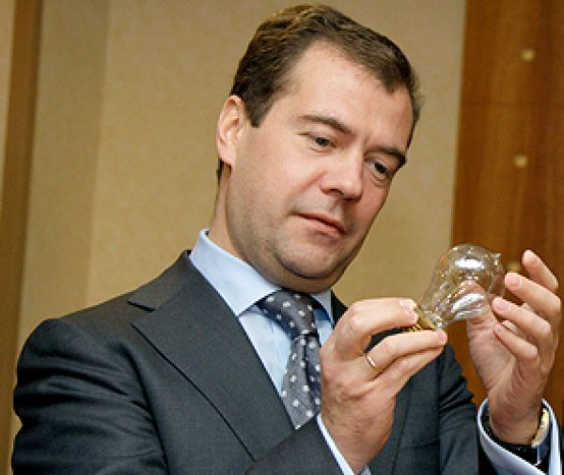
(growth stage) Target Programs
The aim:
To support successful small innovative enterprises in specific prioritized thematic areas of economy.
Three directions (out of 5) of the national priorities of the Russian economy set by the President of the Russian Federation
Energy efficiency and energy saving;
Information and communication technologies;
Health and Pharmaceutical industry
(Nuclear technologies)
(Space technologies)

Slide 12
(Internationalization stage) Export-oriented and bilateral
The aim:
To support successful small innovative enterprises to increase their competitiveness on the international market and give access to .
Program to support small innovative companies with the export potential (annual - over 150 companies financed)
“Anticrisis” program 2009 (110 companies being financed)
Bilateral financing programs with European funding agencies
Multilateral programs (pilot initiatives)

Slide 13
Bilateral memorandums signed with:
Germany, International Bureau of BMBF
(since 2008, 5 calls for proposals, ~ 80 projects financed)
France, a public-sector institution providing support to French SME’s
(since 2009, 3 calls for proposals, 15 projects financed, on-going process of selection of proposals)
Finland, the Funding Agency for Technology and Innovation
(since 2011, 16 projects being financed, currently open call)

Slide 14
Multilateral cooperation:
Pilot initiative (Russia, Germany, Israel, Greece, Turkey, Switzerland), FASIE acts as a funding agency
70 applications received, 11 projects financed
ERANET for fostering cooperation between SME’s in various areas ob biotech. Annual calls. 4 projects being financed.
ERANET designed for small enterprises, two calls per year, 5 projects to be financed
ERANET on Industrial Biotechnology. Annual calls. 2 projects being financed
One of the largest ERANETs (25 countries), designed to finance projects in the “New Materials” theme.

Slide 15
Supporting instruments
Gate2RuBin = Russian gateway to EEN;
An efficient mechanism to establish technological partnerships and to apply for funding;
Over 30 applications received by FASIE – partners found through EEN
Notes:
15

Slide 16
How it works

Slide 17
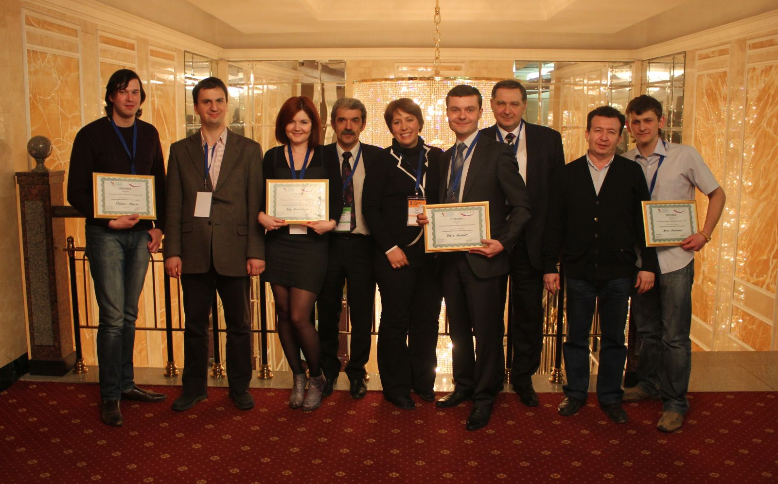
And Education, of course!
Cooperation with CRDF (USA)- from 2007
From 2012: New Format! Participation of IC2- Texas University
Webinars + Intensive trainings + Selection of winners (grants to pitch in the US)
2012: 150 innovators from
25 regions
2013: 180 innovators from
20 regions
Notes:
17

Slide 18
Clusters and innovative regions, together with #AIRR

Slide 19
Thank You !

