Slide 1
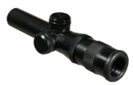
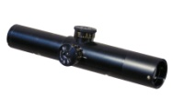
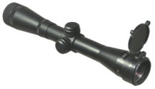
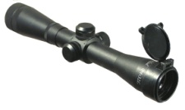
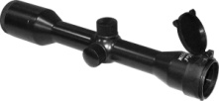
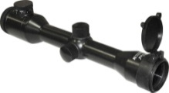
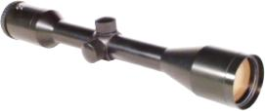
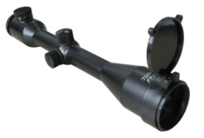
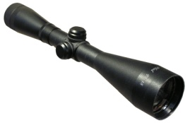
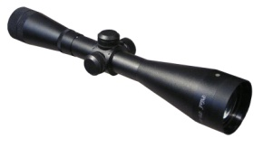
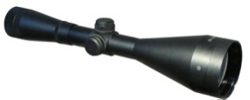
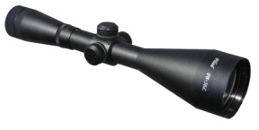
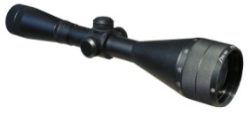
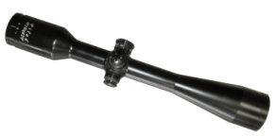
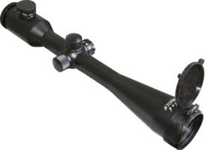
VOMZ,JSC
Price List 2013. EURO currency.
TRADE NAME |  | COMMENT | PRICE
RIFLESCOPES
PILAD Р 3,5х20 (with diopter adjustment) tube D=25,2 mm |  | Reticules: T | 57,90
PILAD Р3,5х20 C tube D=25,2 mm |  | Reticules: T | 56,20
PILAD Р4х32 tube D=25,4 mm |  | Reticules: T, Mil Dot, Cross, Parabola | 68,50
PILAD Р4х32 L (illuminated reticule) tube D=25,4 mm |  | Reticules: LS, LC, LK, LD | 84,80
PILAD Р4х32 M tube D=25,4 mm |  | Reticules: T | 81,00
PILAD Р4х32 ML (illuminated reticule) tube D=25,4 mm |  | Reticules: LC, LS, LKG, LK, LD | 97,10
PILAD 6х42– NEW! tube D=25,4 mm |  | Reticules: T , Mil Dot , Cross , Parabola | 116,80
PILAD 6х42L(illuminated reticule)– NEW! tube D=25,4 mm |  | Reticules: : LC, LS, LKG, LK, LD | 126,80
PILAD Р8х48 tube D=25,4 mm |  | Reticules: T , Mil dot , Cross , Parabola | 84,90
PILAD Р8х48 L (illuminated reticule) tube D=25,4 mm |  | Reticules: : LC, LK, LD, LY | 88,50
PILAD Р8х56 tube D=25,4 mm |  | Reticules: T, Mil Dot , Cross , Parabola | 84,90
PILAD Р8х56 L (illuminated reticule) tube D=25,4 mm |  | Reticules: LC, LK, LD, LY | 88,50
PILAD Р8х56 LF (illuminated reticule + anti-parallax) tube D=25,4 mm |  | Reticules: LC, LK, LD | 91,90
PILAD 10х42 F – NEW! tube D=25,4 mm |  | Reticules: T, FG, Cross, Mil Dot, FFT, SNR | 110,25
PILAD 10х42 LF(illuminated)– NEW! tube D=25,4 mm |  | Reticules: LC, LS, LKG, LK, LD | 124,00

Slide 2
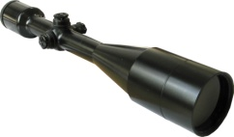
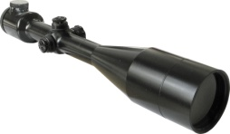
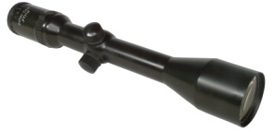
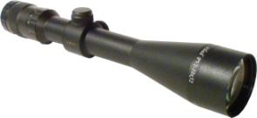
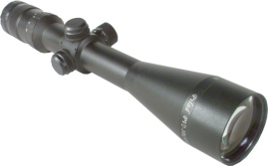
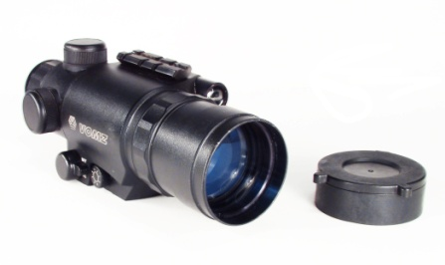
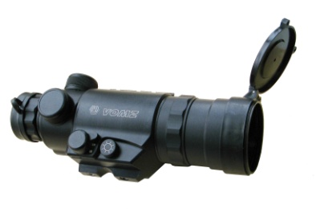
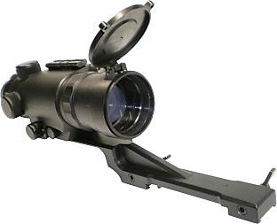
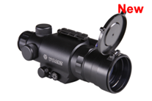
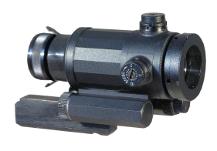
PILAD 12х50 F tube D=25,4 mm |  | Reticules: Mil Dot, FG, Cross, FFT, SNR | 118,10
PILAD 12х50 LF (illuminated reticule) tube D=25,4 mm |  | Reticules: : LC, LS, LKG, LK, LD | 126,00
PILAD PV 1,2-6х24 tube D=30 mm |  | Reticules: : T, Mil Dot, FG, Cross | 130,20
PILAD PV 1,2-6х24L tube D=30 mm |  | Reticules: LC | 133,50
PILAD PV 2 - 10 *48 tube D=30 mm |  | Reticules: T, Mil Dot, Cross | 142,50
PILAD PV 2 - 10 *52 tube D=30 mm |  | Reticules: Parabola , T | 128,60
PILAD PV 2 - 10 *52L (illuminated reticule) tube D=30 mm |  | Reticules: LC | 136,50
NIGHT VISION SCOPES
PNS 2,5x50 |  | Reticules: peak, cross | 311,30
PNS 2,5x50 Е (with LM-prism) |  | Reticules: peak, cross | 311,30
PNS 2,5x50 with mount for СZ550 |  | Reticules: peak, cross | 404,25
PNS 3x50 CERAMIC IMAGE INTENSIFIER GEN.1+ |  | Reticules: peak, cross | 318,00
PN 1,9X25 GEN.2+ |  | Reticule: Dot | 1900,0

Slide 3
For 25,4 mm body tube riflescopes (upper fitting) | Type 3 | To fit scopes: P4x32 (L/M/ML) on «TOZ-78», «TOZ-99», «Bars», «Los», «Sobol», «Izh-18MN», with transient lath – on “Izh-27”, “TOZ-34”; P8X48 (L), P8X56(L), P6X42, P10X42F(L),P12X50F(L) ON “TOZ-78”, “TOZ-99”; P3,5X20 – on “Izh-18MN”, with transient lath – on “Izh-27”, “TOZ-34”. | 23,65
 | Тype 2 (steel) | To fit scopes P4x32(L), P4x32M(L), P3,5x20(C) on arms with the lath «weaver». | 23,65
 | Type 7 - (aluminum) | To fit scopes P4x32 (L/M/ML), P6x42 (L), P8x48 (L), P8x56 (L), P10x42 (L), P12x50F(L) on the arms “TOZ-78”, “TOZ-99”, «Bars», «Los», «Sobol», “Bekas”, “Izh-MN”, with transient lath – on “Izh-27”, “TOZ-34”; P4x32(L)/(ML), P3,5x20 on “Izh-94” – Taiga (guide width 12 mm), “MR-512”, “Izh-60”. | 23,65
For 25,4 mm body tube riflescopes (side fitting) | V3-1a ( aluminum) | To fit scopes P4x32 (L/M/ML), P8x48 (L), P8x56 (L), P6x42 (L), P10x42F (L), P12x50F (L), P3,5x20 (C) on the carbines “Vepr”, “SKS”, “KO-44”, “KO-91”. | 24,00
 | V3 – 1v (aluminum) | To fit scopes P4x32 (L/M/ML), P8x48 (L), P8x56 (L), P6x42 (L), P10x42F (L), P12x50F (L), P3,5x20 (C) on “Saiga”, “Vepr-Hunter”. | 24,00
 | V3-1d (aluminum) | To fit scopes P4x32 (L/M/ML), P8x48 (L), P8x56 (L), P6x42 (L), P10x42F (L), P12x50F (L), P3,5x20 (C) on carbine “Tiger”. | 35,50
 | V1-1a (steel) | To fit scopes P4x32 (L/M/ML), P8x48 (L), P6x42 (L), P10x42F (L) on the carbine “Tiger” ,“SKS”, “KO-44”, “KO-91” (without a lath). The support is supplied with “swallow tail” lath. | 30,20
 | V1-1b (steel) | To fit scopes P4x32 (L/M/ML), P8x48 (L), P6x42 (L), P10x42F (L) on the carbine “Saiga”; P8x56 (L), P12x50F (L) on the carbines “Tiger”, “Saiga”. | 30,20
For 30 mm body tube riflescopes (upper fitting) | Type 7a (aluminum) | To fit scopes PV1,2-6x24 (L), PV2-10x48, PV2-10x52(L) on the arms “TOZ-78”, “TOZ-99”, “Bars”, “Los”, “Sobol”, “Bekas”, “Izh-18MN”, “IZH-94” – Taiga (guide width 12 mm), with transient lath – on “Izh-27”, “TOZ-34”. | 23,65
For 30 mm body tube riflescopes (side fitting) | V3-1b (aluminum) | To fit scopes PV1,2-6x24 (L), PV2-10x48, PV2-10x52(L) on the carbines “Vepr” ,“SKS”, “KO-44”, “KO-91” . | 35,50
 | V3-1g (aluminum) | To fit scopes PV1,2-6x24 (L), PV2-10x48, PV2-10x52(L) on the carbines “Saiga” ,“Vepr-Hunter” . | 35,50
 | V 3-1e (aluminum) | To fit scopes PV1,2-6x24 (L), PV2-10x48, PV2-10x52(L) on the carbine “Tiger” . | 35,50
 | V 1-1v (steel) | To fit scopes PV1,2-6x24 (L), PV2-10x48, PV2-10x52(L) on the carbines “SKS”(without a lath), “KO-44”, “KO-91” . The support is supplied with “swallow tail” lath. | 30,20

Slide 4
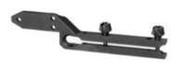
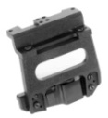
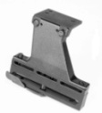
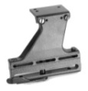
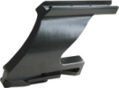
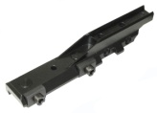
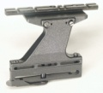
For PILAD Р3,5х20, Р3,5х20С | Type 8 а, 8 b ( aluminum ) | 8 а - To fit scopes P3,5x20 (C) on “Izh-94” North (guide with 7mm); 8 b – To fit scopes P3,5x20 (C) on “Izh-94” North (guide with 12mm). | 30,15
For night vision scopes | Type LOS | To fit scope PNS 2,5x50 on “Los”, “Bars”. | 23,65
 | Euroclamp | - for the placing of scope PNS 2,5x50 on WEAVER base. | 23,40
 | V 2-2 | To fit scope PNS 2,5x50 on the carbines “Saiga”, “Tiger”, “SKS”, “KO-44”, “KO-91”. | 23,65
 | V 3 - 2а | To fit scope PNS 2,5x50 on “Tiger”. | 17,85
 | V3 – 2b | To fit scope PNS 2,5x50 on “Saiga”, “Vepr-Hunter”. | 17,85
 | V3 - 2е | To fit scope PNS 2,5x50 on “Tiger” carbine. | 17,85
 | CZ-550 | To fit scope PNS 2,5x50 on carbines “CZ-550”. | 124,70
For night vision scopes with LM-prism – NEW! | 039 | To fit night vision scope PNS 2,5x50 with mount “Europrism” (LM-prism) on carbines “Tiger”, “SKS”, “Vepr”, “Saiga”. The scope may be fixed on the support guide in one of three positions. | 49,10
 | 042 | Upper Mount for «Europrism » (on «weaver») To fit night vision scopes PNS 2,5x50 with mount “Europrism” (LM-prism) on carbines “Vepr-Super” to “weaver” lath . The scope may be fixed on the support guide in one of three positions. | 72,20
For 25,4 mm body tube riflescopes (side fitting) – NEW! | 043 | To fit scopes with diameters 25,4 mm on carbines “Tiger”, “SKS”, “Vepr”, “Saiga”. Rings are removable and may be fixed on the support guide in one of two positions. | 72,20
With «weaver» | V3 – 2v (aluminum ) | To fit scopes with “weaver” lath fixing , on carbines “Vepr”, “SKS”, “KO-44”, “KO-91”. | 30,20
 | V3 – 2g (aluminum) | To fit scopes with “weaver” lath fixing, on carbines “Saiga”, “Vepr-Hunter”. | 30,20
 | V3 – 2d (aluminum ) | To fit scopes with “weaver” lath fixing, on the carbines “Tiger”. | 30,20
With «swallowtail» | VIII-4b | To fit scopes on “swallow tail” lath, on the carbines “Vepr”. | 30,20

Slide 5
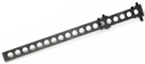
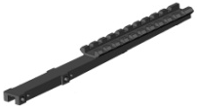
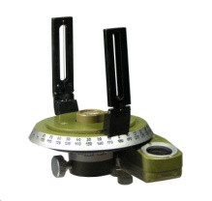
Transient bases | Transient slat “swallow tail” | To be fixed on “Izh-27”, “TOZ-34” | 10,00
 | “Swallow tail” lath | To fix various accessories (scopes, infrared projector, directional microphone, laser designator, etc) on “Saiga” type carabines. | 10,00
«Weaver» base 004 |  | Transient base with ”weaver” top for IZH-27, TOZ-34 fitting | 13,10
Base 037 |  | Transient base with ”weaver” top for “dovetail” base fitting | 20,00
Base 008 |  | Swallowtail base | 13,75
AZIMUTH COMPASS
АR-1 |  | For forest management and topographic works | 42,40

