Slide 1
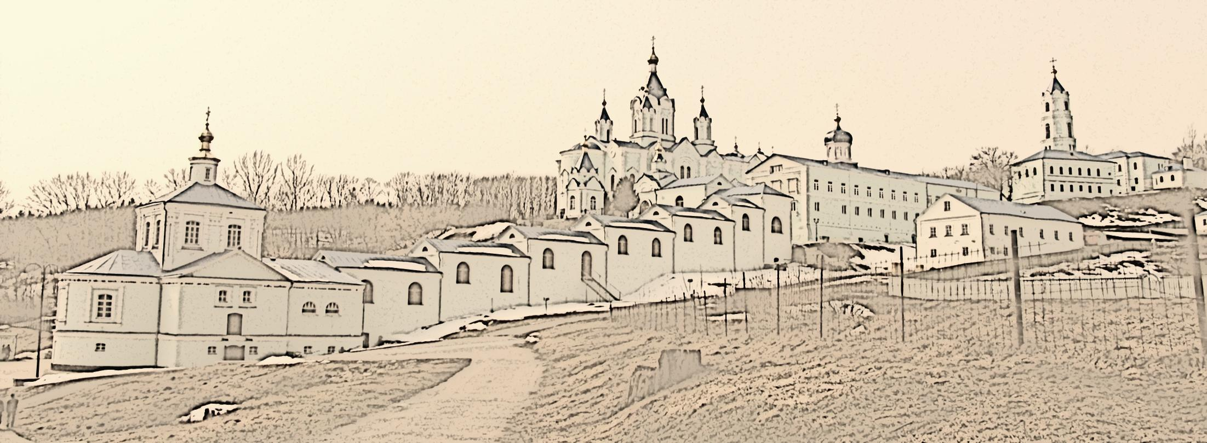
We invite to cooperation!
Kursk Korenskaya Fair

Slide 2
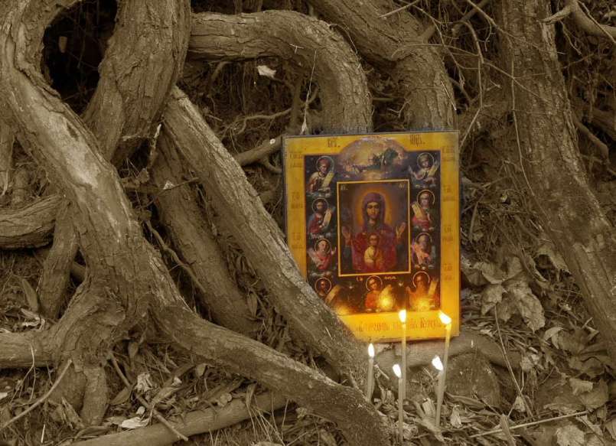
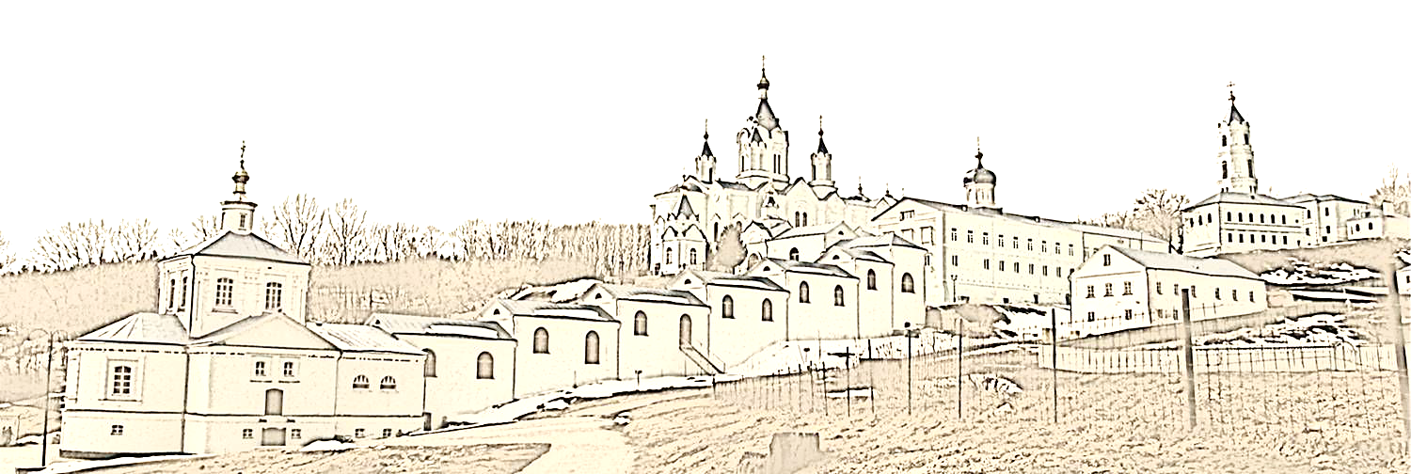
We invite to cooperation!
KURSK KORENSKAYA FAIR or, how it was called earlier Korennaya Fair is a unique event into the life of our region.
Holding of Kursk Korenskaya Fair was inseparably linked to the crowded religious processions of the wonderworking icon “The Virgin of the Sign” Kursk –Korennaya, that has taken place in Kursk province.

Slide 3
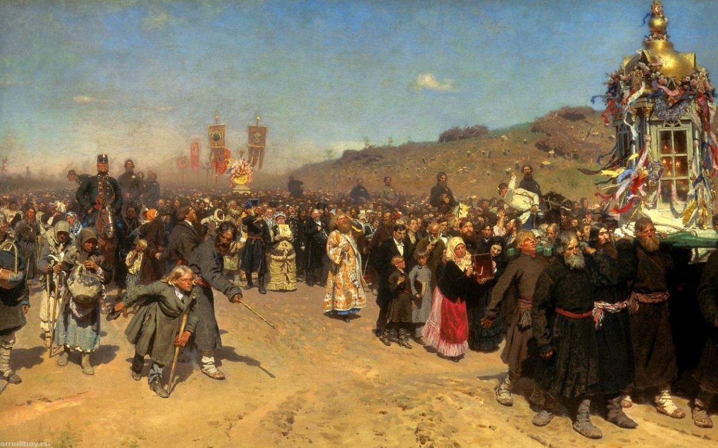
We invite to cooperation!
The famous Russian artist I.E. Repin depicted one of the religious processions.
I.E. Repin «The religious procession in Kursk province».
1883

Slide 4
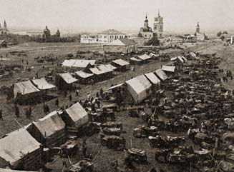
We invite to cooperation!
The first officially attested reference to the Fair related to 1708.
Since ancient times, there were three major market places in Russia: one on the Volga River, the other one in Siberia, and the third was here, in Central Russia.
Trade rows. Photo of the XIX century

Slide 5
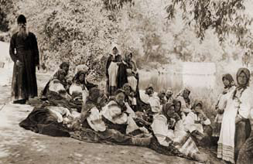
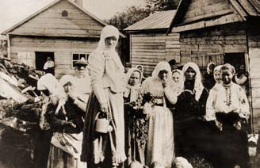
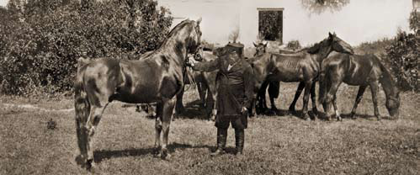
We invite to cooperation!
The Fair has become an important place of goods exchanging between Moscow State and Ukraine. In addition, it was an important issue for the European foreign trade of Russia.
The rest of the pilgrims on the shore of Tuskar river. Photo of the XIX century
Hay market. Kursk. Photo of the XIX century
Breeding horses from the stables of A. A. Fet. Photo of the XIX century

Slide 6
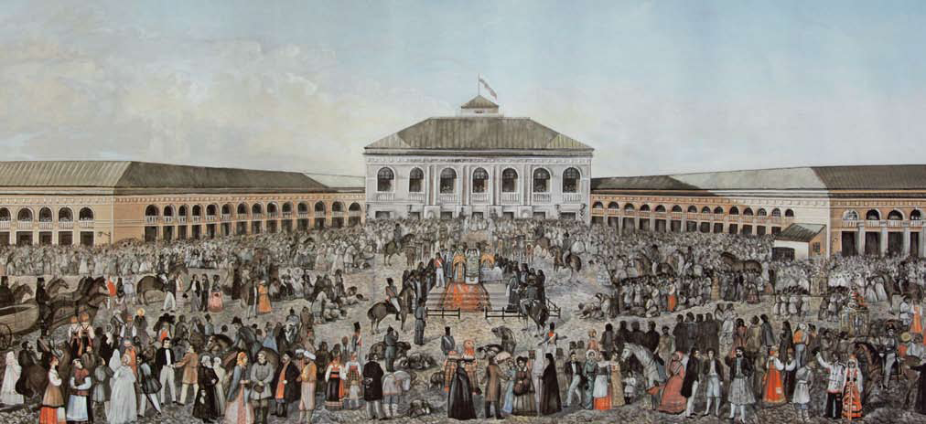
We invite to cooperation!
According to the decree of Empress Catherine II in 1787 Korenskaya Fair has received all-Russian status, and in 1824 became international.
In the second half of the nineteenth century, the turnover of the Fair reached 7 million rubles.
View of the Fairgrounds at the Korennaya Pustin. Lithograph of the ХIХ century

Slide 7
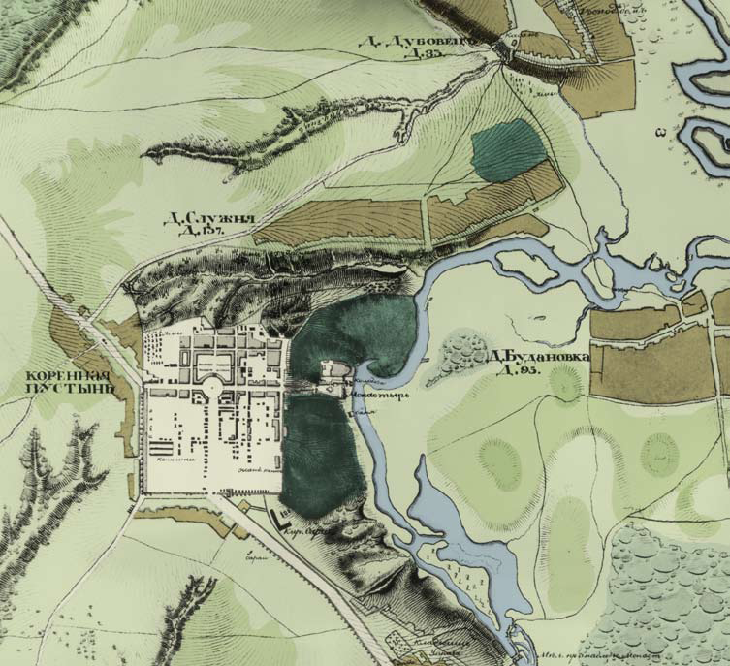
We invite to cooperation!
Located on more than 60 acres of land there were 650 commercial buildings, and the Fair Court Yard, built by the famous architect Dzhakomo Kvarengi.
At that time the Yard was considered to be one of the most beautiful ones in Russia
Plan of Korennaya Fair on a military topographic map (1830-ies)

Slide 8
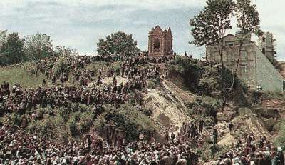
We invite to cooperation!
At the end of the XIX century the Fair has gradually lost its former importance and for several decades has been erased from the history.
After the October revolution, rapid destruction of the monastery began.
The pilgrims in Korennaya Pustin. Photo of the XIX century
In 1924-1926 the main Cathedral was blown up, the bells were sold, the bell tower, the stairs and the Church of the Life-giving Source were destroyed.

Slide 9
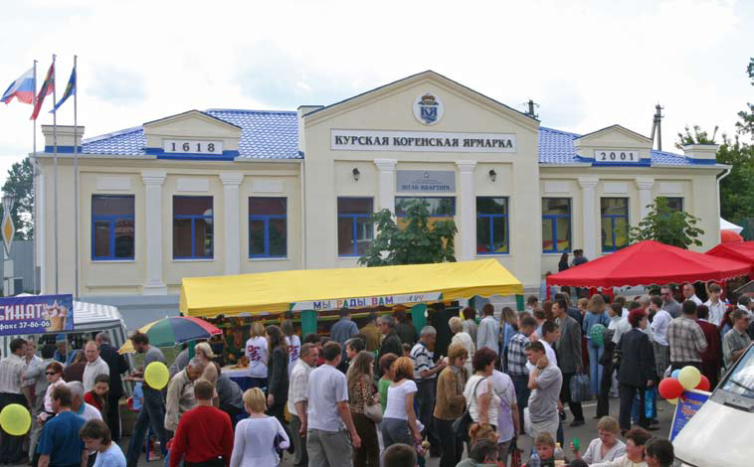
We invite to cooperation!
On the 1st of November, 1989 Korennaya Pustin has been handed over to the Kursk-Belgorod diocese for restoration. In 1990 the religious procession was revived.
On the 23-th of September 2001 the Fair started to work at the walls of the monastery.
The I Interregional universal wholesale-retail Kursk Korenskaya Fair was attended by 36 companies, 26 of which represented Kursk region and 10 represented other regions of Russia.

Slide 10
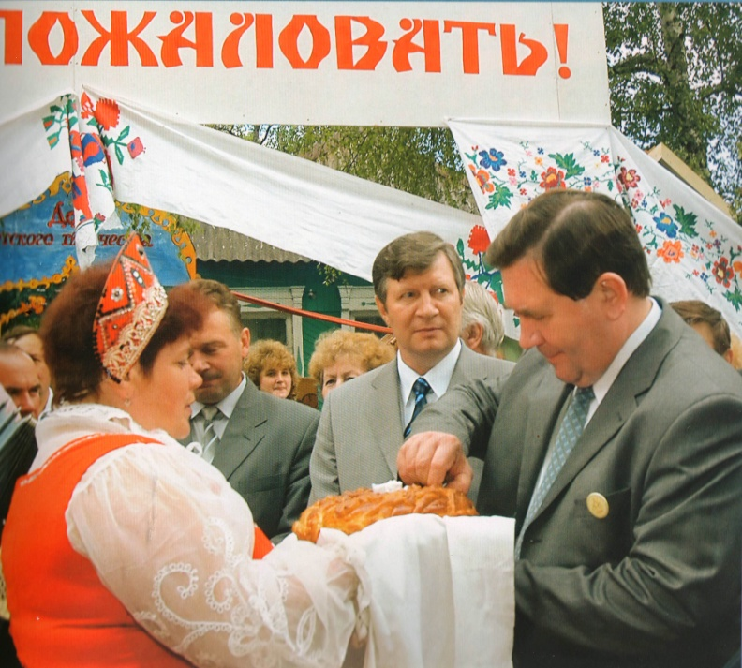
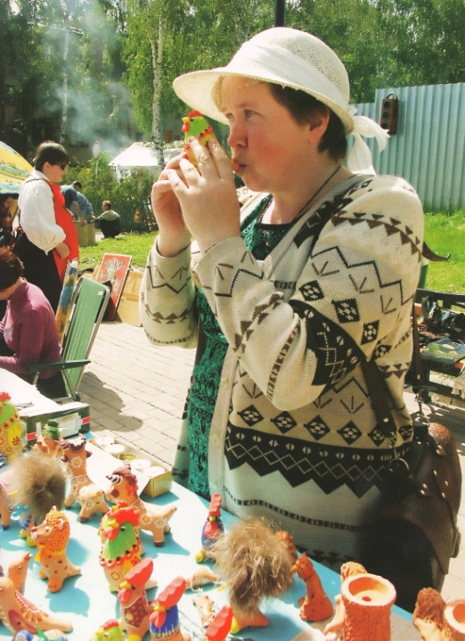
We invite to cooperation!
On the 6th of July 2002 foreign delegations from Yugoslavia, Slovenia and Poland for the first time participated in II Korennaya Fair.
18 districts of Kursk region organized rural farmsteads.

Slide 11
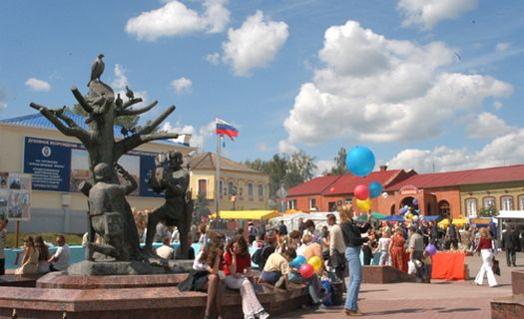
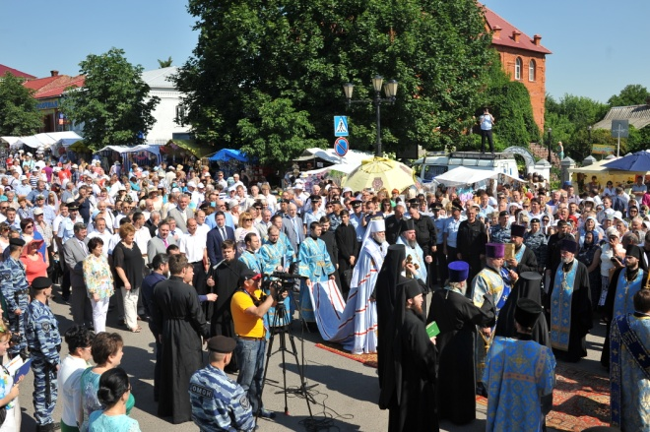
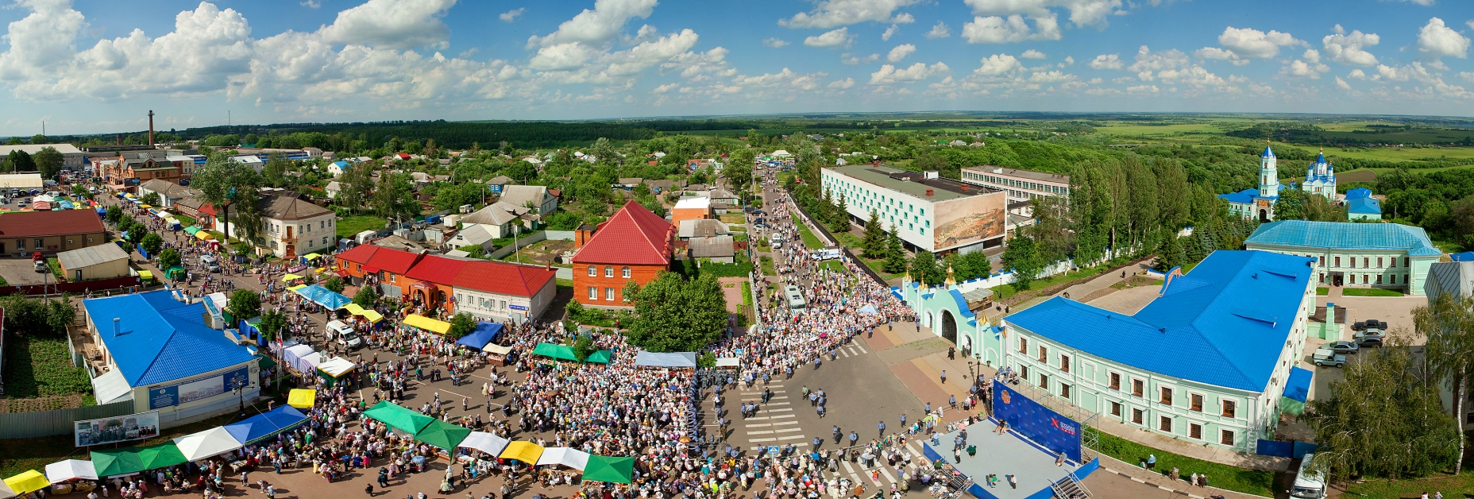
We invite to cooperation!
Due to its size and large scale, Korenskaya Fair now is considered to be one of the main marketplaces of our country.

Slide 12
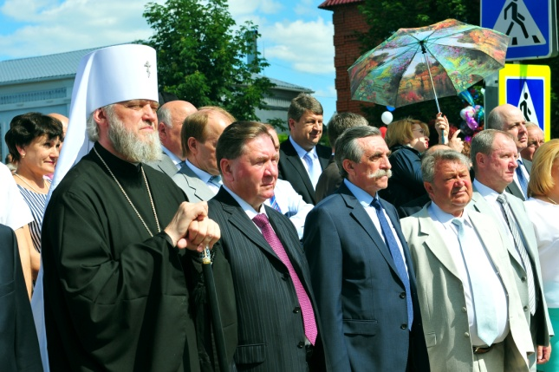
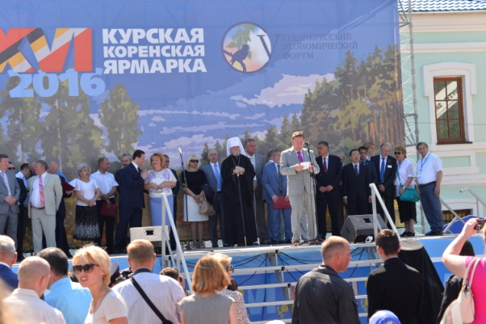
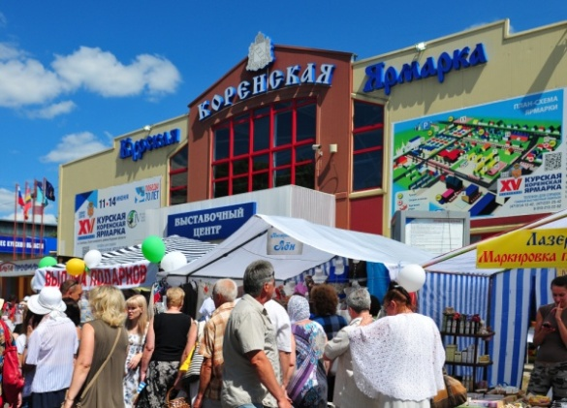
We invite to cooperation!
Here, at the sacred walls of the Korennaya Pustin representatives of government, business, community and clergy meet together, uniting their thoughts and consolidating efforts to the prosperity of the country.

Slide 13
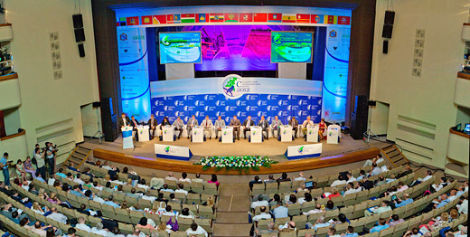
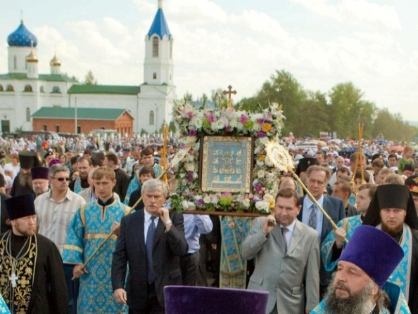
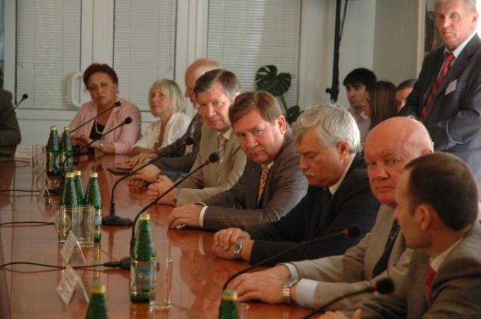
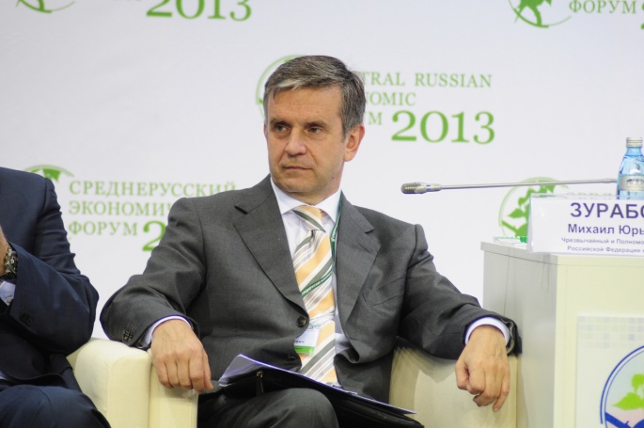
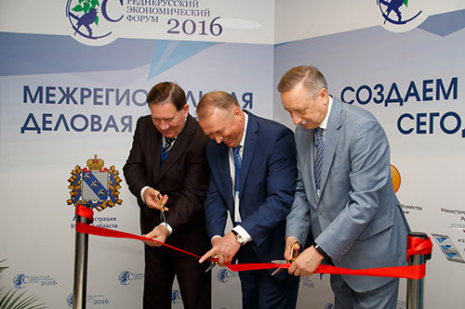
We invite to cooperation!
Kursk Korenskaya Fair is organized with the support of the leadership of the Central Federal district and the sector-specific federal ministries of the Russian Federation.
Since 2012 the Mid-Russian Economic Forum has been held within the frame of Kursk Korennaya Fair.

Slide 14
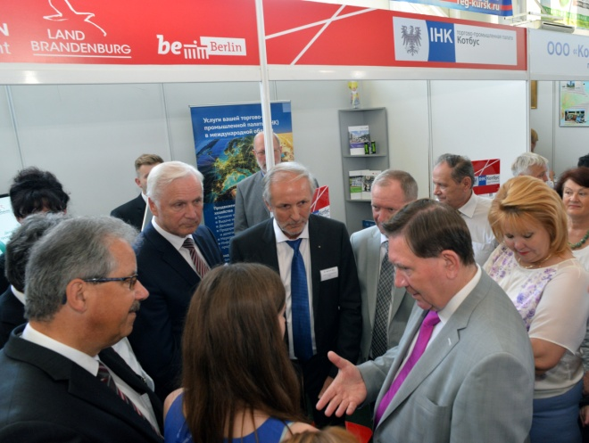
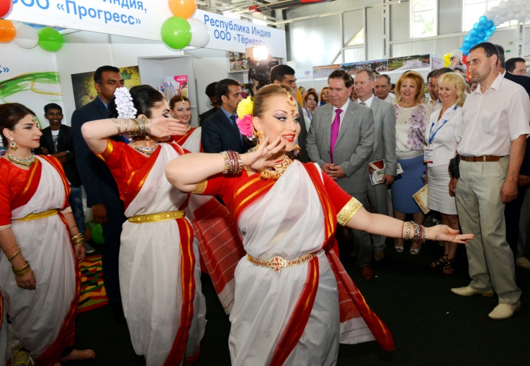
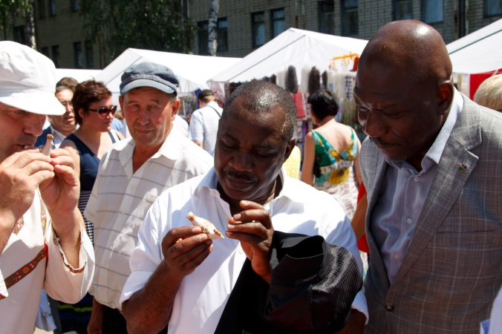
We invite to cooperation!
16 years passed since the revival of the Fair.
We can say with pride that it has regained popularity.
In 2016, the number of guests and participants of the Fair amounted to more than 6 000 people 1 400 business entities.

Slide 15
We invite to cooperation!
Dynamics of increase of guests and participants of the Fair

Slide 16
We invite to cooperation!

Slide 17
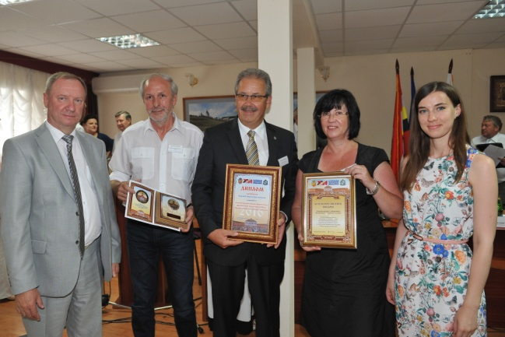
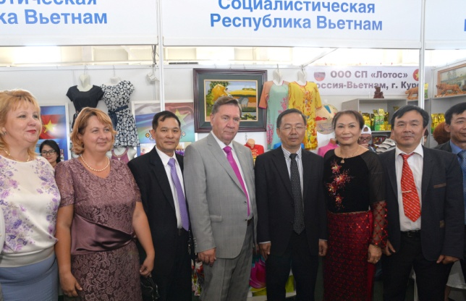
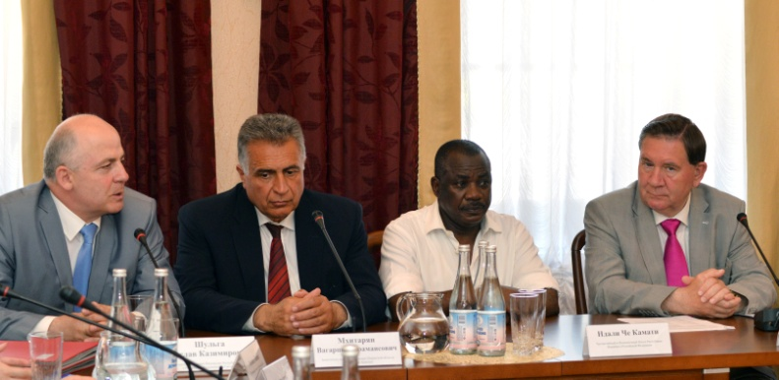
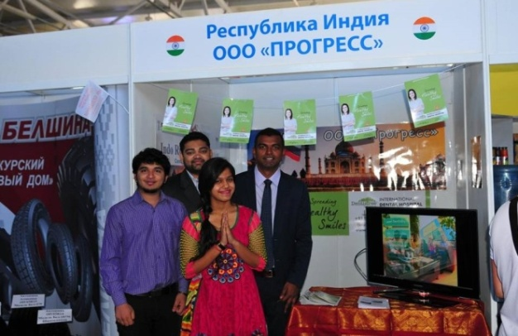
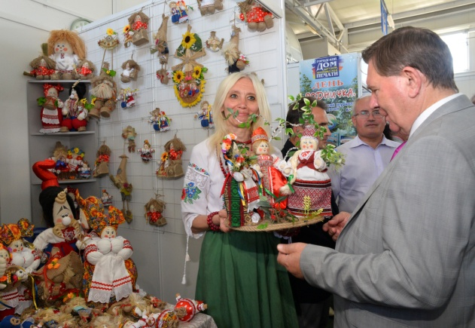
We invite to cooperation!
The geography of cooperation has widened.
In 2016 the Fair was attended by officials and business delegations from 36 Russian regions and 25 countries of CIS and foreign countries, including Serbia, Germany, Bulgaria, Greece, Hungary, France, Finland, Poland, Republika Srpska, Bosnia and Herzegovina, Italy, Slovak Republic, Montenegro, England, Israel, Vietnam, India, Namibia.

Slide 18
We invite to cooperation!

Slide 19
We invite to cooperation!

Slide 20
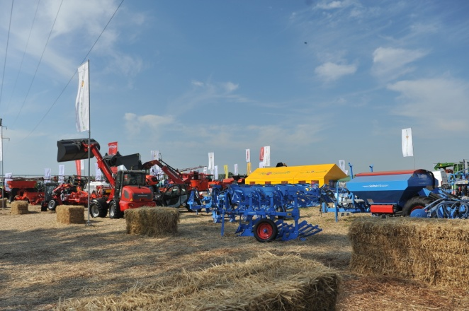
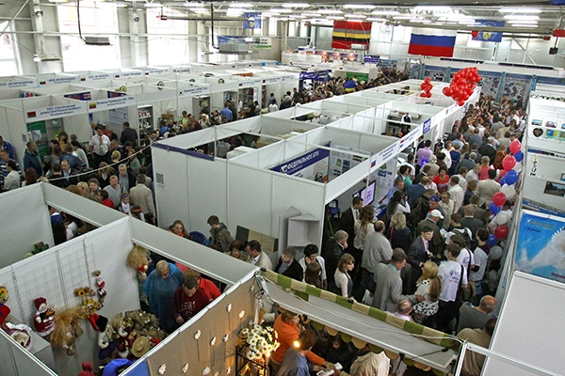
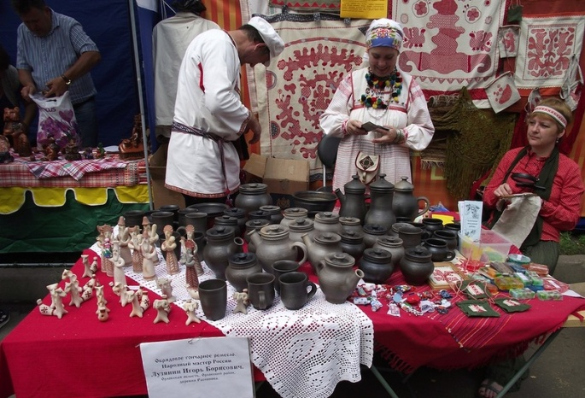
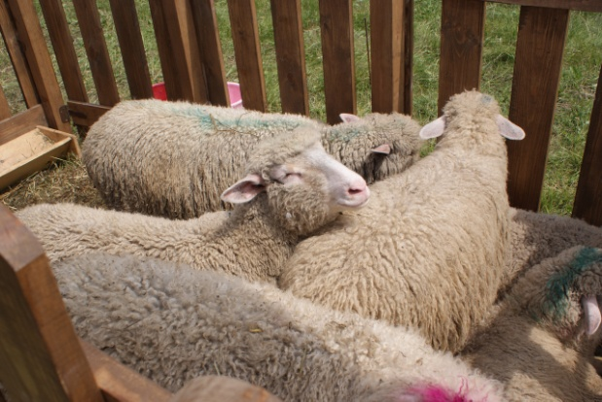
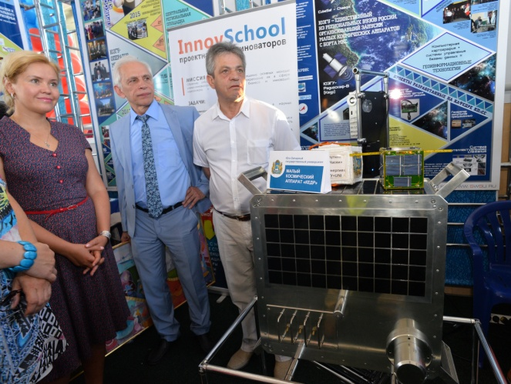
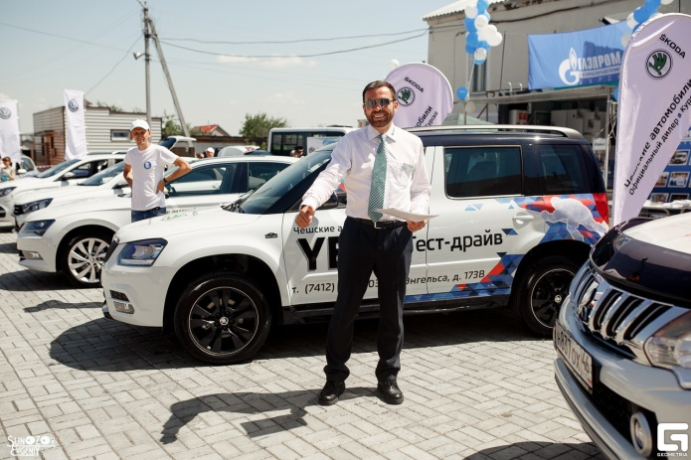
We invite to cooperation!
In pavilions and on open sites the achievements and innovative developments of domestic and foreign companies in industry, agriculture and many other industries are presented. Also there are presented institutions of education, science and culture.

Slide 21
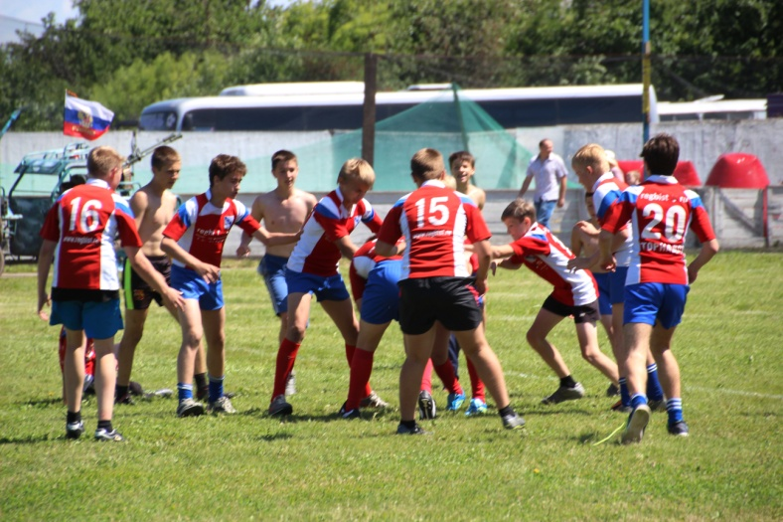
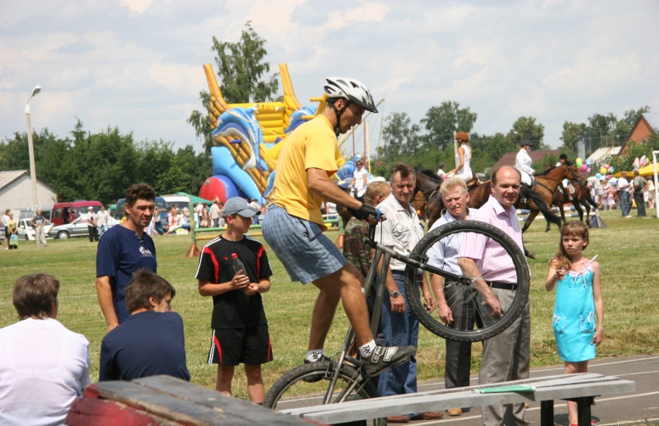
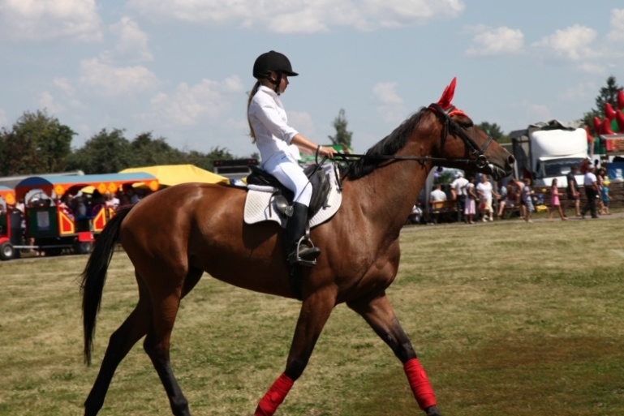
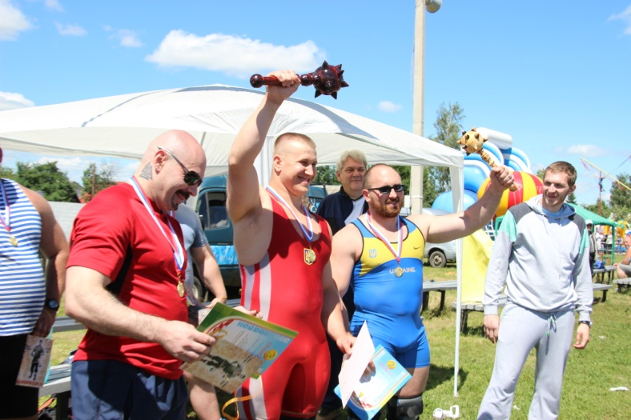
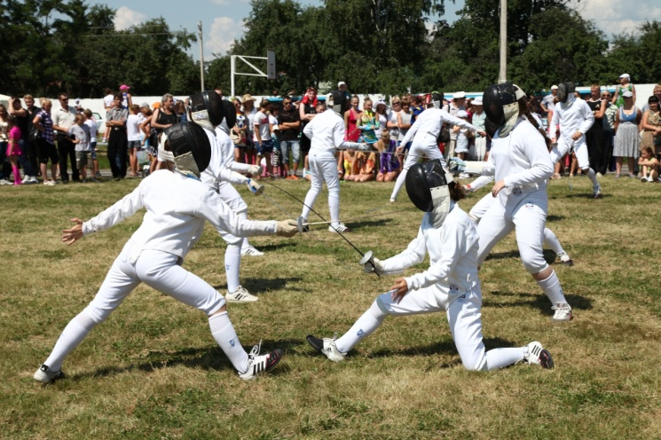
We invite to cooperation!
Within the framework of Kursk Korenskaya Fair sporting events, performances and competitions in various sports are conducted.

Slide 22
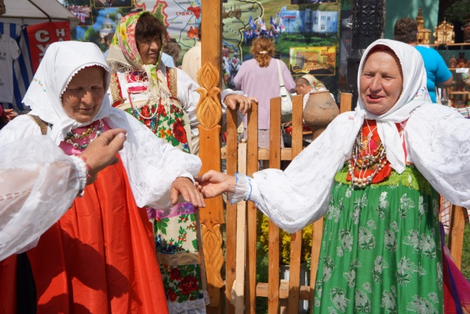
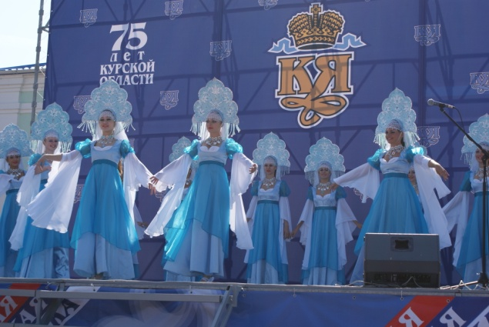
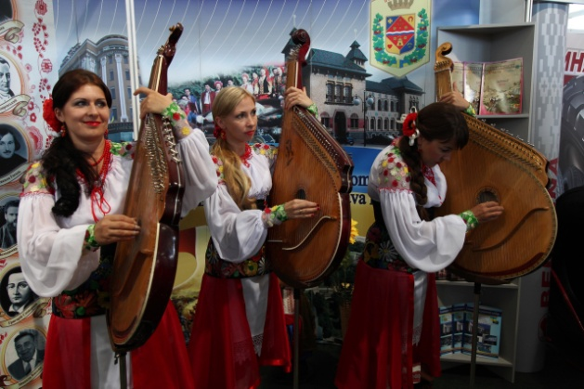
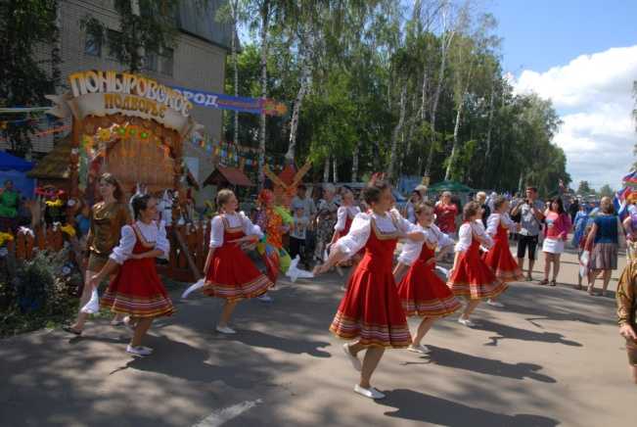
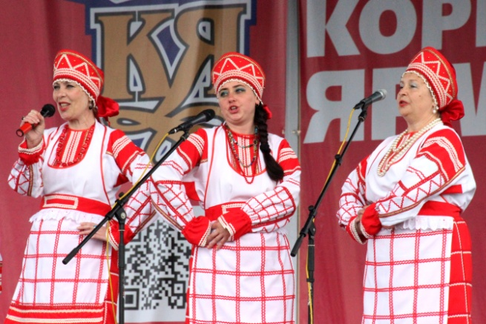
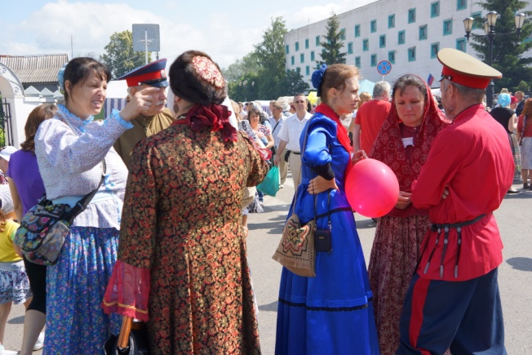
We invite to cooperation!
But the Fair is not the place for only business communications. Holiday atmosphere reigns here from the first until the last day - amateur artists sing and dance on the scenes, clowns entertain guests. The Fair still remains the place of recreation, entertainment and useful purchases for common people.

Slide 23
We invite to cooperation!
According to the results of meetings and negotiations dozens of agreements, protocols and treaties on cooperation in various sectors of the economy are annually signed.

Slide 24
We invite to cooperation!
The XVII Interregional Universal wholesale-retail Fair «Kursk Кorenskaya Fair – 2017» will be run
from June, 15th till 18th 2017!

Slide 25
We invite to cooperation!
Kursk Korenskaya Fair
Further information is possible on the website: kurskyarmarka.ru
Сontact details: сommittee of foreign economic relations development of Kursk region Administration: tell. (4712) 70-11-12, 70-10-99, tell./fax (4712) 55-43-09, e-mail: 305002@mail.ru;
"Exhibition center "Kursk Korenskaya fair":
tell.(4712) 51-25-42, 70-24-88, 51-26-15, 70-10-07,51-37-46, e-mail: kky2017@mail.ru

