Slide 1
The Tambov region

Slide 2
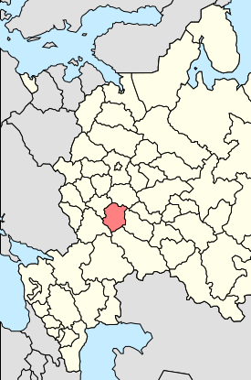
Geographic location
Tambov Region is a part of the Central Federal District
It borders on Voronezh, Lipetsk, Penza and Ryazan regions
Territory - 34.500 sq km
St-Petersburg
Moscow
Tambov oblast
Tambov oblast
Tambov is 480 km to the South-East from Moscow

Slide 3
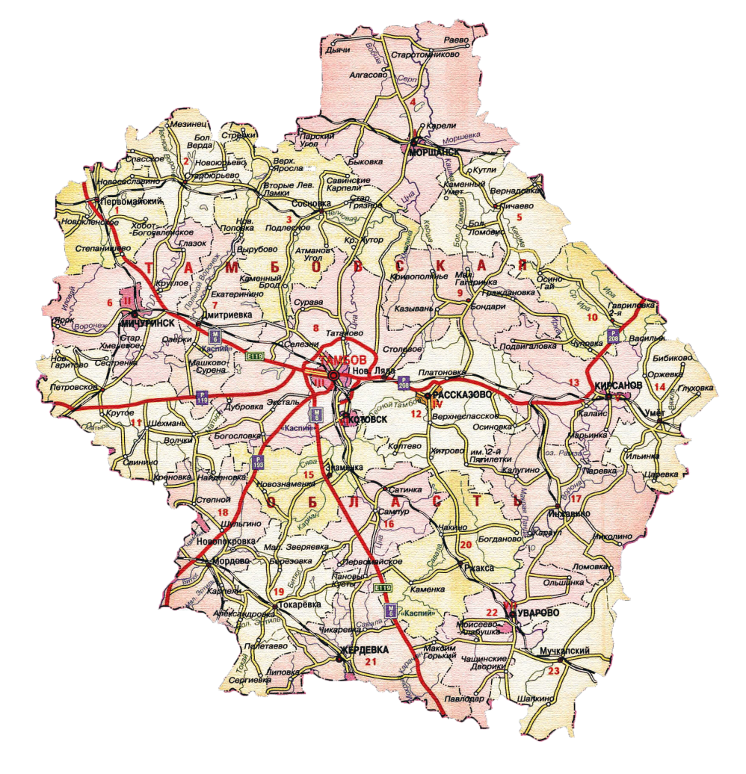
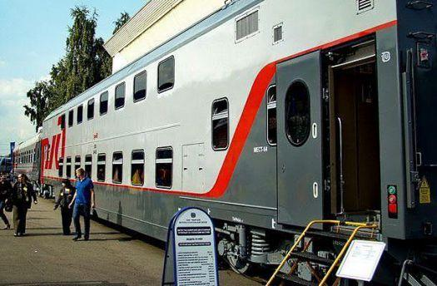
Transport infrastructure
Russian federal highway «Caspian» (Moscow – Tambov – Volgograd – Astrakhan)
«The Tambov Airport»
The flight from Tambov to Moscow takes 50 minutes
Federal motorways:
Voronezh – Tambov
Tambov – Penza
The Michurinsk Railway junction is the most important part in the South Eastern Railway operating 4 directions:
Moscow direction
Rostov direction
Orel direction
Volgograd direction,
And connecting central and remote regions of Russian with foreign countries.
In Tambov oblast there is a developed oil and gas pipelines network, including
oil pipeline "Druzhba" - Russia's largest export line (working capacity 66.5 million tons per year.).
Regional long-distance railways:
The South Eastern Railway: Moscow – Saratov – Almaty;
The Kuybyshevskaya Railway: Moscow – Tashkent.

Slide 4
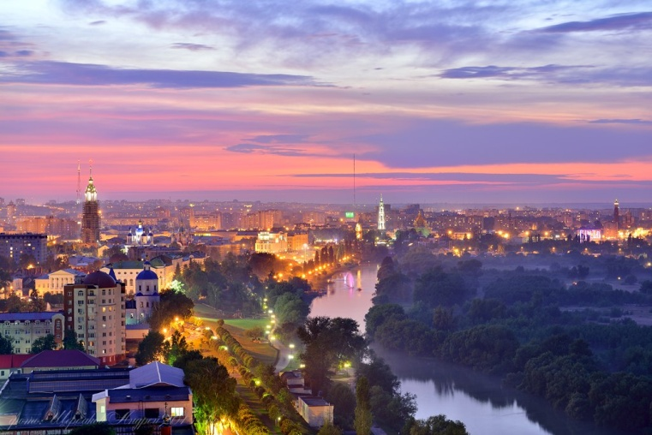
Demographic situation
1 050 295 pers.
Major towns of the Tambov region, the population at 01.01.2016, pers.
The population of the Tambov region at 01.01.2016
Tambov | 288 414
Michurinsk | 94 741
Rasskazovo | 44 180
Morshansk | 39 842
60,15%
39,85%
urban population
rural population
> 50%
Economically active population

Slide 5
Scientific potential
The Tambov State Technical University trains engineers on operation of chemical productions - graduates of "Chemistry and Chemical Technologies" department, and also specialists in machine-building technologies, nanotechnologies, builders, managers and economists. Graduates of TGTU possess core technical competencies in 24 directions that allows to expand as much as possible a range of industrial projects, possible for implementation.
The Tambov State University of G.R. Derzhavin trains specialists in the field of economy, managements, chemistry, mathematics, biology, medicine. In case of higher education institution it is created and successfully the Nanotechnologies and Nanomaterials center works.
Training in higher education institution is conducted more than on 100 specialties and the directions of preparation. In the Tambov state university 15 thousand students are trained.
The Michurinsk state agricultural university prepares a full range of specialists for an agroprombusiness and highly skilled engineers in the field of bioengineering procedures.
The MichGAU is a member of the International scientific organization on gardening (ISHS) (since 2009), the associated member of the international consortium of SEFOTECH.NUT universities (since 2010); possesses the developed scientific and innovative complex the including all-union scientific research institute of genetics and selection of fruit plants of the Russian Academy of Sciences, all-union scientific research institute of gardening etc.
Food and scientific developments of MichGAU are used at the International Space Station (ISS).

Slide 6
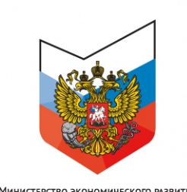
Development assessment of the region for 2015
8th place
in a rating of efficiency of activities of executive bodies
territorial subjects of the Russian Federation
(Government of the Russian Federation, Ministry of Economic Development)
19th place
in the National rating of a condition of the investment climate in subjects of the Russian Federation
12th place
on a public-private partnership level of development
3A1
Minimum risk
Investment rating of the region ("ExpertRA")
1st place
in the All-Russian ecological rating of public organization "Green Patrol"
8th place
on implementation of the program of resettlement from a hazardous dwelling, according to Fund of assistance to reforming of housing and communal services
AA (RUS)
National long-term rating of area with the "Stable" forecast ("Fitch Ratings")
1st place
On socio-political stability. According to Petersburg's’ Policy

Slide 7
Investing activities
122,5 bl. RUB
115,9 th. RUB
The volume of investment on area counting on one inhabitant
The volume of investment on area in 2015

Slide 8
Results of social and economic development of the region in key parameters for 2015
Industry, % | 104,5 (138 billion RUB)
including processing industry, % | 114,1 (64 billion RUB)
Agricultural industry, % | 110,9 (124 billion RUB)
Investments, % | 100,1 (123 billion RUB)
Input of housing | 826 thousand sq.m.
Retail turnover, % | 92,5 (182 billion RUB)
Nominal wage, RUB | 21698,5

Slide 9
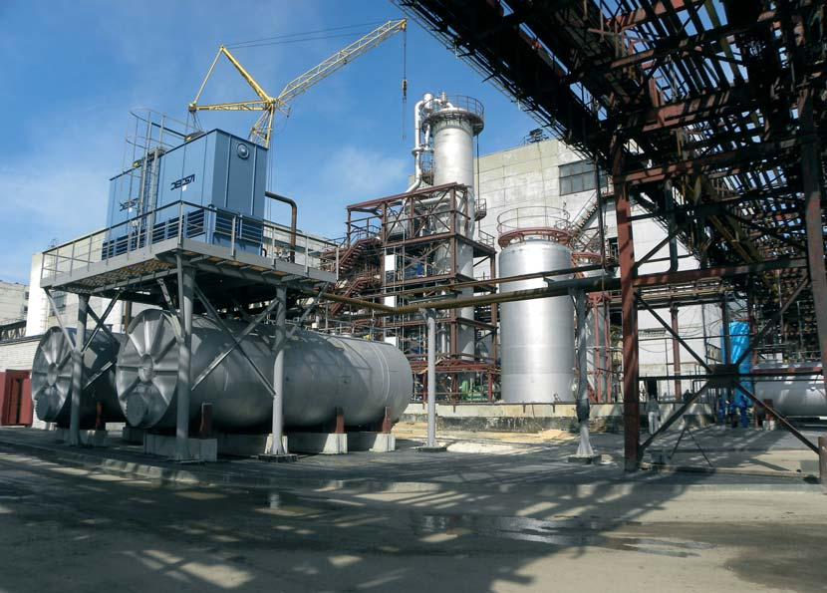
Key industries
Engineering industry
Food and processing industry
Aviation
instrument making (electronic, optical equipment)
Chemical industry
Sewing and tanning enterprises
Radio-radar equipment

Slide 10
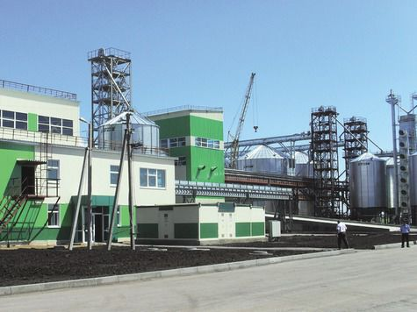
The share of the region in industrial production in Russia
52 %
Share of production of foodstuff
in structure of the processing productions
Dyes organic synthetic and varnishes color (pigmentary) | 24 %
Nonwoven fabrics | 19 %
Granulated sugar | 12,2 %
Finished fabrics | 9,8 %
Ethyl alcohol | 7,9 %
Vegetable oils | 2,2 %
Meat and offal, total | 1,9 %

Slide 11
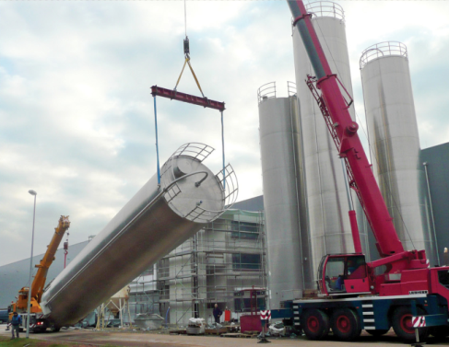
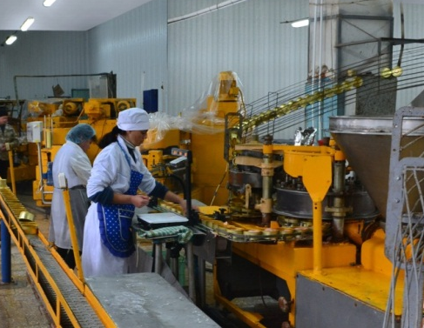
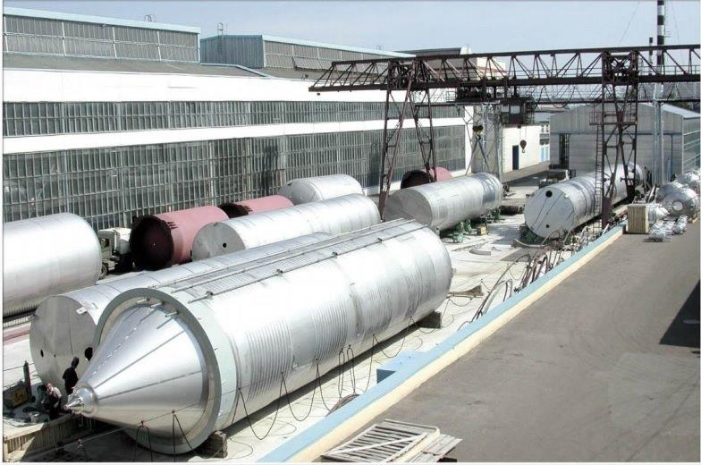
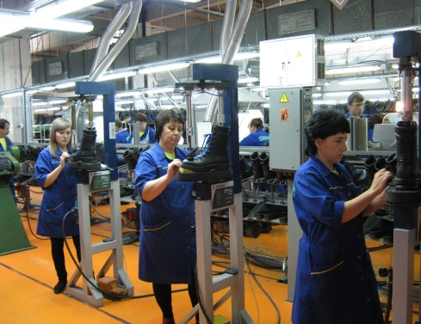
The industry –
one of the leading industries of economy of the region
18%
13%
the number of economically active population of the region is engaged in an industry
of the gross regional product (GRP) is created
in this sphere
128,6
billion RUB
industrial output for the full range of manufacturers in 2015
85%
25%
share of the Tambov oblast in the all-Russian production of dyes
export of the region, about a third of tax and non-tax payments to budgets of all levels provides industrial production

Slide 12
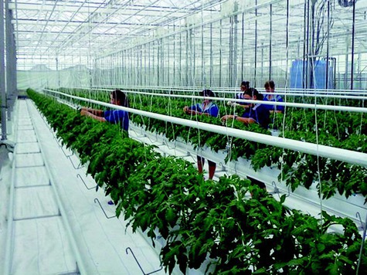
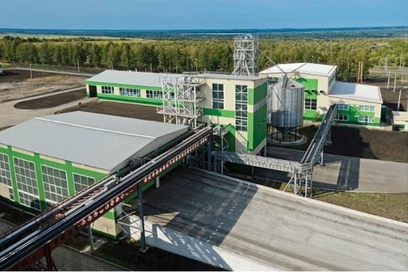
The agricultural complex
20 %
gross regional product to be made in the agrarian and industrial complex sphere
51,6 %
level of profitability of the agricultural enterprises
63,9
billion RUB
30-33
billion RUB
shipped goods of domestic production enterprises of food and processing industry
annual volume of capital investments
in sector of agrarian and industrial complex
LAND FUND - 3,4 million hectares
87%
BLACK EARTH (HUMUS)

Slide 13
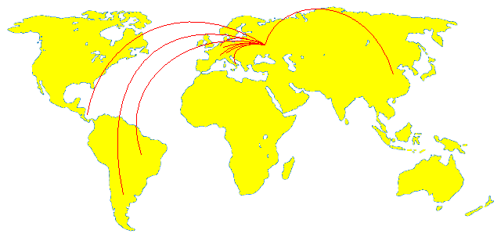
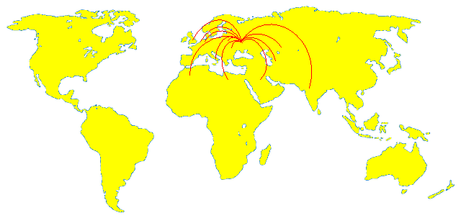
The countries – trade partners of the region
Tambov
Russia
Import: Austria, Argentina, Belgium, Brazil, Germany, Denmark, Italy, China, Cuba, Switzerland.
Main entities importers:
JSC Sugar Plant Nikiforovsky
JSC Znamensky Sugar Plant
JSC Sugar Plant Zherdevsky
Export: Algeria, Belarus, Belgium,
Great Britain, Germany, Egypt, India, Italy, Kazakhstan, Saudi Arabia,
Turkmenistan, Ukraine.
Тамбов
Россия
Main entities exporters:
JSC Pervomayskhimmash
JSC Pigment
JSC Plant of Bearings of Sliding
JSC Tamak
JSC Elektropribor
FKP "Tambov Powder Mill"

Slide 14
Investment policy
The Tambov region provides one of the most perfect mechanisms of the state support of investing activities
the "one touch“ principle of working with the investor ;
prompt coordination of all project and technical documentation;
tax benefits and preferential rent *;
state guarantees.
For investment attraction
public authorities of the Tambov region
are ready:
to provide at choice the most convenient sites
for construction of the entities (greenfield and brownfield);
to bring to a site necessary engineering communications *;
to give consulting and organizational support.
* According to the Reginoal Law No. 383-Z

Slide 15
Thank you for your attention!

