Slide 1
TATCABLE Plant
INVENT group of companies

Slide 2
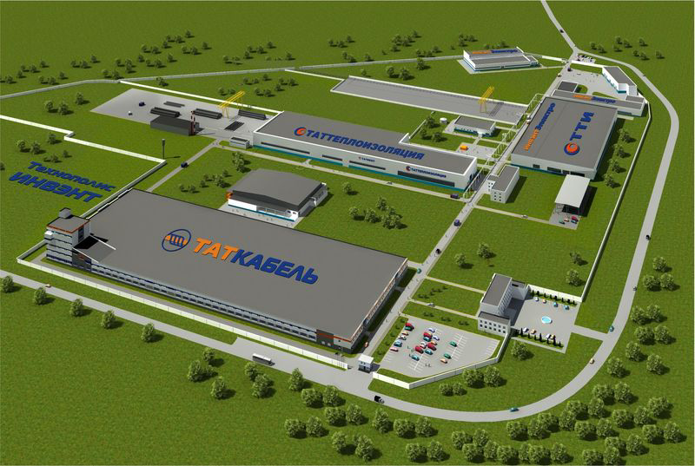
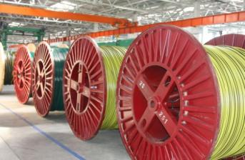
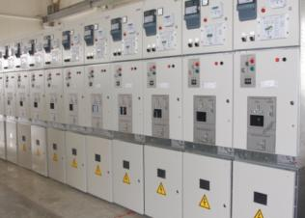
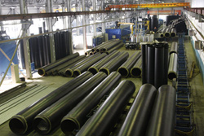
INVENT group of companies
technopolis INVENT
TATCABLE plant is a part of the group of companies INVENT and is located in Technopolis INVENT (Kazan).
Group of companies INVENT – is a modern production and engineering holding.
Products Holding Company is focused on energy enterprises.
The main priorities of the company are quality, reliability and innovation.
Production group of companies INVENT
ELECTRICAL AND POWER-EFFICIENT
EQUIPMENT
POLYURETHANE FOAM INSULATED PIPES
Wire and cable products

Slide 3
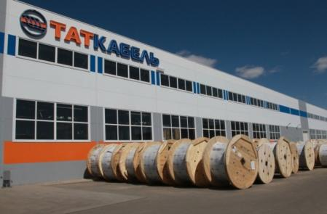
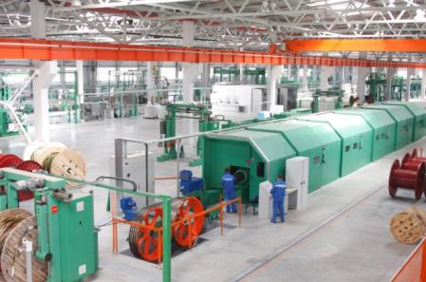
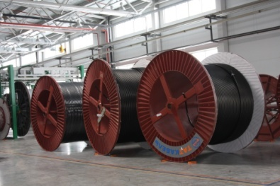
TATCABLE
TATCABLE plant is one of the state-of-the-art ones of Russia which produces the whole range of XLPE insulated energy cables for up to 330 kV.
The plant was commissioned in 2010 and is the largest manufacture of cable products, created in Russia over the past 40 years.
The latest technologies are introduced here to make it possible to manufacture the products of a high-quality according to the world’s standards.
Designed capacity: 20 000 tons of cable products by weight of metal per year.
The factory supplies its products to such companies as JSC ROSSETI, JSC GAZPROM, JSC SETEVAYA COMPANIYA (a grid company).

Slide 4
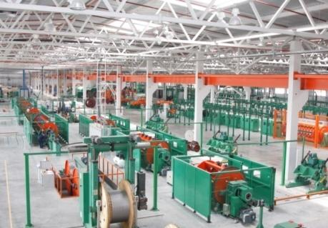
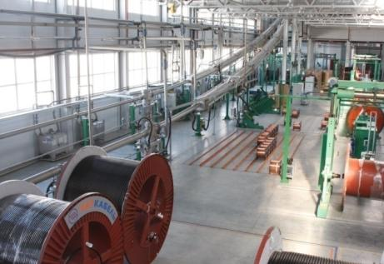
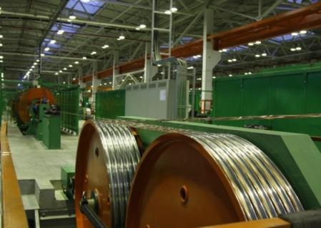
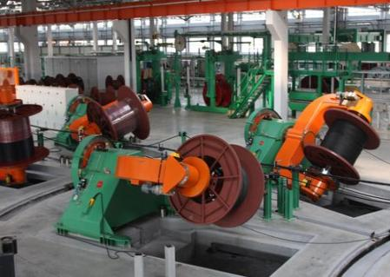
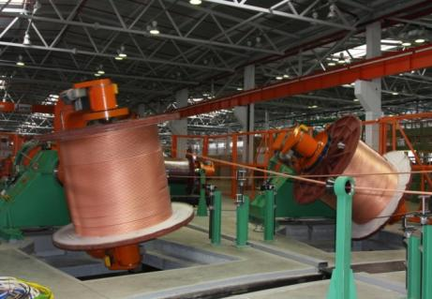
Equipment and Technology
The factory is equipped with the most modern machinery made by internationally leading companies.
All processing operations are performed in one workshop with minimal costs to transport parts due to following a clearly determined route.
The particular production technology that is applied at the factory provides the means of manufacturing products with high accuracy in accordance with the given parameters, which helps to maintain stable characteristics of the cables while keeping reasonable material consumption.

Slide 5
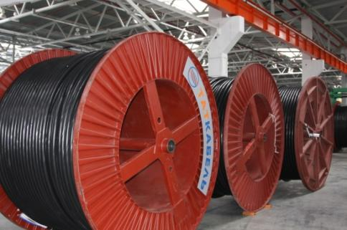
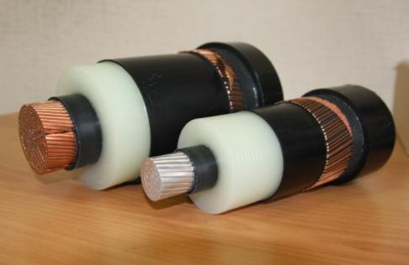
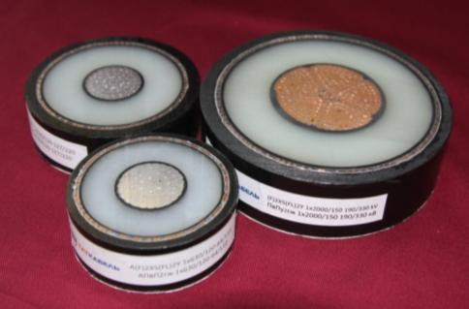
TATCABLE’s competitive advantage
The first Russian producer of high-voltage cable for up to 330 kV
The possibility to manufacture conductors with cross section up to 2500 sq.mm
Production of very long factory lengths per drum with flanges up to 4000 mm in diameter.
The existing Quality Management System complies with the international standard ISO 9001-2008.
The cables and wires manufactured by TATCABLE factory carry the required certificates of conformity to international and Russian standards as follows: DIN VDE, GOST-R, IEC.

Slide 6
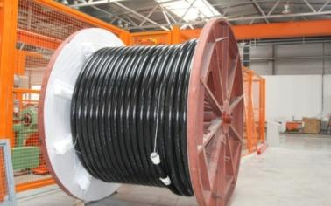
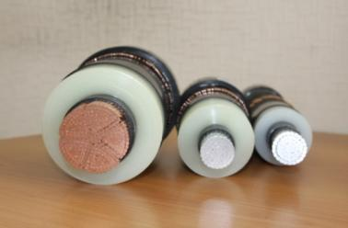
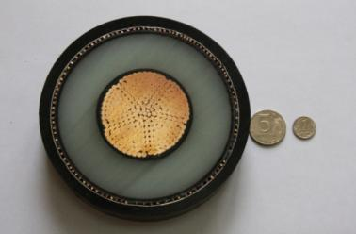
TATCABLE plat production
Designed capacity: 20 000 tons of cable products by weight of metal per year.
NOMENCLATURE
with XLPE- and PVC-insulated power cables
Cables for up to 110-330 kV (XLPE-insulated)
Cables for up to 6-35 kV (XLPE-insulated)
Cables for up to 3 kV (XLPE and PVC)
1st gen. Cables (А)2XS(FL)2Y; (А)2XS(FL)2Y+
Fire-resistant type, -LS
-HF
Fire-resistant type
Fire-resistant type LS
2nd gen. Cables (А)2XS(FL)H
Triple-Core Power Cables
Fire-resistant type HF
Universal Power Cables
Fire-resistant type FRLS
Emergency Cable sets
ECS-1 & ECS-2
Fire-resistant type FRHF
Armored Cables
Armored cables
Conductor
Self-supporting insulated
Self-supporting protected
Non-insulated

Slide 7
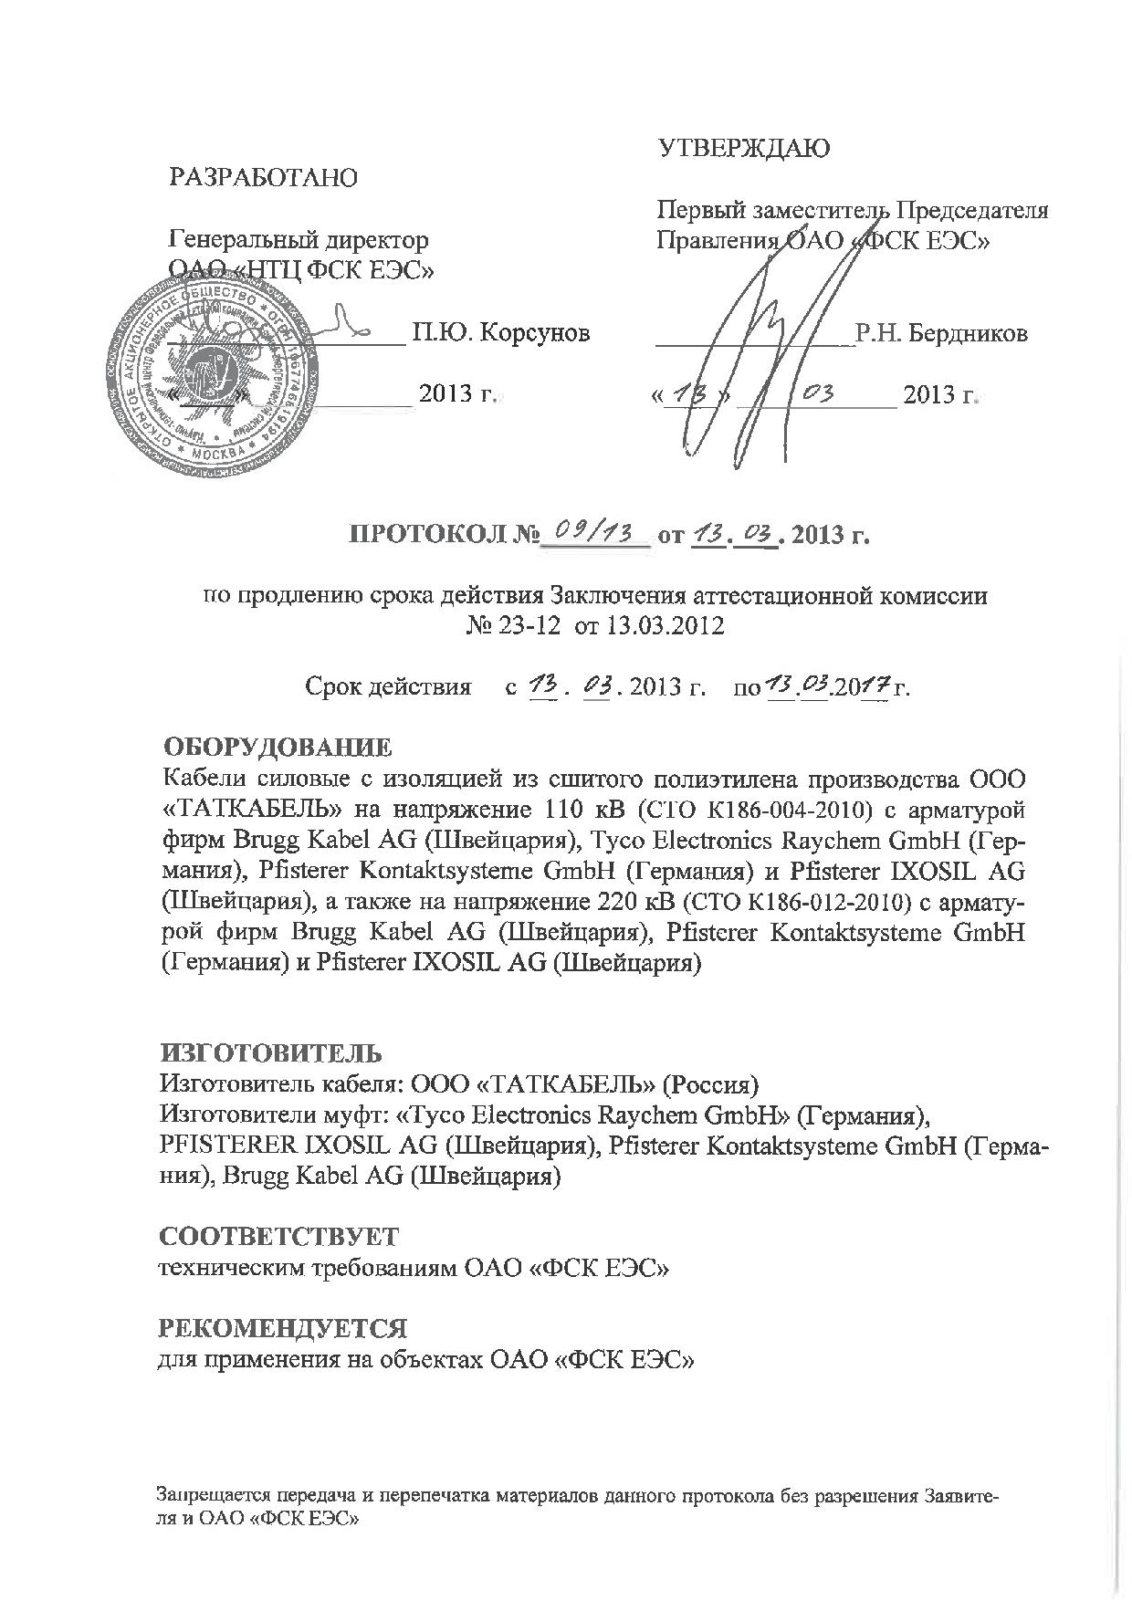
Certified Federal Grid Company

Slide 8
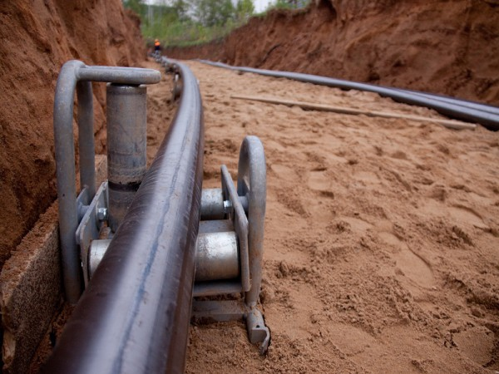
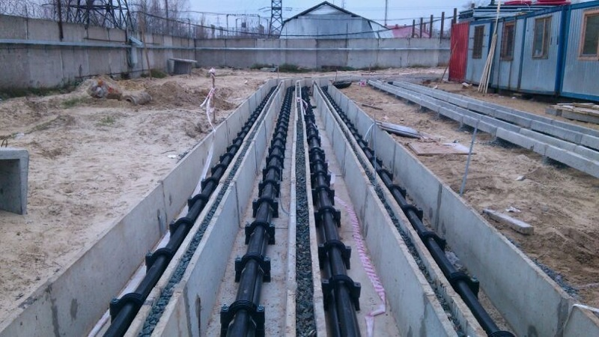
Integrated solutions on ready-to-operate cable systems supply
TATCABLE factory offers its consumers integrated solutions including as follows:
•XLPE-insulated underground, aerial and submarine power cables;
•cable accessories from world’s leading manufacturers;
•screen grounding cables;
•components (cable screen grounding and cross-bonding boxes, clamps, etc.);
•temperature and partial discharge monitoring systems.
Our company also supplies the following services:
•XLPE-insulated cables installation;
•cable accessories and temperature monitoring systems installation;
•fireproofing;
•supervision at all stages of high-voltage cable systems installation (including routine test of a whole cable system).

Slide 9
INVENT group of companies
Kazan
32 Leshozovskaya st., Laihsevskiy district, selo Stolbische, Tatarstan Republic, 422624
Telephones: +7 (800) 200-96-97
fax: +7 (843) 221-07-22
office@tatcable.ru
www.tatcable.ru

