Slide 1
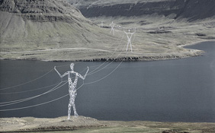
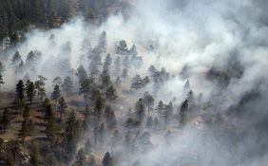
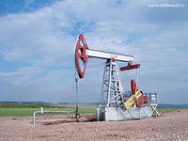
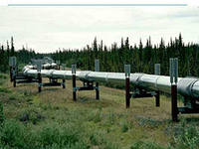
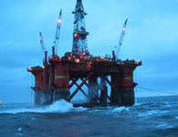
Unmanned systems
Group of companies
Contact: Irina Trefilova
E-mail:info@unmanned.ru
Tel.:+7(3412)51-51-65
Notes:
1

Slide 2
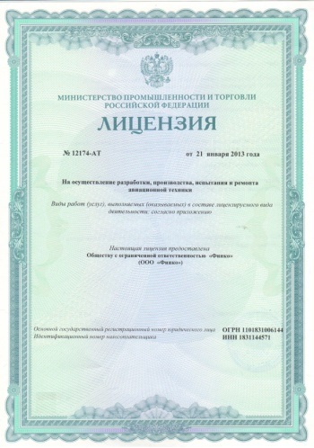
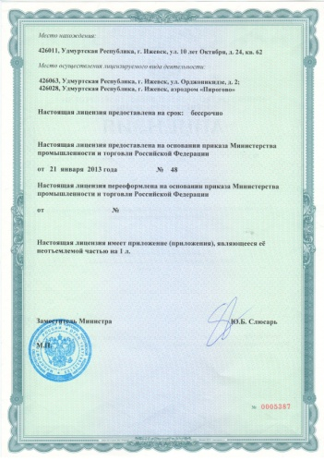
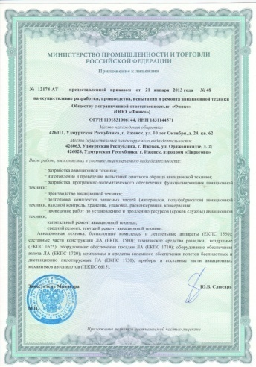
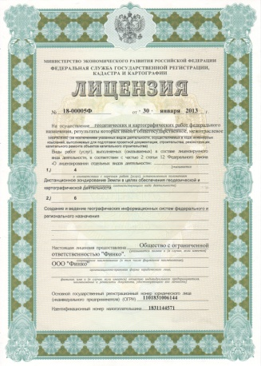
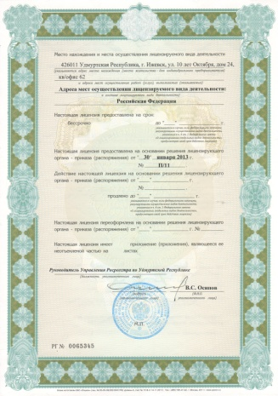
Licences
The company has:
License for aircrafts design,
manufacture, testing and servicing
2. License for geodetic and mapping
services on the federal level
Our customers
www.unmanned.ru
Notes:
2

Slide 3
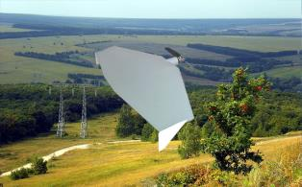
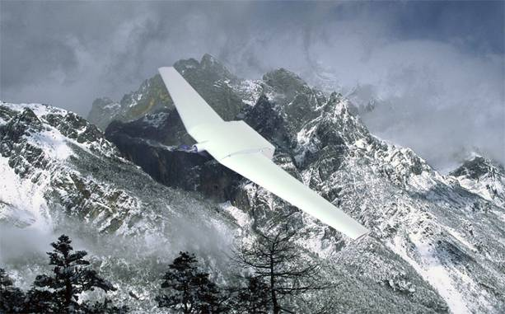
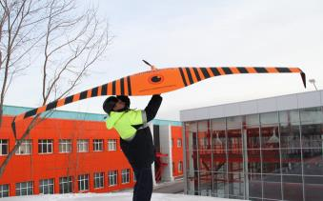
Unmanned aerial vehicles
Supercam S-100
Supercam S-250
Supercam S-350
www.unmanned.ru
Notes:
3

Slide 4
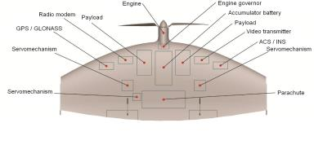
S-100
Wingspan | 1 m
Length | 0.47 m
Takeoff weight | 2,5 kg
Engine | electric motor
Velocity | 65-120 km/h
Data transmission range (TV, IR) | 15-25 km
Flight duration | 1 h 40 min
Payload | video camera 12 Mp, photo camera, thermographic camera
Notes:
4

Slide 5
S-250
Wingspan | 2.5 m
Length | 0.69 m
Takeoff weight | 8,5 kg
Engine | electric motor
Velocity | 65-130 km/h
Data transmission range | 90 km
Flight duration | Up to 3 h
Payload | video camera, photo camera, thermographic camera
Notes:
5

Slide 6
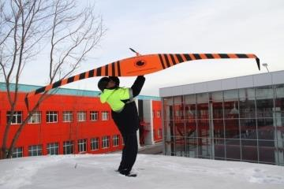
S-350
Wingspan | 3.2 m
Length | 0.8 m
Takeoff weight | 10 kg
Engine | electric motor
Velocity | 65-130 km/h
Data transmission range | 90 km
Flight duration | Up to 4 h 30 min
Payload | video camera, photo camera, thermographic camera

Slide 7
advantages of uav supercam
10 min – time for deployment
UAV take-off with no additional facilities
Flight on the designated route in the automatic mode with opportunity to change the flying course of the UAV
The opportunity of control handover from one Ground Control Station to the other
In case communication between the GCS and the UAV is broken, the UAV returns to the take-off position in the automatic mode
During the flight video data are transmitted from the UAV to GCS and the data (velocity, altitude, geodesic coordinates, flight duration, battery charge, Greenwich time) could be seen on the GSC screen and are saved to the computer memory
The UAV can be operated by one person
Notes:
7

Slide 8
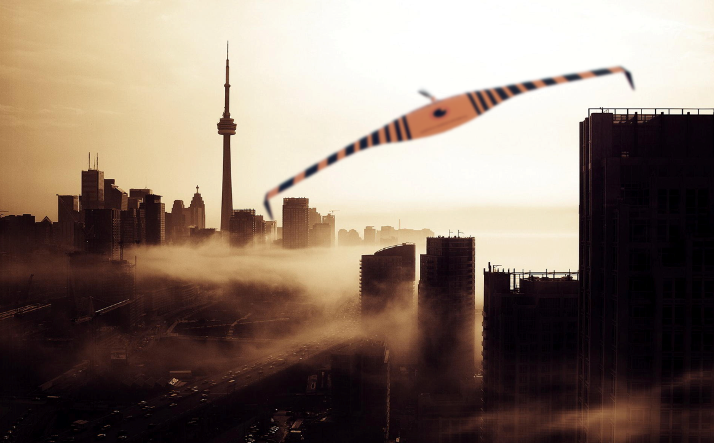
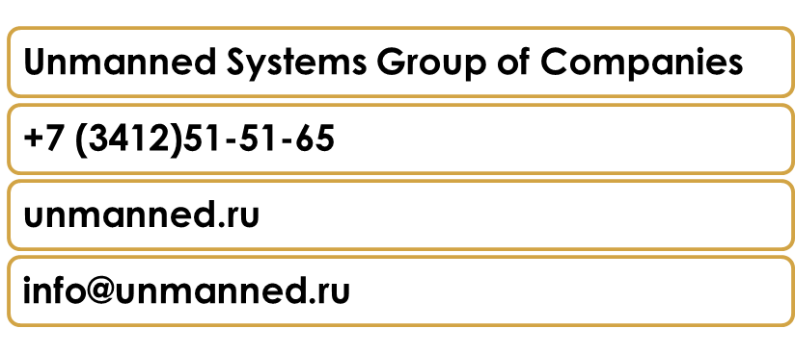
Thank you for your attention!
Notes:
8

