Slide 1
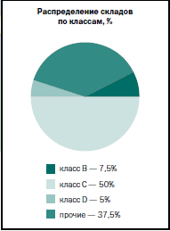
Investment proposal: Class A logistics park in Tyumen Region*
Higher rent rates than in other cities of the Ural Federal District;
Lack of well-equipped storage facilities (Mostly Class C and D storage facilities, a few Class B storage facilities, and no Class A storage facilities are found in Tyumen) a typical storage facility is less than 10,000 m²;
Rent rates range widely. The average rent rate in 2013 was 195 RUB per sq.m. per month; for unheated storage facilities – 80-180 RUB per sq.m. per month, 5% of the rent rate exceeds 300 RUB per sq.m. per month.
Retail is developing rapidly. Efficient retail area rate in the early 2014 was 815 sq. m per 1000 citizens. By the end of 2014 the retail area will have added 552,600 sq.m.;
Retail turnover in the Tyumen Region has been 286.5 bln RUB (61% higher than in 2010)
Major projects are under development now in the Tyumen Region. When they are launched, the cargo flow will rise. The cargo turnover in Jan – May 2014 in the Tyumen Region (including Autonomous Districts) was 363 421.1 mln ton-km.
Market
conditions
Initial data:
Location:
Tyumen City District, close to federal motorways, railroads, convenient transportation avenues.
Necessary conditions:
Site area 40-60 hectares
Storage area 80 000 m²
Rent 1 m² − 450 RUB/m²
Staff:
165 people
CAPEX: 1100 mln RUB
Inception date: January 2015
Estimated period: up to 2025
Performance indicators*:
Internal rate of return (IRR): 20 %
Net present value (NPV): 1029 mln. RUB
Pay-back period (PР): 5 years
Economic
conditions
*We can offer different sites for the project either municipal or privately-owned;
*Since 2015 investment projects exceeding 300 mln RUB will be exempt from property tax and will be entitled to profit tax reduction.

Slide 2
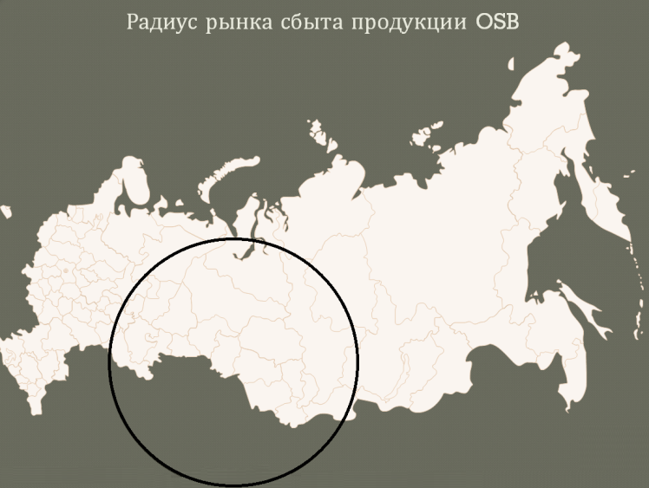
OSB production investment in Tyumen Region with annual capacity of 350 000 m³ per year*
OSB market share - 20% higher than in 2012. Market capacity in Russia in 2014 – 800 000 m3. Market capacity in the CIS – 300 000 м3.
The present and starting manufacturers in Russia (Kalevala, NLK, Kronospan) are forecast to cover 25% (280 000 m3) of the Russian and CIS market in 2015 .
The OSB plant in the Tyumen Region will let control the markets in self-supporting economies of some Russian regions and the CIS Asian countries (Kazakhstan, Tajikistan, Uzbekistan), with total population number of about 80 mln people (including 30 mln people in Russia)
Major OSB production development trends: import substitution, export expansion to the CIS countries, low-rise housing construction, plywood substitution in construction.
Bulk yield – 994 mln m3, estimated periodic yield – 16.3 mln m³, including soft wood – 3.2 mln m³.
Market
conditions
Initial data :
Wood processing capacity:
Up to 540 000 m³ per year – round wood, chips, particles, other wood waste
Necessary conditions :
Site area 20-40 hectares
Power supply capacity 15 MW
Staff:
230 people(including maintenance and management personnel)
salary including insurance - 40 000 RUB per person
CAPEX: 87.5 mln EUR
Inception date : January 2015
Estimated period : up to 2025
Performance indicators *:
Internal rate of return (IRR): 15 %
Net present value (NPV): 112 mln EUR
Pay-back period (PР): 7 years
Economic
conditions
*We can offer different sites for the project either municipal or privately-owned;
*Since 2015 investment projects exceeding 300 mln RUB will be exempt from property tax and will be entitled to profit tax reduction.

Slide 3
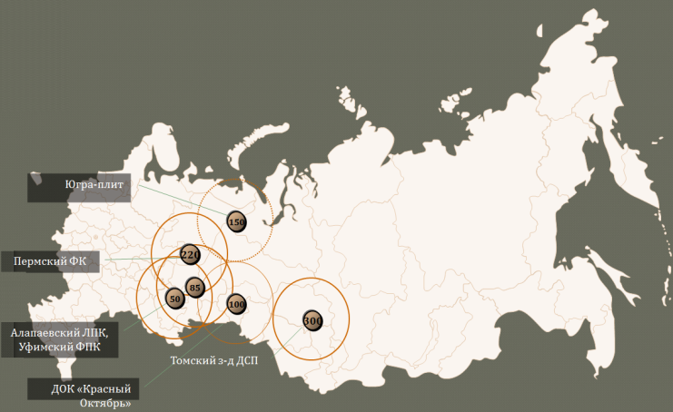
Chipboard production investment in Tyumen Region with annual capacity of 225 000 m³ per year *
Now 6 plants supply the Ural and Siberan market with chipboards, only 1 of them, “Ugra-plit” is a modern plant equipped with the ContiRoll® press
50% of chipboard consumption is supplied by these plants, and 50% - by the plants from Central Russia.
About 20% of the Russian furniture manufacturers are located in the Urals and Siberia.
Major chipboard production development trends: import substitution, export expansion to the CIS countries,(mainly to Kazakhstan), potential rise of furniture manufacturing in the Urals and Siberia, shut down of outdated chipboard production (4 plants).
Market
conditions
Bulk yield – 994 mln m3, estimated periodic yield 16.3 mln m³, including soft wood – 3.2 mln m³.
Initial data:
Wood processing capacity:
Up to 350 000 m³ per year – round wood, chips, particles, other wood waste
Necessary conditions :
Site area 20-40 hectares
Power supply capacity 15 MW
Specific heat consumption 2.9 GJ/m³
Specific power consumption 140 kW×h/m³
Resin consumption 58 kg/m³
Staff:
230 people(mainly: engineers, operators, electricians, directors and managers )
CAPEX: 67 mln EUR
Inception date : January 2015
Estimated period : up to 2025
Performance indicators *:
Internal rate of return (IRR): 21 %
Net present value (NPV): 119 mln EUR
Pay-back period (PР): 5 years
Economic
conditions
*We can offer different sites for the project either municipal or privately-owned;
*Since 2015 investment projects exceeding 300 mln RUB will be exempt from property tax and will be entitled to profit tax reduction.

Slide 4
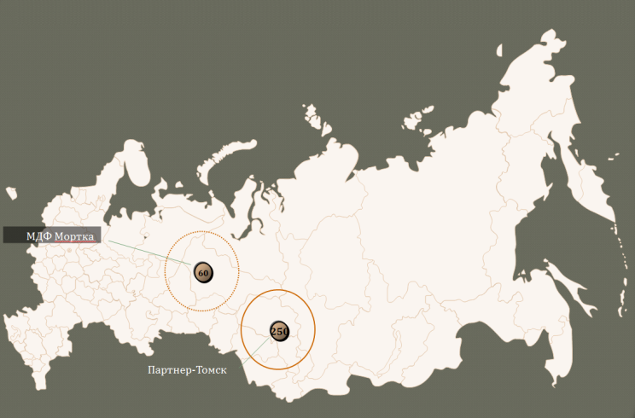
MDF production investment in Tyumen Region with annual capacity of 220 000 m³ per year*
Now 2 plants supply the Ural and Siberan market with MDF, only 1 of them, “Partner-Tomsk” is a modern plant equipped with the ContiRoll® press.
50% of MDF consumption is supplied by these plants, and 50% - by the plants from Central Russia.
About 20% of the Russian furniture manufacturers are located in the Urals and Siberia.
Major MDF production development trends: import substitution, export expansion to the CIS countries,(mainly to Kazakhstan), potential rise of furniture manufacturing in the Urals and Siberia, shut down of outdated MDF production (Mortka MDF), increase of MDF consumption in flooring (about 45% MDF is used for laminated flooring worldwide, in Russia - 10%).
Market
conditions
Bulk yield – 994 mln m3, estimated periodic yield 16.3 mln m³, including soft wood – 3.2 mln m³.
Initial data:
Wood processing capacity:
Up to 340 000 m³ per year – round wood, chips, particles, other wood waste
Necessary conditions :
Site area 20-40 hectares
Power supply capacity 15 MW
Specific heat consumption 4,3 GJ/m³
Specific power consumption 350 kW×h/m³
Resin consumption 90 kg/m³
Staff:
170 people(including maintenance and management personnel)
CAPEX: 77.5 mln EUR
Inception date : January 2015
Estimated period : up to 2025
Performance indicators *:
Internal rate of return (IRR): 19 %
Net present value (NPV): 105 mln EUR
Pay-back period (PР): 6 years
Economic
conditions
*We can offer different sites for the project either municipal or privately-owned;
*Since 2015 investment projects exceeding 300 mln RUB will be exempt from property tax and will be entitled to profit tax reduction.

Slide 5
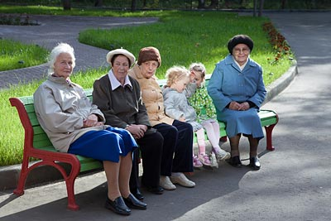
Investment project: Construction of a geriatric homes in Tyumen region.
STATISTICS:
In 2000 there were 600 million people over 60’s, in 2050 – 2 billion people
Population of people 85+ will increase by 5 times. In 2012 – over 44 million people , in 2015 approximately 216 million people.
By 2050 the number of senior citizens in the age over 60 will be higher than the number of the children younger than 15 years – first time in the history.
In Russian Federation the number of senior citizens is approx. 33 million people, from which 18,5 are older than 65 years (13 % of the country population). By 2030 the percentage of senior citizens will increase up to 18%.
Market
conditions
First-order conditions:
The area of the land – more than 5 hectares .
Employees:
50 people
Pay check for 1 employee – 30 000 rubles including insurance premium.
Investment volume: 300 million rubles
Measures of efficiency (discount rate 8%, for the period of 20 years):
Internal rate of return: (IRR): 10 %
Net present value (NPV): 40,4 million rubles
Payback period (PР): 9 years
Economic conditions

Slide 6
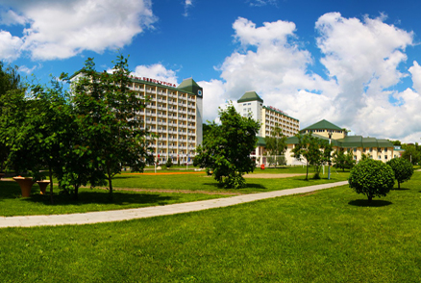
Investment project: construction of recreational sanatorium complex in the Tyumen region.
288 sunny days in the year
Existence of unique thermal springs and sapropelic clays.
Stable and solvent demand from the Tyumen region residents, Khanti-Mansiisk autonomous area, Sverdlovsk, Chelyabinsk, Kurgan region and etc.
Deficit of the high quality supply of the sanatorium service, lack of hotels with SPA-services and aqua parks
Increase in tourist traffic by 35 % over the last 3 years.
Market
conditions
Investment volume: 350 million rubles
Measures of efficiency (discount rate 10%, for the period of 10 years):
Internal rate of return: (IRR): 11 %
Net present value (NPV): 16,98 million rubles
Payback period (PР): 6 years
First-order conditions:
The area of the land – more than 5 hectares .
Employees:
70 people
Pay check for 1 employee – 30 000 rubles including insurance premium.
Economic
conditions

Slide 7
Investment project : construction of theme park in the Tyumen region
Lack of theme parks for children. Really high demand.
High paying capacity of the Tyumen and other regions residents.
Increase in tourist traffic by 35 % over the last 3 years.
Existence of municipal platforms for the implementation of the project.
Market
conditions
Investment volume: 800 million rubles
Measures of efficiency (discount rate 10%, for the period of 10 years):
Internal rate of return: (IRR): 15 %
Net present value (NPV): 166 million rubles
Payback period (PР): 5 years
First-order conditions:
The area of the land – more than 30 hectares .
Employees:
20 people
Pay check for 1 employee – 20 000 / 30 000 rubles including insurance premium.
Economic conditions

Slide 8
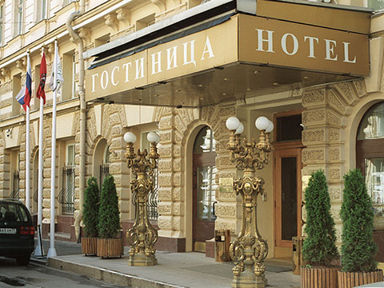
Investment project: construction of a hotel in Yalutorovsk, Tobolsk.
Yalutorovsk and Tobolsk are touristic cities.
Increase in tourist traffic by 35 % over the last 3 years
Deficit of qualitative hotel complexes
Existence of municipal platforms for the implementation of the project.
Market conditions:
First-order conditions:
The area of the land – more than 0,2 hectares .
Employees:
20 people
Pay check for 1 employee – 15 000 / 20 000 rubles including insurance premium.
Investment volume: 250 million rubles
Measures of efficiency (discount rate 10%, for the period of 8 years):
Internal rate of return: (IRR): 27 %
Net present value (NPV): 160 million rubles
Payback period (PР): 4 years
Economic conditions:

Slide 9
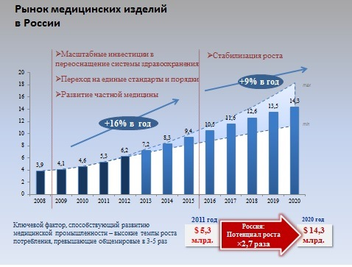
Investment in the construction of a medical equipment production factory*
Development of import substitution in Russia (an import share in consumption more than 70-80%)
The main buyer of the medical equipment production is the government(more than 85% of medical products);
High growth rates of consumption;
The domestic medical equipment is cheaper import by 1.5 – 2 times
Market
conditions
Initial data:
Necessary conditions:
The area of the land plot is 1-3 hectares.
Personnel:
200 people (taking into account the technical repair personnel and AUP)
Pay check for 1 employee - 40 000 rub including insurance premium.
Investment volume: 700 million rubles
Inception date : January 2015
Estimated period: until 2021
Measures of efficiency :
Internal rate of return: (IRR): 15 %
Net present value (NPV): 90 million rubles
Payback period (PР): 5 years
Economic
conditions
* For implementation of the project various options of municipal and private platforms are offered;
* Since 2015 projects with the volume of investment more than 300 million rubles are exempted from payment of the property tax, and also will be able to receive a privilege on income tax.

Slide 10
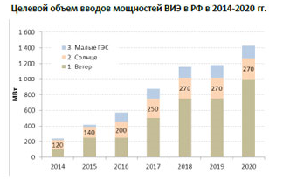
Investment in the construction of solar batteries production factory*
The resolution of the Government of the Russian Federation from 28.05.2013 No. 449 "About the mechanism of stimulation of using renewables in the wholesale market of electric energy and power“
Regulation of the Government of the Russian Federation of 28.05.2013 No. 861-r
In Russia by 2020 an input of about 1,5-2 GW of capacities is planned.
Market
conditions
Initial data:
Volume of production:
85 megawatt per year
Necessary conditions:
The area of the land plot is 3-5 hectares.
Personnel:
250 people (taking into account the technical repair personnel and AUP)
Pay check for 1 employee - 40 000 rub including insurance premium.
Investment volume: 200 million rubles
Inception date : January 2015
Estimated period: until 2025
Measures of efficiency :
Internal rate of return: (IRR): 17 %
Net present value (NPV): 35 million rubles
Payback period (PР): 6 years
Economic
conditions
* For implementation of the project various options of municipal and private platforms are offered;
* Since 2015 projects with the volume of investment more than 300 million rubles are exempted from payment of the property tax, and also will be able to receive a privilege on income tax.

Slide 11
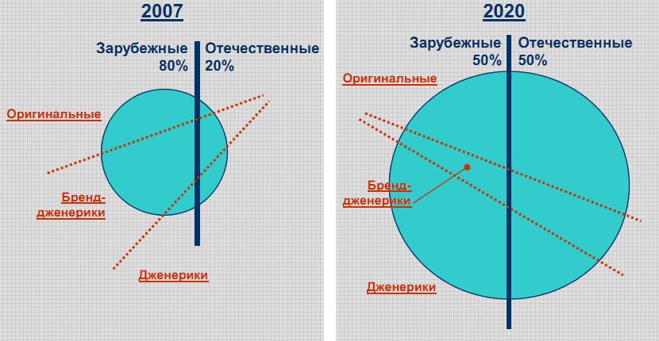
Investment in the construction of pharmaceutical factory*
Mandate of the Government of the Russian Federation No. VZ-P12-1366 from March 6th , 2008 about the elaboration of the strategy of development of the domestic pharmaceutical industry until 2020.
The main buyer of the medical equipment production is the government(about 40% of medicines);
High growth rates of consumption;
Improvement of the national legislation.
Market
conditions
Инновационный сценарий. Рынок лекарств в РФ.
Initial data:
Necessary conditions:
The area of the land plot is 1-3 hectares.
Personnel:
170 people (taking into account the technical repair personnel and AUP)
Pay check for 1 employee - 40 000 rub including insurance premium.
Investment volume: 1 billiard rubles
Inception date : January 2015
Estimated period: until 2021
Measures of efficiency :
Internal rate of return: (IRR): 33 %
Net present value (NPV): 3?8 billiard rubles
Payback period (PР): 7 years
Economic conditions
* For implementation of the project various options of municipal and private platforms are offered;
* Since 2015 projects with the volume of investment more than 300 million rubles are exempted from payment of the property tax, and also will be able to receive a privilege on income tax.

Slide 12
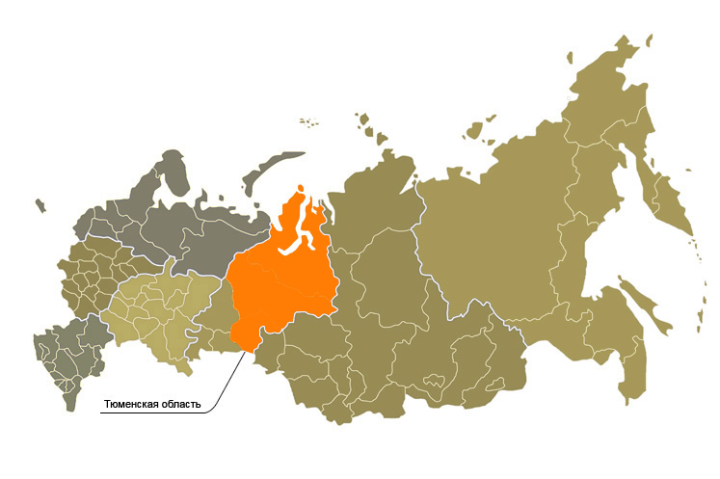
Investment in the creation of garment, shoe, textile or leather production in Tyumen region *
Tyumen region one of the most dynamically developing regions of Russian Federation.
Economical base of the region - fuel industry.
In the region (including autonomous areas) the main part of the Russian reserves of natural gas (91%) and oil (67%) is concentrated.
The average size of the “expenses per capita” Tyumen region has the leading position among all other regions.
Large network enterprises of retail trade are situated in Tyumen. (Metro Cash & Carry, Megamart, the Coin, Mosmart, the Tape, the Intersection, Auchan).
Market
conditions
Initial data:
Necessary conditions:
The area of the land plot is 1-2 hectares.
Tyumen region has suitable infrastructure platforms for production creation: the former garment factory which is in Ishim, garment factory in Yalutorovsk, and also some other platforms of brownfield and greenfield
Personnel:
50-200 people (main categories : seamstresses, mechanics, administrative personnel of platforms )
CAPEX: 200 million rubles
OPEX: 24 million rubles
Inception date : January 2015
Estimated period: until 2025
Measures of efficiency :
Internal rate of return: (IRR): 25 %
Net present value (NPV): 214 million euro
Payback period (PР): 5 years
Economic conditions
* For implementation of the project various options of municipal and private platforms are offered;
* Since 2015 projects with the volume of investment more than 300 million rubles are exempted from payment of the property tax, and also will be able to receive a privilege on income tax.

Slide 13
Business case by SIBUR
Polymers processing investment
Bags production*
Consumption structure
Consumption [mln pcs]
Anticipated PP bags consumption growth for 3 years
2.960
+10%
10%
Standard bags 25-50 kg
High level of bags imported assumes potential substitution
Good prospects for substitution in the construction bags sector
30%
PP bags
(122 000 t PP)
1.400
Market
conditions
1.9 bln pcs
40%
20%
PP bags
import (49 000 t PP)
560
Potential
substitution
food (sugar, flour)
chemicals, fertilizers
Paper bags
1.000
grains
крупы
building and technologic mixes
Return on investment*
Initial data:
Processing capacity:
5000 ton per year
62.5 mln bags
Equipment required:
2 extrusion lines
4 textile machines
Staff:
42 people (4 shifts)
salary including insurance - 60 000 RUB
CAPEX: 112 mln RUB
OPEX: 10 164 RUB per ton produced
Inception date: July 2014
Estimated period: up to 2021
Performance indicators:
Internal rate of return (IRR): 36.2%
Net present value (NPV): 500 mln RUB
Profitability index (PI): 5.9
Economic
conditions
*We can offer different sites for the project either municipal or privately-owned;
*Since 2015 investment projects exceeding 300 mln RUB will be exempt from property tax and will be entitled to profit tax reduction.

Slide 14
Business case by SIBUR
Polymers processing investment
Big bags production*
Consumption structure
Consumption [mln pcs]
Potential demand for big bags lies in increased use of railroads to transport fertilizers
Big bag advantages – automated loading/embarking, special vehicles; easy storage
Processability/ diverse features
36
Big bags
Net import (6.600 t)
Market
conditions
40%
48%
PP big bags
(38.300 t PP)
12%
The fertilizer market has started to replace packaging with big bags. The fertilizer market is ~6 mln ton, it adds 12 mln big bags to potential use.
Anticipated annual average growth of the sector
fertilizers
granulated polymers
mining and metals, building materials, grain, flour
+5%
Return on investment*
Initial data:
Processing capacity:
5000 ton per year
2.5 mln big bags
Equipment required:
2 extrusion lines
4 textile machines
Staff:
60 people (4 shifts including sewing room)
salary including insurance - 60 000 RUB
CAPEX: 133 mln RUB
OPEX: 13 015 RUB per ton produced
Inception date: July 2014
Estimated period: up to 2021
Performance indicators:
Internal rate of return (IRR): 35.3%
Net present value (NPV): 556 mln RUB
Profitability index (PI): 5.6
Economic
conditions
*We can offer different sites for the project either municipal or privately-owned;
*Since 2015 investment projects exceeding 300 mln RUB will be exempt from property tax and will be entitled to profit tax reduction.

Slide 15
Business case by SIBUR
Polymers processing investment
Polymer casting*
Consumption structure
The product size tends to be reduced worldwide, along with ways of fresh product conservation it supports potential growth of the food packaging sector.
The growth of the food packaging sector is caused by rapid retail development and its average annual rate is 7-8%.
The annual average growth rate of the consumer goods sector is 5%.
Demand for egg plastic packaging in the Tyumen Region is 18 mln pcs per year, in the Ural Federal District – 432.3 mln pcs per year.
Demand for plastic cups - 80 mln pcs per year, plastic bottles - 95 mln pcs per year consumed by “Danone” in the Tyumen Region.
28%
Market
conditions
72%
Thin wall food packaging
Consumer goods
In general, polymer casting is highly marginal as well as dynamic.
Return on investment *
Initial data:
Processing capacity:
2500 ton per year
Equipment required:
5-6 casting machines
15-30 casting mould
Staff:
40 people (4 shifts)
salary including insurance - 60 000 RUB
CAPEX: 126 mln RUB
OPEX: 17 846 RUB per ton produced
Inception date: July 2014
Estimated period: up to 2021
Performance indicators:
Internal rate of return (IRR): 32.8%
Net present value (NPV): 435 mln RUB
Profitability index (PI): 4.8
Economic
conditions
*We can offer different sites for the project either municipal or privately-owned;
*Since 2015 investment projects exceeding 300 mln RUB will be exempt from property tax and will be entitled to profit tax reduction.

Slide 16
Business case by SIBUR
Polymers processing investment. Expanded polysterene sheet production – one of the most effective heat insulating materials*
Expanded polysterene consumption structure
Energy efficiency in Russia tends to increase, related rules and regulations have been approved, costs of energy supply grow. All this increases heat insulating materials consumption. Amendments to Federal law №188-ФЗ “Housing Code of the Russian Federation” (in 2013) on creating overhaul fund can stimulate additional demand for heat insulating materials.
Annual growth rate of heat insulating materials market is 8-10% per year.
High quality polysterene production - Alfapor (Perm).
Expanded polysterene sheet transportation for short distances requires processing plants in every region.
Market
conditions
72%
In general Expanded polysterene sheet production is highly marginal
Return on investment *
Initial data:
Processing capacity:
Up to 5000 ton EPS per year
Equipment required:
Automated line, capacity up to 400 000 m³ per year (prefoaming device, oven, block mould, air lift)
Staff:
4 people (manufacturing only)
salary including insurance - 40 000 RUB per person
CAPEX: 116 mln RUB
OPEX: 1070 RUB per 1 м³ produced
Inception date : January 2015
Estimated period: up to 2028
Performance indicators*:
Internal rate of return (IRR): 41 %
Net present value (NPV): 279 mln RUB
Pay-back period (PР): 4 years
Economic
conditions
*We can offer different sites for the project either municipal or privately-owned;
*Since 2015 investment projects exceeding 300 mln RUB will be exempt from property tax and will be entitled to profit tax reduction.

Slide 17
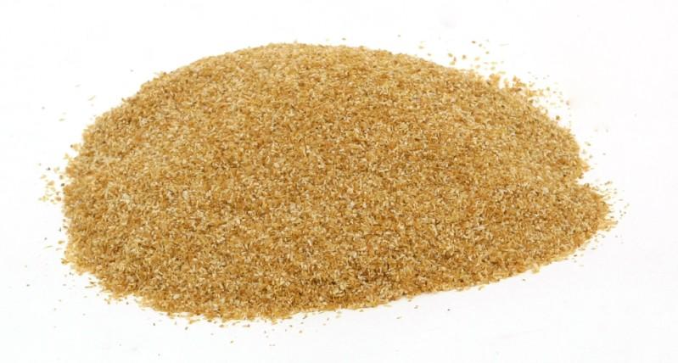
Investment project: construction of feeding additive compound production factory in Tyumen region *
Steady demand on the territories of Ural federal district.
Existence of municipal platforms for implementation of the project
Market
conditions
Investment volume: 1 billion rubles
Measures of efficiency :
Internal rate of return: (IRR): 21 %
Net present value (NPV): 425 million rubles
Payback period (PР): 5 years
Necessary conditions:
The area of the land plot from 30 hectares.
Staff :
70 people
Pay check for 1 employee – 35 000 /40 000 rub including insurance premium.
Economic conditions
* For implementation of the project various options of municipal and private platforms are offered;
* Since 2015 projects with the volume of investment more than 300 million rubles are exempted from payment of the property tax, and also will be able to receive a privilege on income tax.

Slide 18
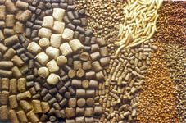
Investment project: reprocessing corn in Tyumen region *
Products with a high value added – turn 60 000 tons of grain (480 million rubles) into 1400 million rubles of the income
Production:
Lemon acid – 20 000 tons,
BVMK – 33 000 tons,
Existence of municipal platforms for the implementation of the project
Competitive production while entering the foreign markets
State support
Market conditions
Necessary conditions:
The area of the land plot from 20 hectares.
Staff :
120 people
Pay check for 1 employee – 35 000 /40 000 rub including insurance premium.
Investment volume: 2,1 billion rubles
Measures of efficiency :
Internal rate of return: (IRR): 30 %
Net present value (NPV): 500 million rubles
Payback period (PР): 4 years
ЭкEconomic conditions
* For implementation of the project various options of municipal and private platforms are offered;
* Since 2015 projects with the volume of investment more than 300 million rubles are exempted from payment of the property tax, and also will be able to receive a privilege on income tax.

Slide 19
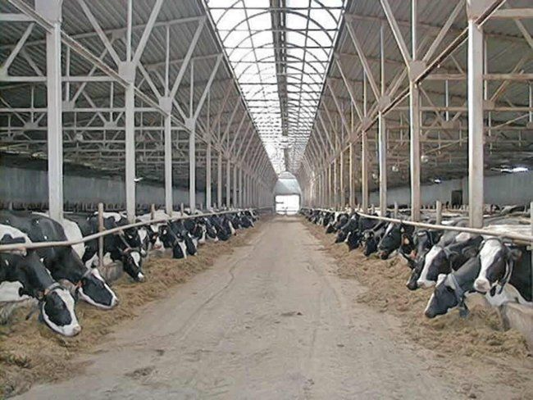
Investment project: building dairy complex in Tyumen region*
Soon in Tyumen region will be made a large production of the Danone companies, OOO “Dairy factory “Absolut” which will cause an increase in the volumes of milk consumption as raw materials in a total amount of 117,5 thousand tons per year for production of dairy products.
Existence of municipal platforms for implementation of the project
State support
Market
conditions
Necessary conditions:
The area of the land plot from 20 hectares.
Staff :
150 people
Pay check for 1 employee – 35 000 /40 000 rub including insurance premium.
Investment volume: 2,1 billion rubles
Measures of efficiency :
Internal rate of return: (IRR): 18 %
Net present value (NPV): 260 million rubles
Payback period (PР): 10 years
Economic conditions
* For implementation of the project various options of municipal and private platforms are offered;
* Since 2015 projects with the volume of investment more than 300 million rubles are exempted from payment of the property tax, and also will be able to receive a privilege on income tax.

Slide 20
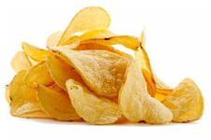
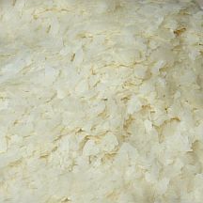
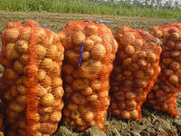
Investment project: construction of potato reprocessing factory in Tyumen region *
Costs of the first stage of production can be 150 million rubles (lines of production of chips and corn flakes)
On productivity of potatoes in farms of all categories the Tyumen region is the leader among all of the subjects of the Russian Federation and Ural federal district.
The central position in heart of Russia at the crossroads of the main trade directions.
Existence of the developed research centers and high concentration of scientific clusters.
Existence of municipal platforms for the implementation of the project
Market
conditions
Necessary conditions:
The area of the land plot from 20 hectares.
Staff :
100 people
Pay check for 1 employee – 20 000 /30 000 rub including insurance premium.
Investment volume: 1 billion rubles
Measures of efficiency :
Internal rate of return: (IRR): 15 %
Net present value (NPV): 208 million rubles
Payback period (PР): 5 years
Economic conditions
* For implementation of the project various options of municipal and private platforms are offered;
* Since 2015 projects with the volume of investment more than 300 million rubles are exempted from payment of the property tax, and also will be able to receive a privilege on income tax.

Slide 21
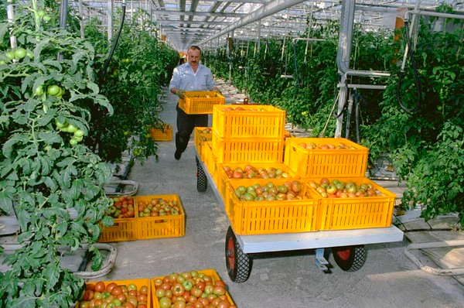
Investment project: construction of hothouse combine in Tyumen region *
Existence of municipal platforms for the implementation of the project
State suport
Steady demand on the territories of Ural federal district.
Market
conditions
Necessary conditions:
The area of the land plot from 20 hectares.
Staff :
180 people
Pay check for 1 employee – 35 000 /40 000 rub including insurance premium.
Investment volume: 2 billion rubles
Measures of efficiency :
Internal rate of return: (IRR): 30 %
Net present value (NPV): 400 million rubles
Payback period (PР): 5 years
Economic conditions
* For implementation of the project various options of municipal and private platforms are offered;
* Since 2015 projects with the volume of investment more than 300 million rubles are exempted from payment of the property tax, and also will be able to receive a privilege on income tax.

Slide 22
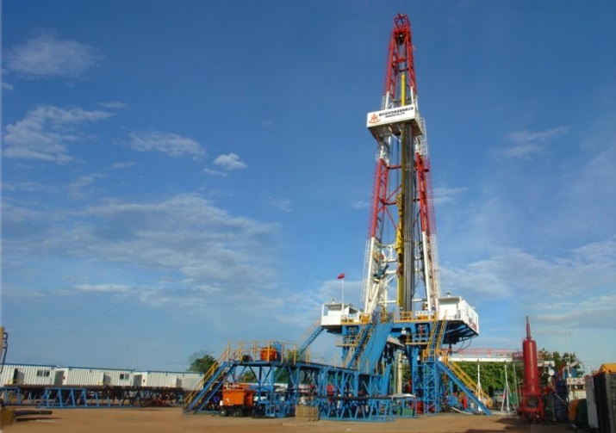
Investment in the construction of drilling rig production factory *
Number of the operating drilling rigs in Russia – 1900 units, 1500 of them are efficient. Most of the drilling rigs were constructed in 1987-1992 and operational capability date is 25 years, which will come to an end in the next few years.
Market
conditions
According to “Russian Oil-and-gas Union” statistics in order to maintain current drilling level Russian service companies need to change at least 1000 drilling rigs in the next few years. The cost of the change may be 20 billion $.
Initial data:
Volume of production:
25 or more drilling rigs per year
Necessary conditions:
The area of the land plot is 20-40 hectares.
Staff :
800-1000 people (taking into account the technical repair personnel and AUP)
Pay check for 1 employee – 40 000 rub including insurance premium.
Approximate investment volume: from 10 billion rubles
Measures of efficiency :
Internal rate of return: (IRR): 35 %
Net present value (NPV): 500 million rubles
Payback period (PР): 5 years
Economic conditions
* For implementation of the project various options of municipal and private platforms are offered;
* Since 2015 projects with the volume of investment more than 300 million rubles are exempted from payment of the property tax, and also will be able to receive a privilege on income tax.

Slide 23
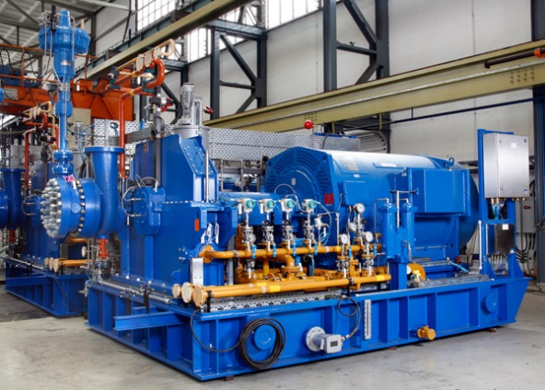
Investment in the construction of oil-well tubing equipment production factory*
Due to the current government arrangements concerning the import substitution of the oil-and-gas sector, existence of extensive scientific and technical base, proximity of oil and gas crafts and convenient
geographical position, the production of the gas-distributing pump and compressor equipment on the territory of the Tyumen region is possible.
Share of the oil-well tubing equipment import – 70%.
Market
conditions
Initial data:
Volume of production:
120 different types of pumps per year
Necessary conditions:
The area of the land plot is10-12 hectares.
Staff :
800-1000 people (taking into account the technical repair personnel and AUP)
Pay check for 1 employee – 35 000 /40 000 rub including insurance premium.
Approximate investment volume: from 5 billion rubles
Measures of efficiency :
Internal rate of return: (IRR): 22 %
Net present value (NPV): 1 billion rubles
Payback period (PР): 6-7 years
Economic conditions
* For implementation of the project various options of municipal and private platforms are offered;
* Since 2015 projects with the volume of investment more than 300 million rubles are exempted from payment of the property tax, and also will be able to receive a privilege on income tax.

Slide 24
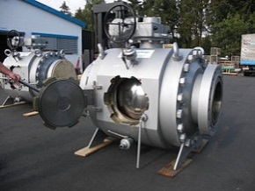
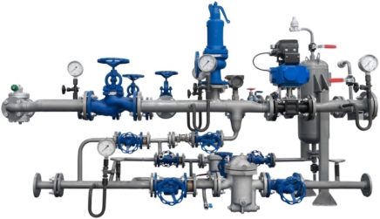
Investment in the construction of
a high-quality pipeline valves production factory*
Due to the current government arrangements concerning the import substitution of the oil-and-gas sector, existence of extensive scientific and technical base, proximity of oil and gas crafts and convenient
geographical position, the production of a high-quality pipeline valves is possible: valves, cranes of various spherical diameters, the regulating fittings, latches, pressure regulators, etc.
Share of such production in Russian Federation– 56%.
Market
conditions
Initial data:
Volume of production:
400 units per year
Necessary conditions:
The area of the land plot is 10-12 hectares.
Staff :
500-1000 people (taking into account the technical repair personnel and AUP)
Pay check for 1 employee – 35 000 /40 000 rub including insurance premium.
Approximate investment volume: from 4 billion rubles
Measures of efficiency :
Internal rate of return: (IRR): 28 %
Net present value (NPV): 500-700 million rubles
Payback period (PР): 8 years
Economic conditions
* For implementation of the project various options of municipal and private platforms are offered;
* Since 2015 projects with the volume of investment more than 300 million rubles are exempted from payment of the property tax, and also will be able to receive a privilege on income tax.

Slide 25
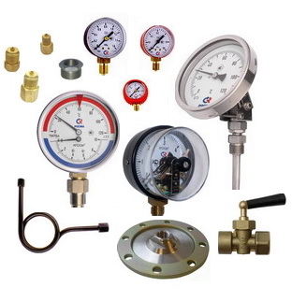
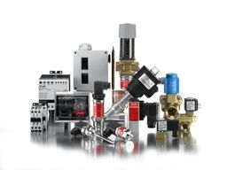
Investment in the construction of control instrumentation
equipment production factory*
- Due to the current government arrangements concerning the import substitution of the oil-and-gas sector, existence of extensive scientific and technical base, proximity of oil and gas crafts and convenient geographical position, the production of high quality control instrumentation equipment, specifically flowmeters, counters, chromatographs, calibrators, manometers, analyzers, humidity measuring instruments, etc.
- Share of control instrumentation equipment import - 70%
Market
conditions
Initial data:
Volume of production:
Necessary conditions:
The area of the land plot is 3-5 hectares.
Staff :
200-300 people (taking into account the technical repair personnel and AUP)
Pay check for 1 employee – 45 000 / 50 000 rub including insurance premium.
Approximate investment volume: from 1,5 billion rubles
Measures of efficiency :
Internal rate of return: (IRR): 20 %
Net present value (NPV): 300-500 million rubles
Payback period (PР): 7 years
Economic conditions
* For implementation of the project various options of municipal and private platforms are offered;
* Since 2015 projects with the volume of investment more than 300 million rubles are exempted from payment of the property tax, and also will be able to receive a privilege on income tax.

Slide 26
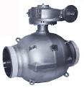
Investment in the construction of electric
equipment production factory*
- Due to the current government arrangements concerning the import substitution of the oil-and-gas sector, existence of extensive scientific and technical base, proximity of oil and gas crafts and convenient geographical position, the production of electric equipment , specifically electric motors, diesel power plants for drilling rigs, electric drives for spherical cranes remote control.
- Share of such equipment import in Russian Federation - 70%
Market
conditions
Initial data:
Volume of production:
Necessary conditions:
The area of the land plot is 5-10 hectares.
Staff :
500-600 people (taking into account the technical repair personnel and AUP)
Pay check for 1 employee – 45 000 / 50 000 rub including insurance premium.
Approximate investment volume: from 3 billion rubles
Measures of efficiency :
Internal rate of return: (IRR): 25 %
Net present value (NPV): 400-550 million rubles
Payback period (PР): 6 years
Economic conditions
* For implementation of the project various options of municipal and private platforms are offered;
* Since 2015 projects with the volume of investment more than 300 million rubles are exempted from payment of the property tax, and also will be able to receive a privilege on income tax.

Slide 27
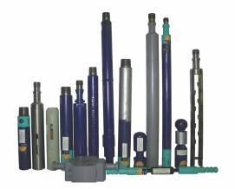
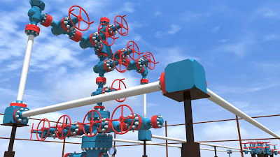
Investment in the production of underground borehole equipment
and gushing fittings production factory*
- Due to the current government arrangements concerning the import substitution of the oil-and-gas sector, existence of extensive scientific and technical base, proximity of oil and gas crafts and convenient geographical position, the production of underground borehole equipment and gushing fittings is possible.
-Share of such equipment import in Russian Federation - 65%
Market
conditions
Initial data:
Volume of production: from 1000 units per year
Necessary conditions:
The area of the land plot is 5-10 hectares.
Staff :
600-700 people (taking into account the technical repair personnel and AUP)
Pay check for 1 employee – 35 000/50 000 rub including insurance premium.
Approximate investment volume: from 4 billion rubles
Measures of efficiency :
Internal rate of return: (IRR): 30 %
Net present value (NPV): 400-550 million rubles
Payback period (PР): 5 years
Economic conditions
* For implementation of the project various options of municipal and private platforms are offered;
* Since 2015 projects with the volume of investment more than 300 million rubles are exempted from payment of the property tax, and also will be able to receive a privilege on income tax.

Slide 28
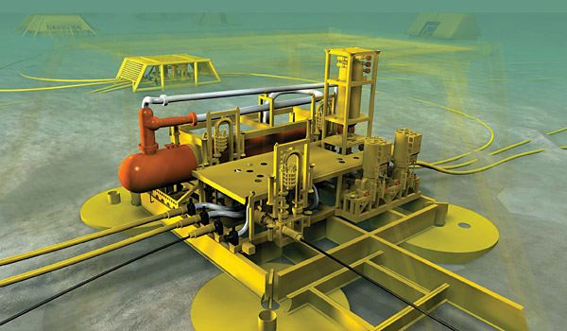
Investment in the construction of equipment for underwater mining complexes production factory*
Due to the current government arrangements concerning the import substitution of the oil-and-gas sector, existence of extensive scientific and technical base, proximity of oil and gas crafts and convenient geographical position, the production of underwater mining complexes equipment is possible, specifically bases of template, protective designs of template, manifold modules, modules of contours, connection devices, underwater blocks of the estuarial equipment, underwater control systems.
Share of such equipment import in Russian Federation - 100%
Market
conditions
Initial data:
Volume of production: from 60 units per year
Necessary conditions:
The area of the land plot is10-15hectares.
Staff :
800-1000 people (taking into account the technical repair personnel and AUP)
Pay check for 1 employee – 45 000/50 000 rub including insurance premium.
Approximate investment volume: from 10 billion rubles
Measures of efficiency :
Internal rate of return: (IRR): 30 %
Net present value (NPV): 2 billion rubles
Payback period (PР): 7 years
Economic conditions
* For implementation of the project various options of municipal and private platforms are offered;
* Since 2015 projects with the volume of investment more than 300 million rubles are exempted from payment of the property tax, and also will be able to receive a privilege on income tax.

Slide 29
Investment in the construction of agricultural machinery and component parts production factory*
- Due to the development of agro-industrial complex of the Tyumen region and essential state support of agricultural subjects, demand for new agricultural machinery and accessories constantly grows. The increase in demand for tractors, dryers, silos, bunkers, seeders, separators, plows, sprayers, cultivators, mowers, cattlefeeders is especially noticeable.
- The share of import of this production in the Russian Federation – 60%
Вид техники Приобретенной фермерами Тюменской области | Кол-во единиц | Стоимость с НДС тыс. руб. | Сумма выделенных гос. субсидий тыс. руб.
 | 2013 | 2013 | 2013
из них:
тракторы | 414 | 755227,55 | 192052,2
Комбайны/погрузчики | 205 | 1281862,9 | 435483,1
Иная техника: сушилки, силосы, бункеры, сеялки, сепараторы, плуги, опрыскиватели, культиваторы, косилки, кормораздатчики, гребнеобразователи. | 517 | 1060507,2 | 351816,9
Всего сельхозтехники: | 1136 | 3097597,7 | 979352,226
Market
conditions
Initial data:
Volume of production: from 200 units per year
Necessary conditions:
The area of the land plot is 15 -20 hectares.
Staff :
1000-1500 people (taking into account the technical repair personnel and AUP)
Pay check for 1 employee – 45 000/50 000 rub including insurance premium.
Approximate investment volume: from 7 billion rubles
Measures of efficiency :
Internal rate of return: (IRR): 20 %
Net present value (NPV): 500 mln - 1bln rubles
Payback period (PР): 8 years
Economic conditions
* For implementation of the project various options of municipal and private platforms are offered;
* Since 2015 projects with the volume of investment more than 300 million rubles are exempted from payment of the property tax, and also will be able to receive a privilege on income tax.

Slide 30
Ceramic brick plant investment*
Ceramic brick consumption in the Tyumen Region was 330 mln pcs in 2013. Import rate from other region was 235 mln pcs. So the regional production proved to be deficient.
The Region has more than 300 building material fields (sands, glue), the estimated resources are over 1100 mln m³.
Regional sales market and local resources for ceramic brick production are present.
Market
conditions
Anticipated investment volume
from 1.2 bln RUB to 1.6 bln RUB
Performance indicators:
Internal rate of return (IRR): 20 %
Net present value (NPV): 250 - 300 mln RUB
Pay-back period (PР): 6 years
Initial data:
Production capacity :
60 mln per year
Necessary conditions:
Site area 5-10 hectares
Staff:
250-300 people(including maintenance and management personnel)
salary including insurance - 35 000 - 40 000 RUB per person
Economic
conditions
*We can offer different sites for the project either municipal or privately-owned;
*Since 2015 investment projects exceeding 300 mln RUB will be exempt from property tax and will be entitled to profit tax reduction.

Slide 31
Plate glass plant investment*
- Due to the high regional building rate, plate glass consumption is about 2 mln m2 per year. The total plate glass consumption in the Ural Federal District is about 15 mln m2 per year.
- The Region has rich resources of glass sands, preliminary estimations are 10 mln m3.
Market
conditions
Initial data:
Production capacity :
10 mln m2 per year
Necessary conditions:
Site area 15-20 hectares
Staff:
300-400 people(including maintenance and management personnel)
salary including insurance - 35 000 - 40 000 RUB per person
Anticipated investment volume
more than 3 bln RUB
Performance indicators:
Internal rate of return (IRR): 24 %
Net present value (NPV): 400 - 500 mln RUB
Pay-back period (PР): 8 years
Economic
conditions
*We can offer different sites for the project either municipal or privately-owned;
*Since 2015 investment projects exceeding 300 mln RUB will be exempt from property tax and will be entitled to profit tax reduction.

Slide 32
Foam-glass plant investment*
- Due to the high regional building rate, climate, increased requirements to heat insulating materials, glass sand resources that let produce high quality quenched cullet, the market situation is favorable for foam-glass blocks and casing production.
- Application:
* Multi-storeyed residential, commercial, industrial, individual building.
* Heat insulation for pipes in petrochemical industry and in housing and utility sector.
Market
conditions
Initial data:
Production capacity :
40 000 m3 per year
Necessary conditions:
Site area 5-10 hectares
Staff:
100-150 people(including maintenance and management personnel)
salary including insurance - 35 000 - 40 000 RUB per person
Anticipated investment volume
from 900 mln RUB to 1 bln RUB
Performance indicators:
Internal rate of return (IRR): 24 %
Net present value (NPV): 150 - 250 mln RUB
Pay-back period (PР): 8 years
Economic
conditions
*We can offer different sites for the project either municipal or privately-owned;
*Since 2015 investment projects exceeding 300 mln RUB will be exempt from property tax and will be entitled to profit tax reduction.

Slide 33
Investment in dry building mixes plant *
The rate of dry building mixes consumption in the Tyumen Region including Khanti-Mansi and Yamal-Nenets Autonomous Districts was 410 000 ton in 2013.
If the regional building rate continues to grow, the rate of dry building mixes consumption will rise by 40-45% ( 600 000 ton per year) by 2020.
Market
conditions
Initial data:
Production capacity :
400 000 per year
Necessary conditions:
Site area 10-20 hectares
Staff:
250-300 people(including maintenance and management personnel)
salary including insurance - 35 000 - 40 000 RUB per person
Anticipated investment volume
from 1.3 bln RUB to 1.6 bln RUB
Performance indicators:
Internal rate of return (IRR): 25 %
Net present value (NPV): 150 - 200 bln RUB
Pay-back period (PР): 5 years
Economic
conditions
*We can offer different sites for the project either municipal or privately-owned;
*Since 2015 investment projects exceeding 300 mln RUB will be exempt from property tax and will be entitled to profit tax reduction.

Slide 34
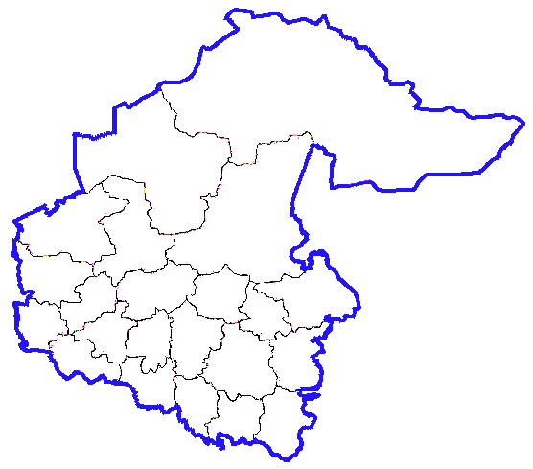
Developed together with JSC “SIBUR Holding”
Investment in the construction bioethanol production factory*
The region has large reserves of low-quality wood (to 14 million m³ a year), nowadays options of effective utilization of this resources are absent.
Possibility of partnership with the SIBUR-Holding company, that has abroad examination in the advanced biotechnologies field
Entry into the export markets (Europe, Asia).
Рmarket conditions
73 млн.м³
Объем неосвоенной древесины в области
Initial data:
Production capacity : Production of bioethanol with the capacity of 60 tons.
Necessary conditions:
Site area 3-5 hectares
Staff:
300-400 people(including maintenance and management personnel)
salary including insurance - 35 000 - 40 000 RUB per person
Capex: 150 mln. euro
Measures of efficiency :
Internal rate of return (IRR): 8 %
Net present value (NPV): 8 bln rubles
Pay-back period (PР): 5 years
Экономические
предпосылки
*We can offer different sites for the project either municipal or privately-owned;
*Since 2015 investment projects exceeding 300 mln RUB will be exempt from property tax and will be entitled to profit tax reduction.

Slide 35
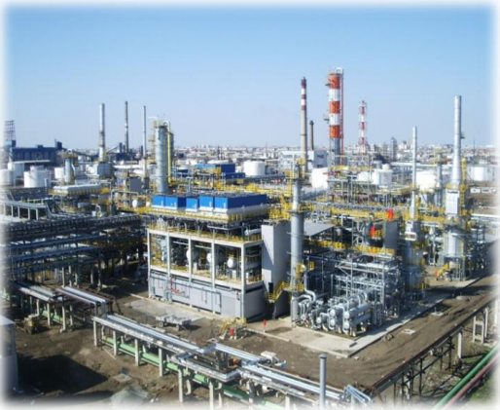
Investment in the construction of mineral fertilizers production factory*
Proximity of raw materials for production of mineral fertilizers - natural gas;
Proximity to auxiliary raw materials - river water,
(for implementation of the project it municipal
platform in Tobolsk is offered and close proximity to the river and to necessary engineering communications is available);
Possibility of transportation of production through the Northern Sea Route both to Europe, and to Asia - to the main export markets.
Market
conditions
Initial data:
Production capacity :
Approximately 400 000 tons.
Necessary conditions:
Site area 50-80 hectares
Staff:
Approximately 1000 people(including maintenance and management personnel)
salary including insurance - 35 000 - 40 000 RUB per person
Anticipated investment volume
1500 mln.dollars
Measures of efficiency :
Internal rate of return (IRR): 19,6 %
Net present value (NPV): 235 mln rubles
Pay-back period (PР): 6 years
Economic conditions
*We can offer different sites for the project either municipal or privately-owned;
*Since 2015 investment projects exceeding 300 mln RUB will be exempt from property tax and will be entitled to profit tax reduction.

