Slide 1
ZIOSAB-DON Plant

Slide 2
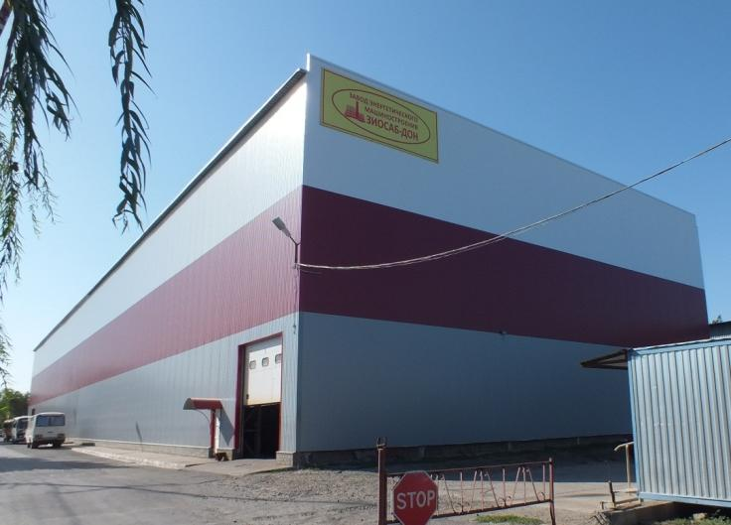
About Us:
Plant of power engineering ZIOSAB-DON was founded in Volgodonsk, Rostov Region in 2003.
Personnel number: more than 200 persons.
Production areas: 7 000 m².
Open storage areas: 10 000 m².
Annual product release: 5 000 tons.

Slide 3
About Us
The basic company’s activity is equipment manufacturing for large and small power engineering objects. For thermal power objects of large capacity the plant manufactures subsidiary equipment for HRSG downstream gas turbines, power-generating and industrial power steam and hot-water boilers from carbon, heat-resistant and stainless steel grades.
Product range for released boiler equipment for small power engineering objects includes 15 MW hot-water boilers, steam boilers with steam capacity up to 20 tons of steam per hour.

Slide 4
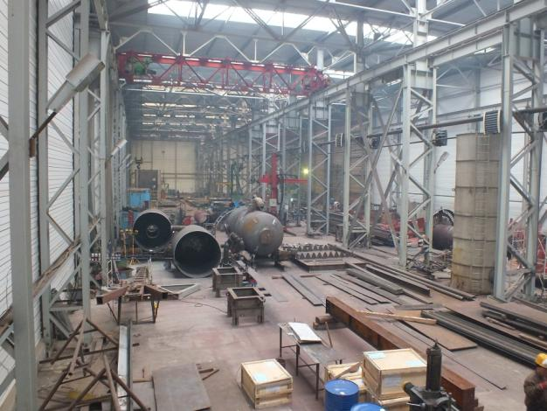
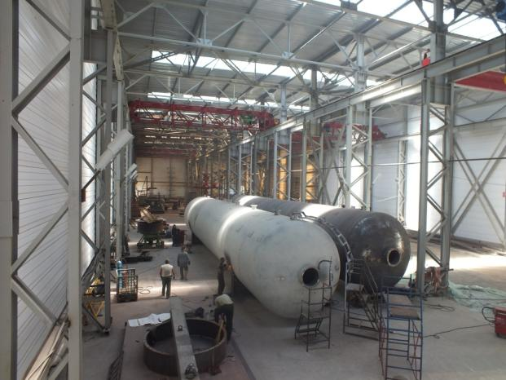
Production Areas
Production building 3000 m² is equipped with 6 cranes 10 tons capacity each.
There are technical facilities for manufacturing power-generating equipment with unit mass 40 tons.

Slide 5
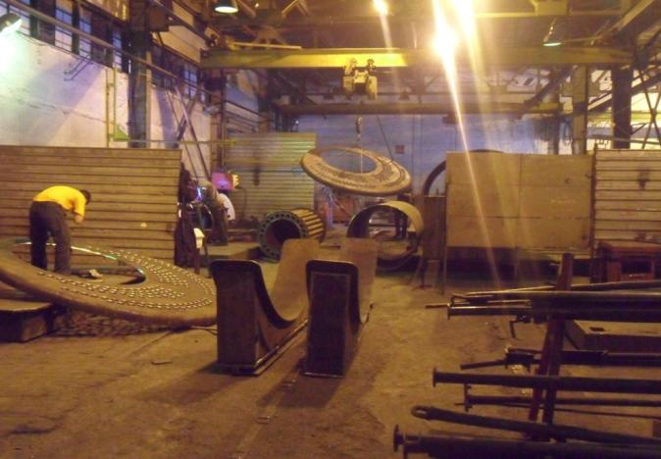
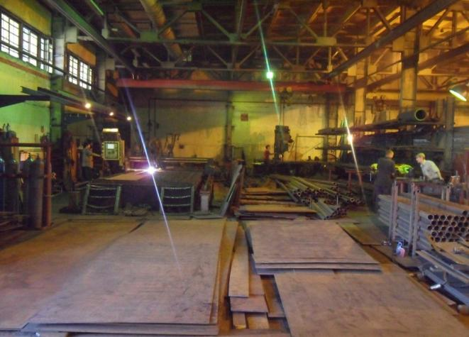
Production Areas
Production-blanking building with the area of 1500 m² consists of three gantries 14 m each, equipped with 6 cranes 5 tons capacity each.

Slide 6
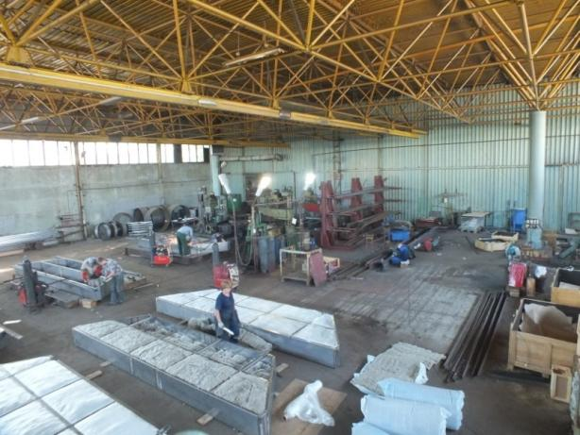
Production Areas
Assembly-welding building with the area of 1900 m²
is equipped with cranes 3 tons capacity each.

Slide 7
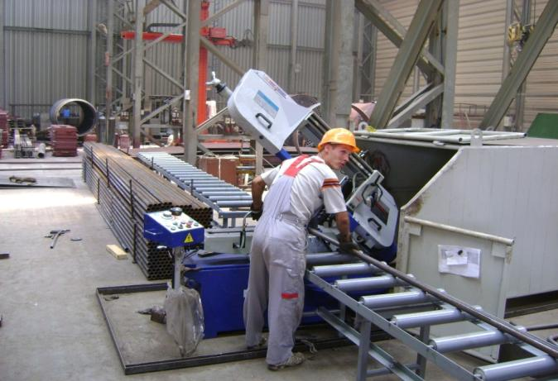
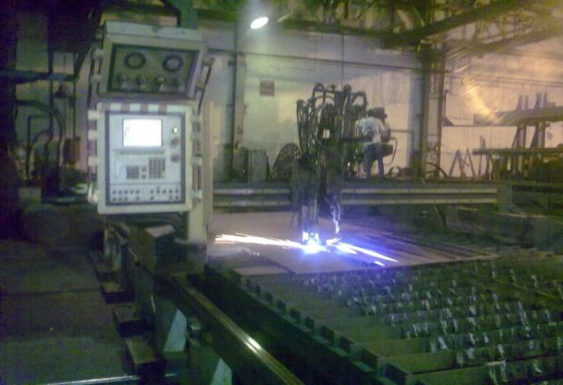
Production Equipment
Rolled steel cutting with band-sawing machine 330SSAV(13”).
Flat pattern cutting with thermal cutting machine “MESSER”.

Slide 8
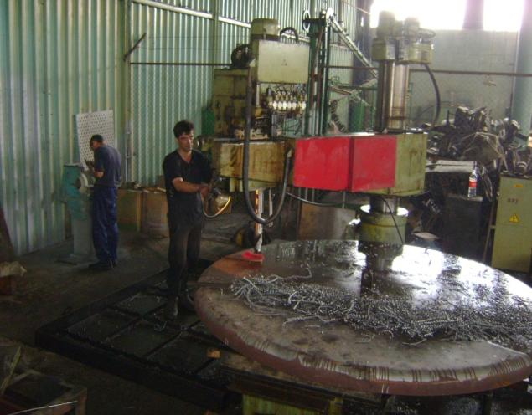
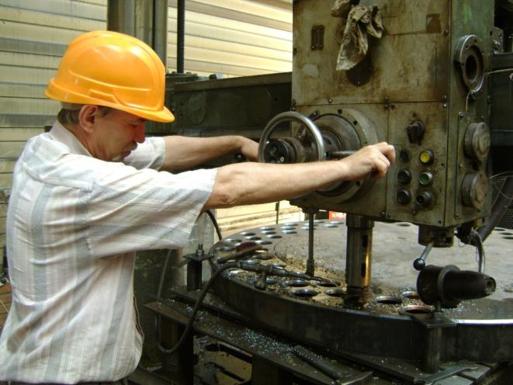
Production Equipment
Drilling area for tube plate processing is equipped with 6 radial drilling machines 1К55 and one 1К57.

Slide 9
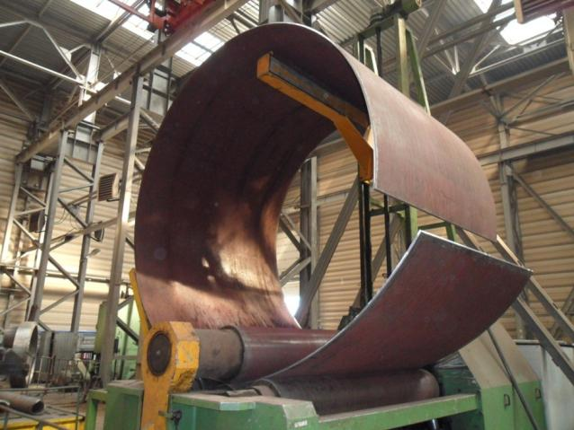
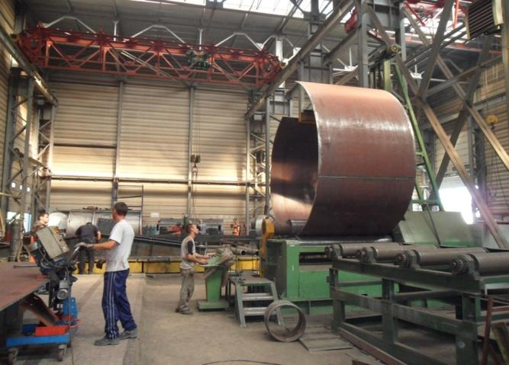
Production Equipment
Shell rolling with 4-roll sheet-bending machine “CHR. HAUSLER”, sheet thickness up to 30 mm, width up to 2000 mm, rolling diameter up to 5000 mm.

Slide 10
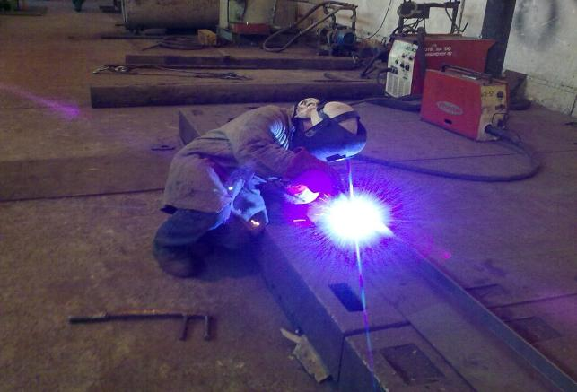
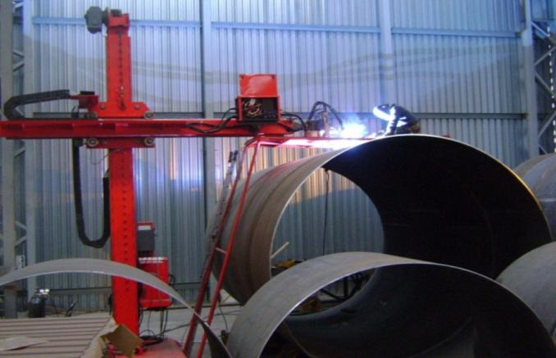
Production Equipment
Semi-automatic and automatic gas-shielded welding with “FRONIUS” equipment.

Slide 11
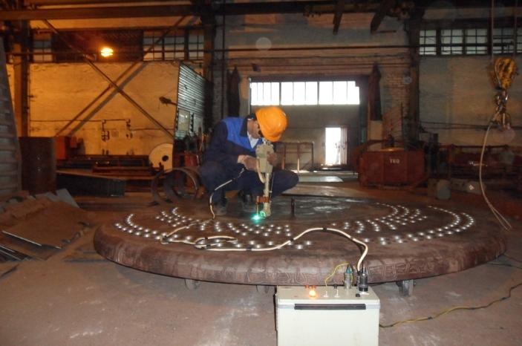
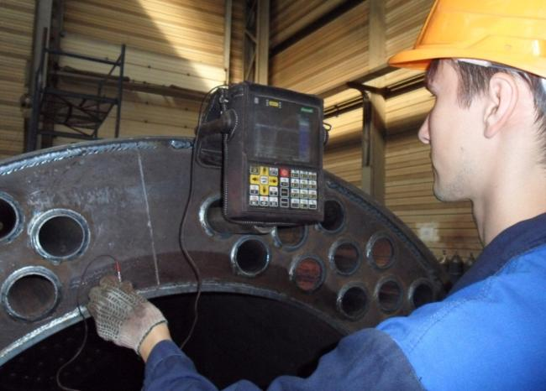
Product Quality Control
Receiving inspection by metal steeloscope (multipurpose steeloscope of СЛУ type).
UT – welds control with ultrasound flaw detector UDZ-204 PELENG.

Slide 12
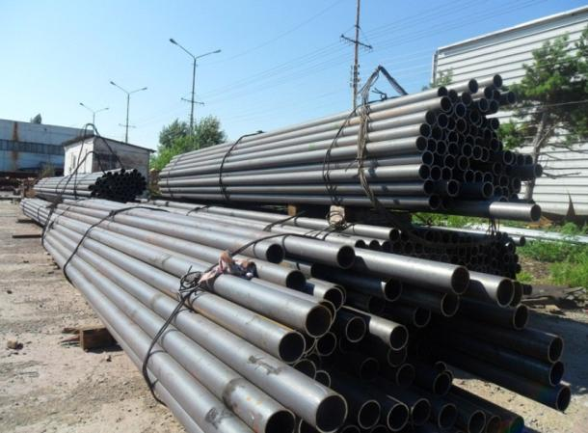
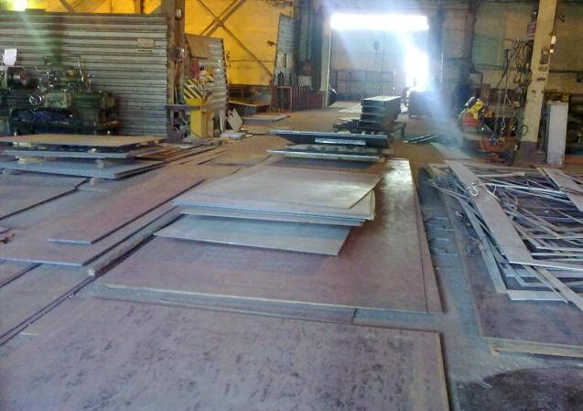
Raw Materials
Storage yard of seamless boiler tubes and rolled steel plates.

Slide 13
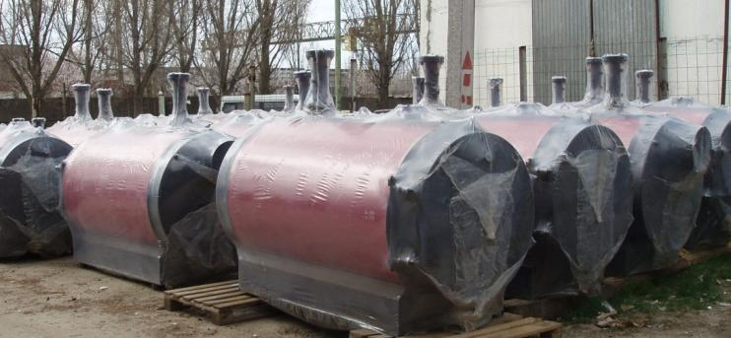
Hot-Water Boilers
At the present moment LLC Plant ZIOSAB-DON manufactures 12 types of steel hot-water fire tube-flue two-pass boilers of “ZIOSAB” series with the capacity from 125 kW to 3.0 MW, hot-water gas tube-fire tube three-pass boilers “ZIOSAB-5000” with the capacity of 5.0 MW.

Slide 14
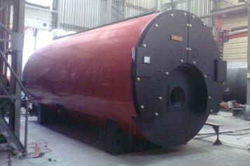
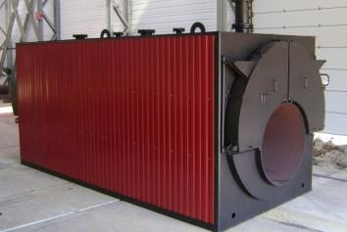
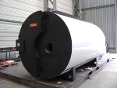
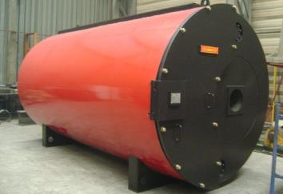
Hot-Water Boilers
Steam fire tube-flue three-pass boilers “FR-25” with the capacity from 1.0 to 20.0 t/h of steam;
Hot-water fire tube-flue three-pass boilers “FR-10”, “FR-16” with the capacity from 0.5 MW to 15.0 MW.

Slide 15
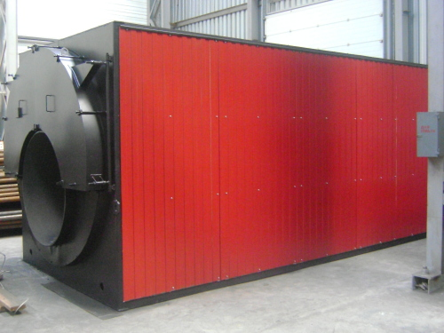
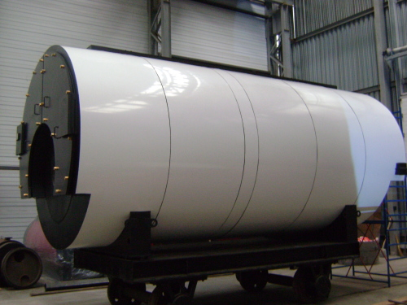
Hot-Water Boilers
Hot-water boiler
“FR10-8-16-204”
(8.0 MW, mass – 24 tons)
At the territory of production building ready for shipment on railway platform
Boiler “ZIOSAB-5000”
(5.0 MW, mass - 18 tons)

Slide 16
Equipment for Large Power Engineering
Objects
Equipment for HRSG, power-generating and industrial power steam and hot-water boilers, capacitive and heat-exchanging equipment:
- Boiler gas ducts covering panels;
- Confusers and diffusers;
- Silencers for steam discharge and gas path;
- Flash tanks of continuous and intermittent blow-down;
- Headers, tubular air preheaters, high pressure heating surfaces;
- Capacitive and heat-exchanging equipment with diameter from 4.5 m and mass up to 40 tons and others.

Slide 17
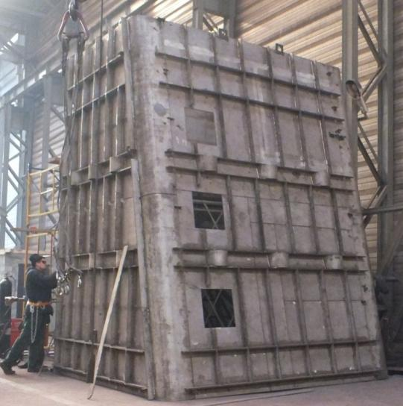
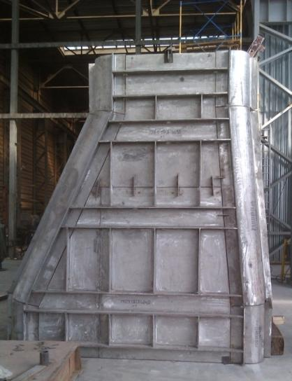
HRSG Diffuser Dzhubginskaya TPP
HRSG Diffuser Chelyabinskaya TPP-1

Slide 18
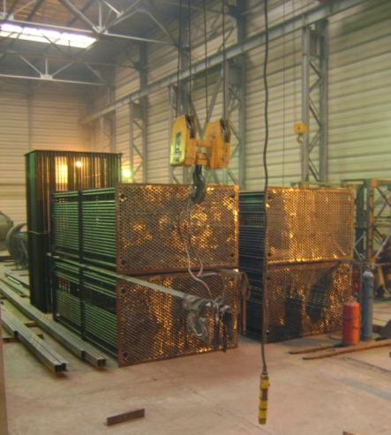
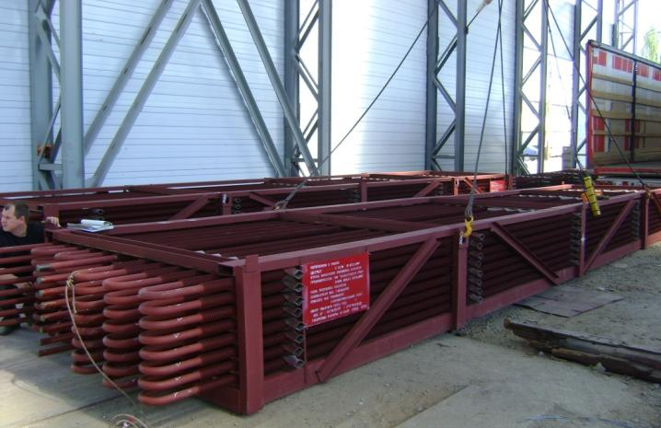
Economizers from finned tubes for boiler plant of Ekibastuzskaya GRES-1.
Tubular Air Preheaters for JSC EEK Aksu, Kazakhstan.

Slide 19
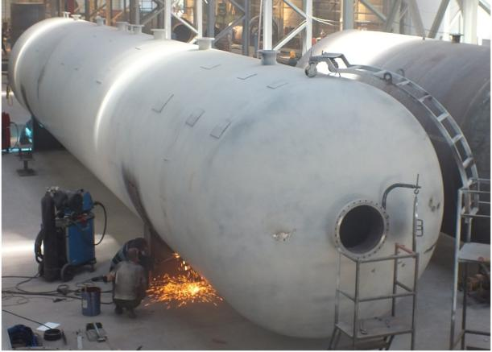
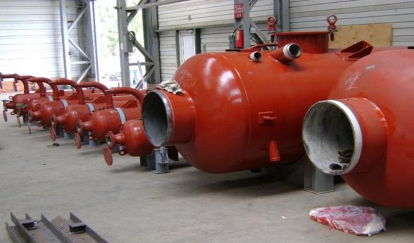
Continuous blow-down flash tanks for TPP.
Settling chamber V=200 m3 for JSC Rosneft.

Slide 20
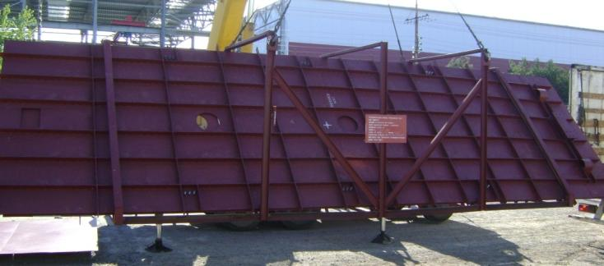
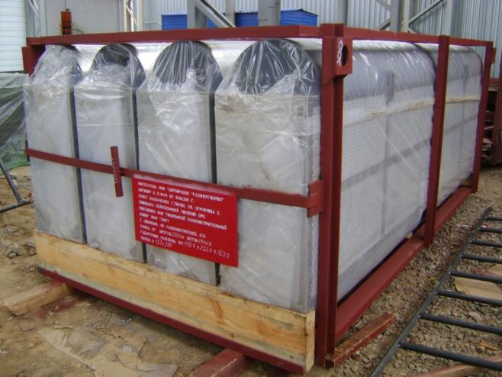
Gas silencers for Aleksinskaya TPP
Boiler casing panels Chelyabinskaya TPP-1

Slide 21
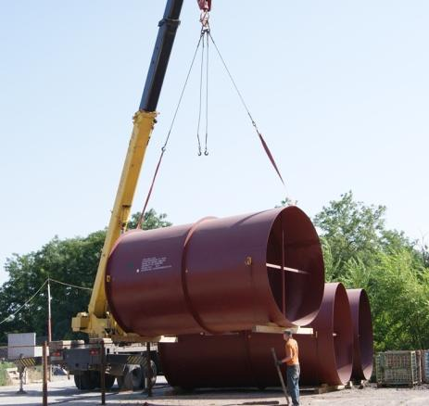
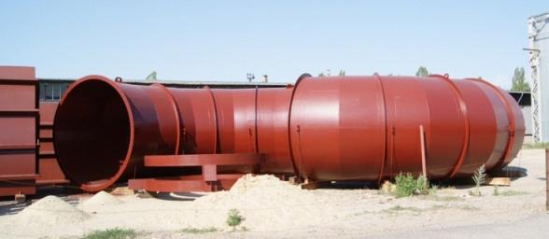
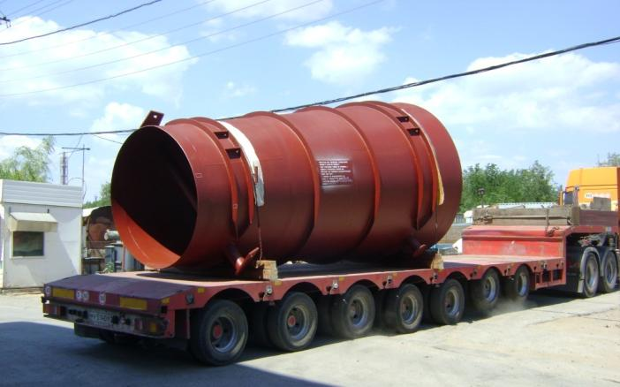
Products for POLYZIUS AG
Gas ducts of cement works
(Kerch, Ukraine)

Slide 22
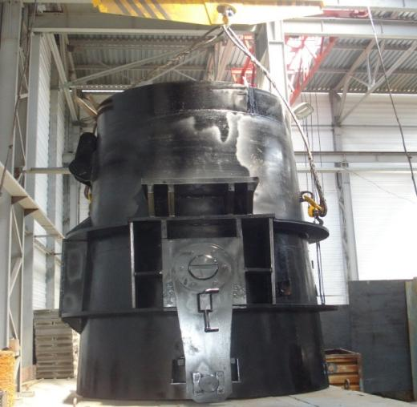
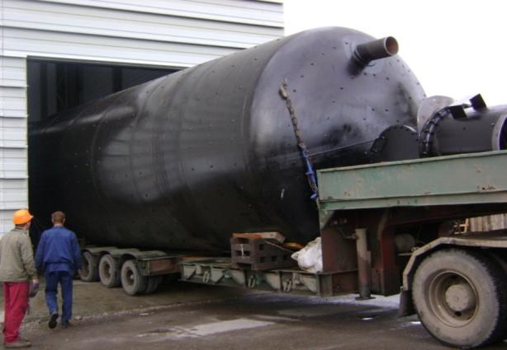
Oil product tank V=200 m³. For Novoshakhtinsk Oil Processing Plant.
Bowl AKP-40 (for metallurgy, weight - 11 tons).

Slide 23
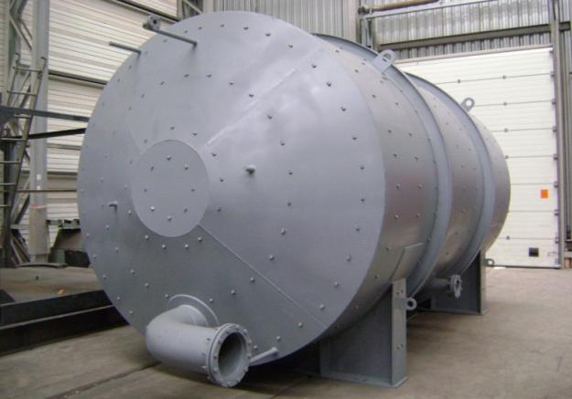
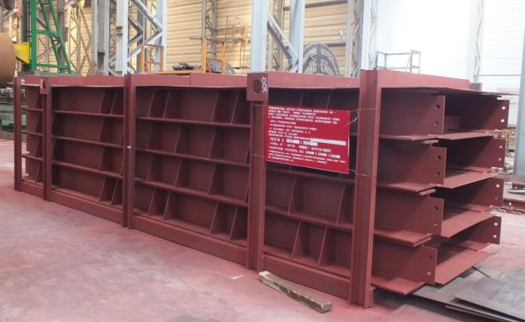
Convection gas duct for Dzhubginskaya TPP in transportation packing.
Condensate tank
20 m³, weight - 12 tons for Novoshakhtinsk Oil Processing Plant.

Slide 24
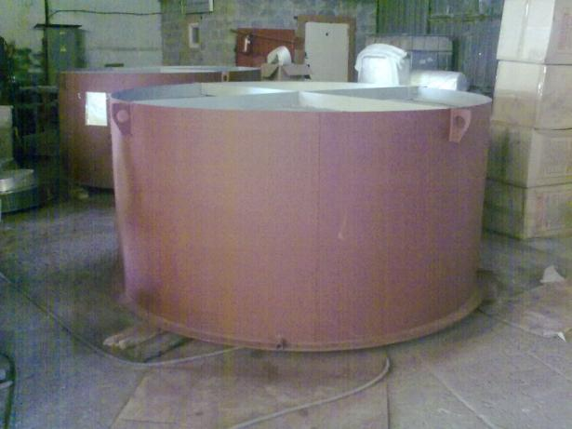
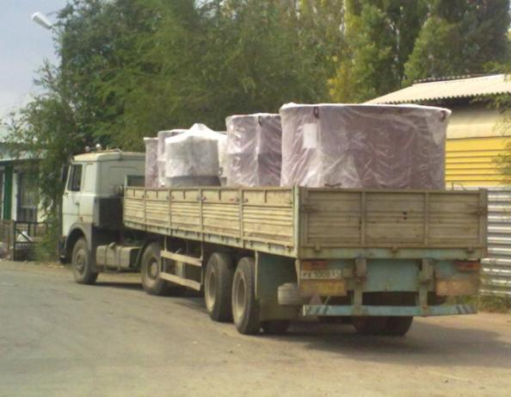
Steam discharge silencers. Customer – JSC TEK Mosenergo for Adlerskaya TPP

Slide 25
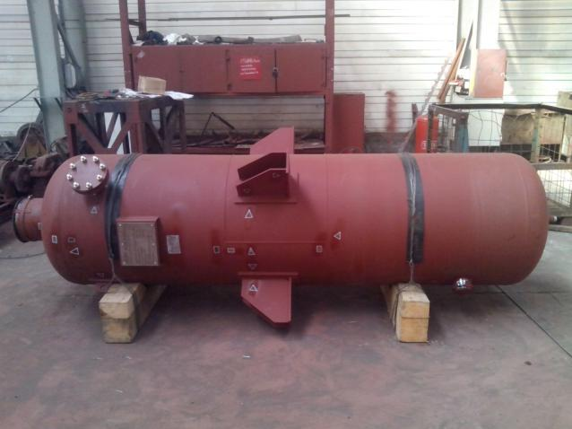
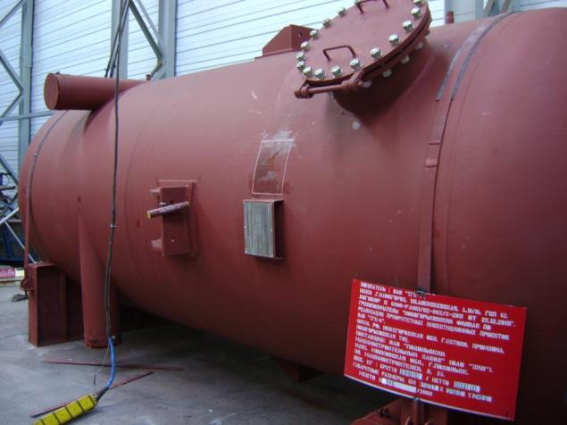
Intermittent blow-down flash tank for Akademicheskaya TPP.
Intermittent blow-down flash tank, GTU TPP-200 project for Lukoil-Permnefteorgsintez, Perm.

Slide 26
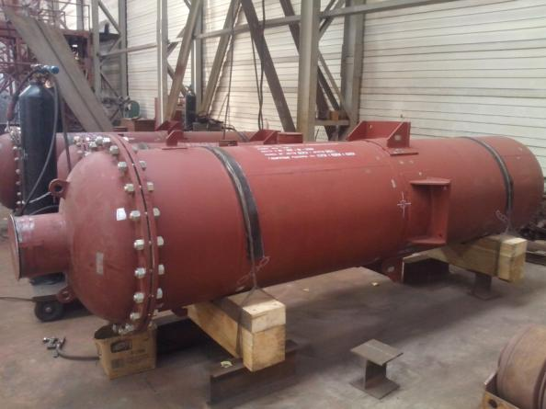
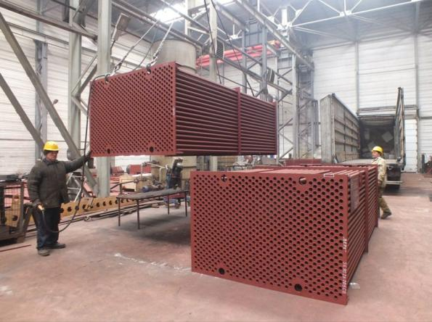
I Stage Air Preheaters semi-sections for Troitskaya GRES.
Intermittent blow-down flash tanks for Voronezhskaya TPP-1.

Slide 27
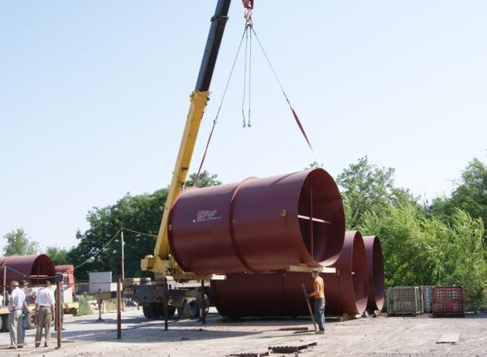
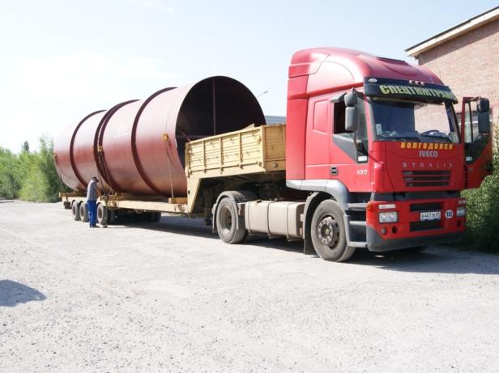
Product shipment: vehicle, railway, river transport
Transportation of oversized cargo to Volgodonsk river port.

Slide 28
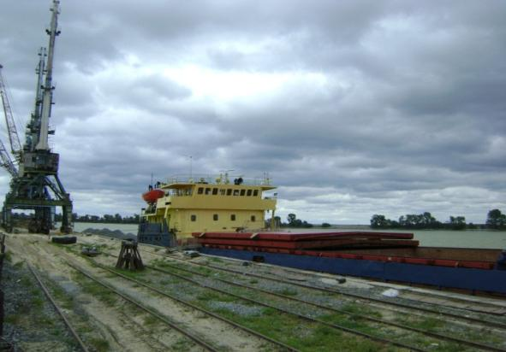
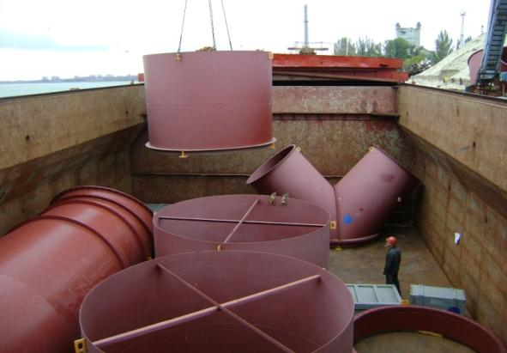
Product shipment for POLYSIUS AG Company
Delivery by river-marine vessels to Kerch port (Ukraine).

Slide 29
Shipment by vehicles
Vehicle transportation of boilers ZIOSAB - 5000 18 tons each.

Slide 30
Shipment by railway
Transportation of boilers ZIOSAB – 5000 on railway platform.

Slide 31
Shipment by railway
Boiler FR – 10 – 8 –10 - 120 on railway platform.
3 boilers ZIOSAB - 2000 for GUP ZhKH (Yakutia).

Slide 32
Staff
Design department and Marketing department.

Slide 33
Transport
Staff delivery to working places and back home is performed by our own transport.

Slide 34
Recreation center on the Don river for staff
The plant owns recreation center on the bank of the Don river, total area 3 Ha.

Slide 35
Recreation center for plant staff and city guests on the Don river
Coast line is 250 m long, there is a beach, sauna, berth for small size vessels, fisherman’s bridges.

Slide 36
Our Geography
Петропавловск-Камчатский
Якутск
Чита
Иркутск
Сургут
Екатеринбург
Пытьях
Киров
Тольятти
Петрозаводск
Санкт-Петербург
Зеленогорск
Псков
Смоленск
Брянск
Орёл
Чебоксары
Белгород
Воронеж
Саратов
Волгодонск
Ставрополь
Астрахань
Сочи
Махачкала
Пятигорск
Пос. Тикси
Petropavlovsk-Kamchatsky, Yakutsk, Chita, Irkutsk, Surgut, Yekaterinburg, Pytyakh, Kirov, Tolyatti, Petrozavodsk, Saint-Petersburg, Zelenogorsk, Pskov, Smolensk, Bryansk, Orel, Cheboksary, Belgorod, Voronezh, Saratov, Volgodonsk, Stavropol, Astrakhan, Sochi, Makhachkala, Pyatigorsk, Tiksi

Slide 37
Equipment of ZIOSAB-DON is operated at thermal power plants all over Russia and at the territory of near-abroad countries:
Ekibastuzskaya GRES-1, Kazakhstan
Chelyabinskaya TPP-1, Chelyabinsk
Dyagilevskaya TPP, Ryazan
Novogorkovskaya TPP, Nizhny Novgorod Region
Unit No.6, Aksu, Kazakhstan
Dzhubginskaya TPP; Adlerskaya TPP
Aleksinskaya TPP, Tula Region
TPP of CJSC GSR Energo, Kolpino
Kurskaya TPP-1
Nizhnevartovskaya GRES and others.

Slide 38
Contacts
Name: Limited Liability Company
Plant of Power Engineering “ZIOSAB-DON” Abbreviated name: Plant “ZIOSAB-DON” Ltd. Legal and actual address:
56, 7th Zavodskaya str., Volgodonsk, Rostov region Tel/fax: (8639) 277610 , 277620, 277831, 277410 e-mail: ziosab-don@mail.ru
www.ziosab-don.ru

