Slide 1
Reasons to invest in the Smolensk Region

Slide 2
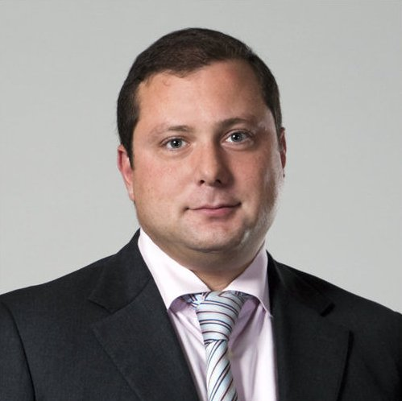
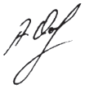
Smolensk Region opens its doors to investors!
Competitive Edge:
- Unique geographical location;
- An important transportation and communication hub;
- High level of power supply;
- Proximity to big industrial centres;
- Developed industry;
- Highly-qualified specialists;
- Available investment sites;
- Preferences for investors;
- Favourable conditions for agricultural development;
- Favourable conditions for tourism development.
Губернатор Смоленской области А.В.Островский
www.smolinvest.com

Slide 3
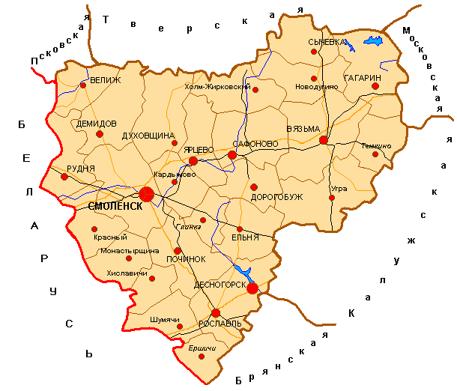
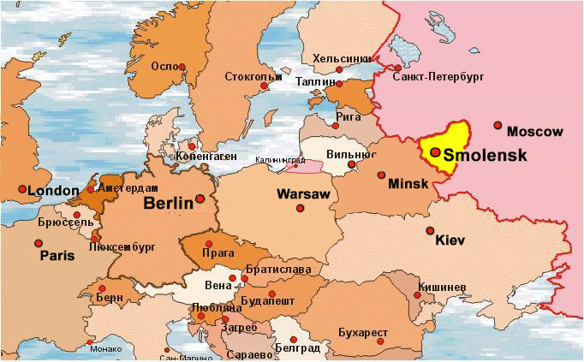
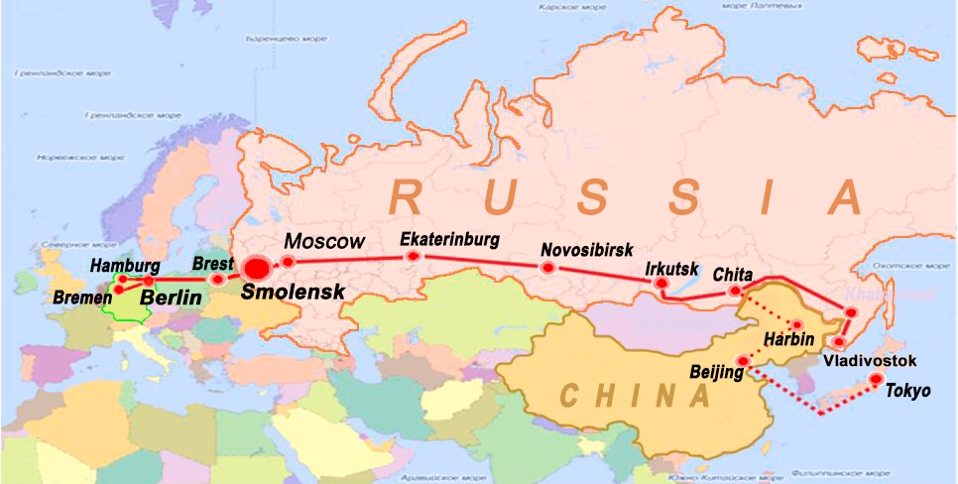
Unique geographical location
Over 68 million people live within a 500-km radius from Smolensk
The total area of the region: 49,8 thousand km²
The population size
983 thousand people
www.smolinvest.com

Slide 4
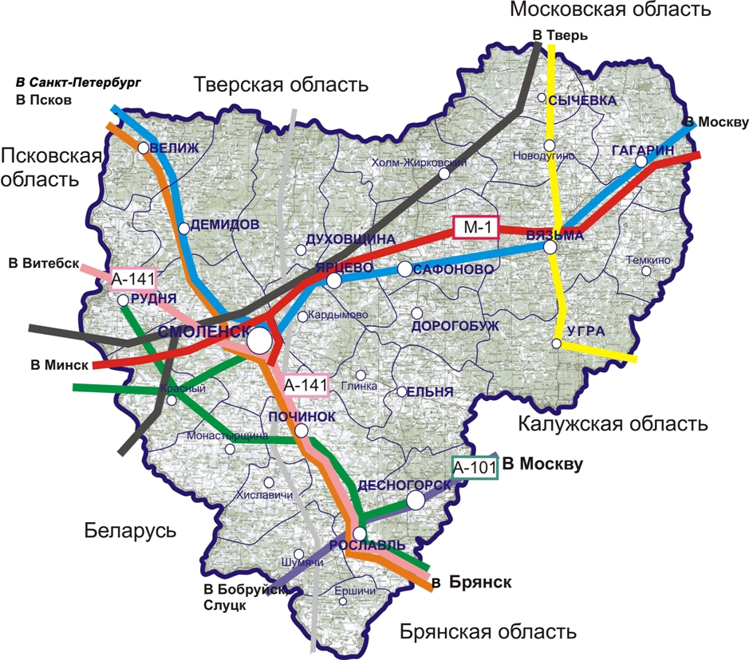
An important transportation and communication hub “Western Gates to Russia”
Located along the border with the Republic of Belarus, the Smolensk Region is an important transportation and communication hub. It borders on 5 Russian regions: Moscow, Kaluga, Tver, Bryansk, Pskov.
The following routes run through its territory:
-Federal highway М-1 «Belarus»;
-Federal highway А-141 «Oryol – Rudnya»;
-Federal highway А-101 «Moscow – Bobruisk»;
- Lateral transportation corridor «North – South» (via St. Petersburg);
- Fiber-optical communication link Moscow – St. Petersburg;
- Fiber- optical communication link
- Moscow – Bryansk – Smolensk – Belarus;
- Gas transmission pipeline «Yamal – Europe»;
- Baltic Pipeline System(BPS-II).
www.smolinvest.com

Slide 5
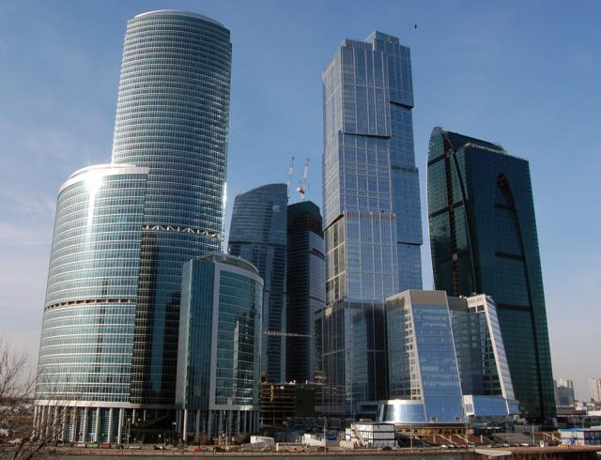
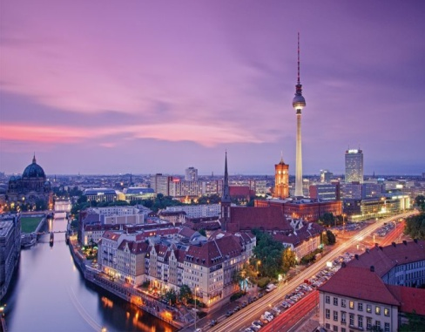
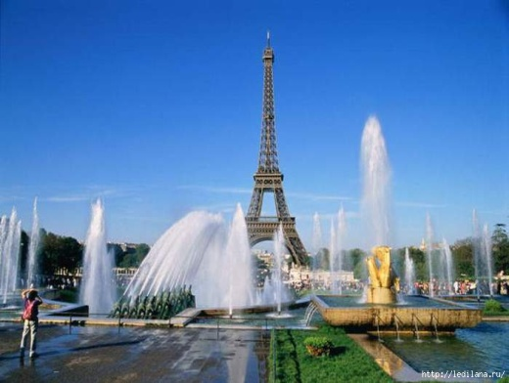
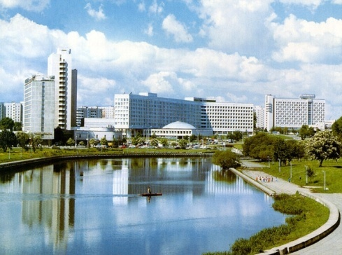
Proximity to big industrial centres
The Smolensk Region lies in the vicinity to Moscow and St. Petersburg:
-distance from Moscow to Smolensk – 370km; (from Gagarin to Moscow – 180km);
- from St. Petersburg to Smolensk – 750km.
It is also located near big cities in Belarus and Europe:
from Minsk to Smolensk – 340km;
from Brest to Smolensk – 660km;
from the Smolensk-Belarus border to Warsaw – 800km, to Berlin – 1370km, to Wien – 1500km, to Paris -2400km.
Moscow-Nice (3315km), one of the longest trans-european routes, runs through its territory (railway connection).
www.smolinvest.com

Slide 6
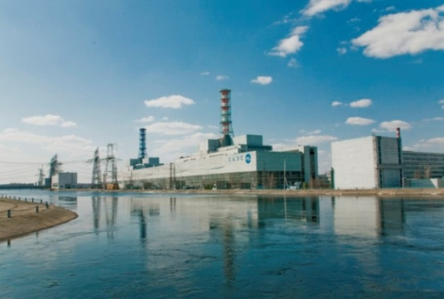
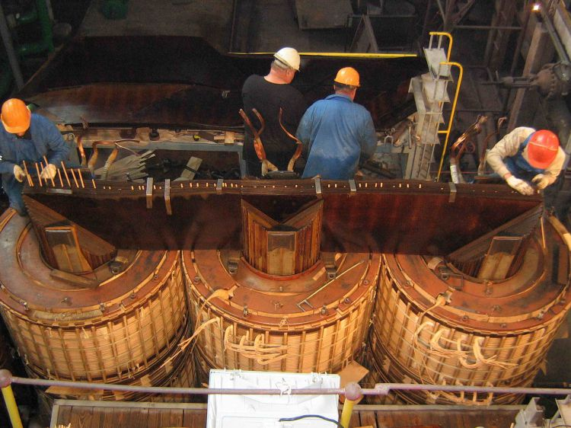
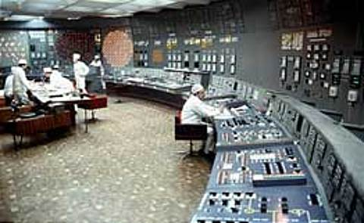
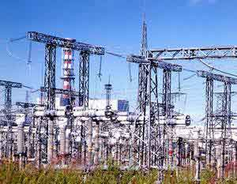
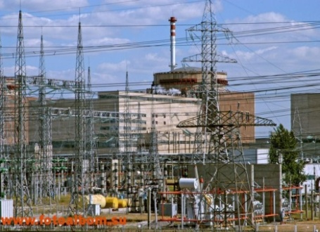
High level of power supply
The Smolensk Region is a power abundant area, which power production exceeds 4 times its power consumption.
Power industry of the region is represented by such large enterprises as the Smolensk Nuclear Power Plant (3000 MW) and the Smolensk Regional Power Station (630 MW), which is a partner of German power-producing concern E.ON. The annual volume of generated electricity is 25 bln. kWh .
www.smolinvest.com

Slide 7
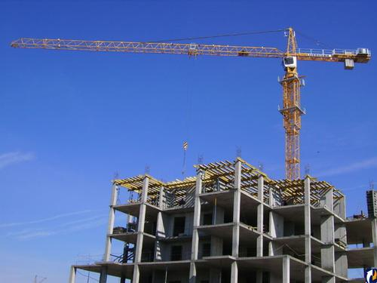
Development priorities of the Smolensk Region Our region looks attractive to Russian and foreign investors - logistics; - machinery production; - wood processing and timber industry; - recycle of low quality wood and wood waste; - food industry; - glass industry; - agriculture; - development of peat deposits and materials for cement production; - development of recreational tourism in combination with event and historical tourism.
Pespective spheres for regional development:
www.smolinvest.com

Slide 8
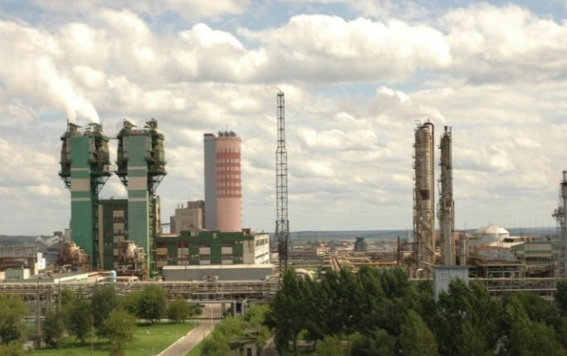
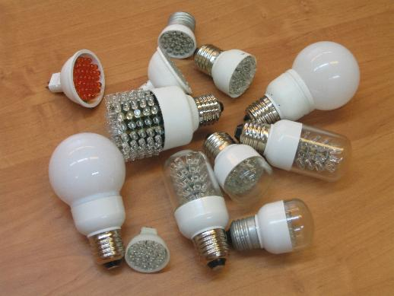
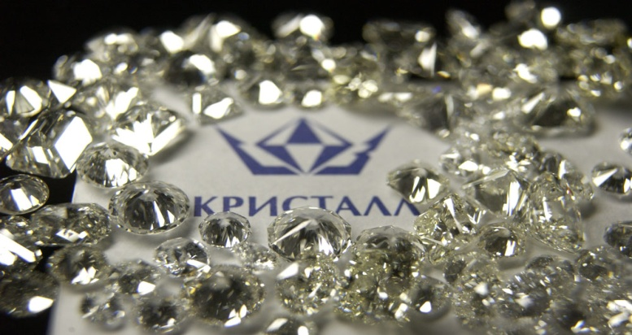
The greatest exporting enterprises
Llc «Dorogobuzh»
production of mineral fertilizers
Lls «OSRAM»
(OSRAM AG, Germany)
production of lamps and lighting systems
Production Corporation «KRISTALL» top-make polished diamonds manufacturer
www.smolinvest.com

Slide 9
Enterprises with foreign capital
www.smolinvest.com

Slide 10
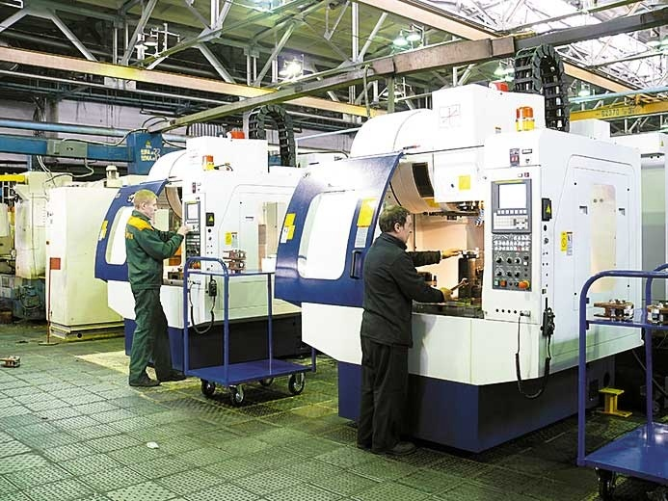
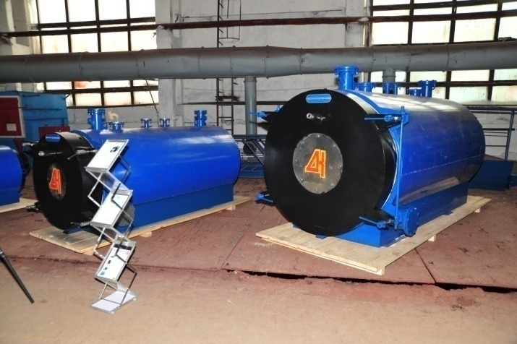
Machine engineering
The machine construction complex of the region integrates more than 200 enterprises with over 35 thousand employees.
It includes:
- transport vehicle industry;
- power engineering industry;
- instrument industry and electric engineering.
www.smolinvest.com

Slide 11
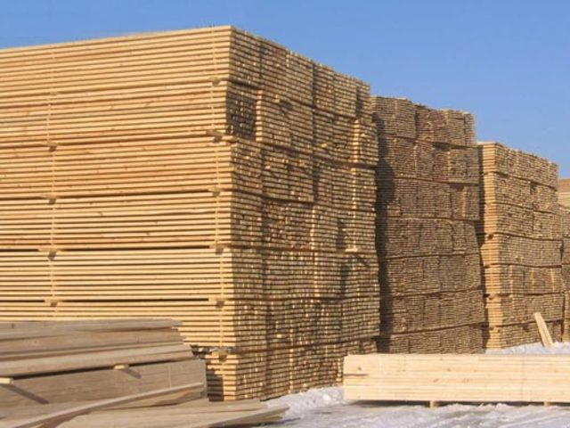
Perspectives of timber and wood processing industry
The opportunity to increase logging in three times
- The total reserve of timber in the state forestry fund – 300 mln. square meters.
- The reserve of exploitable and overripe forests – 56,4 mln. square meters.
- The amount of exploitable and overripe forests – 4,7 mln. square meters per year.
www.smolinvest.com

Slide 12
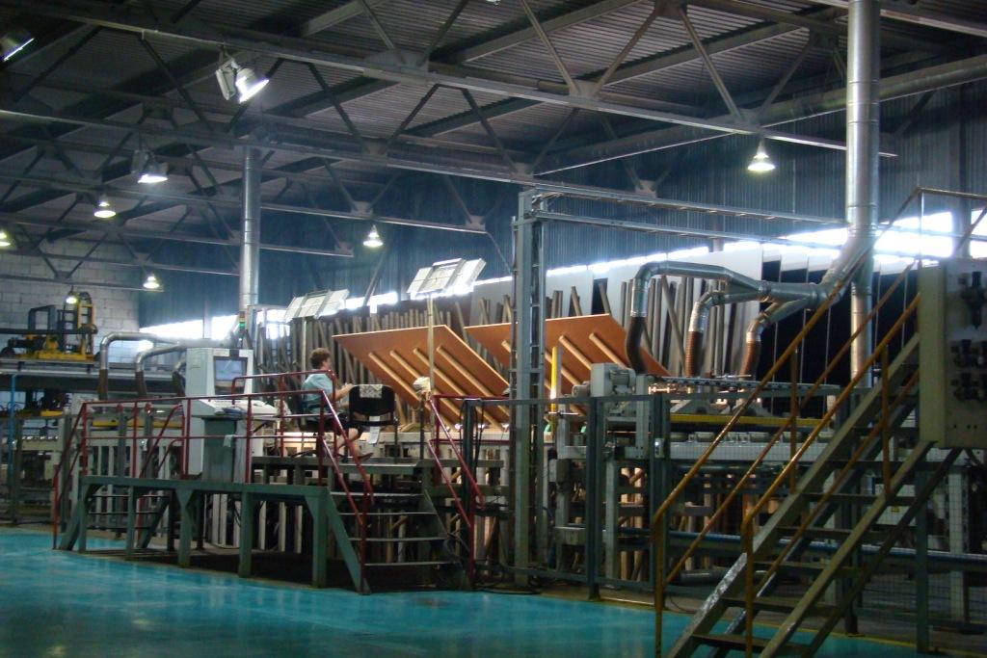
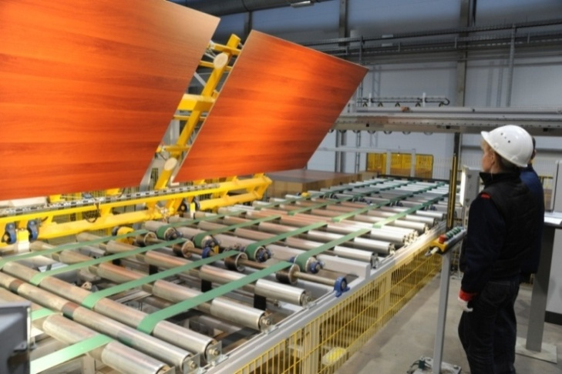
The largest wood processing import-substituting industries
LLC “EGGER DREVPRODUCT GAGARIN”
(EGGER, Austria)
production of flakeboard and
laminated plywood
JSC “Igorevsky wood processing
integrated plant”
implementation of the investment project on the construction of the facility for medium-density fiberboard production on the terms of private-public partnership funded by the INVESTMENT FUND OF RUSSIA
www.smolinvest.com

Slide 13
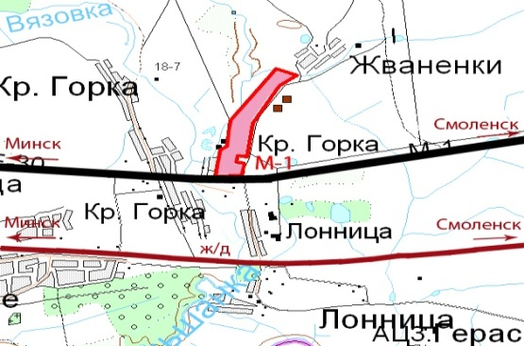
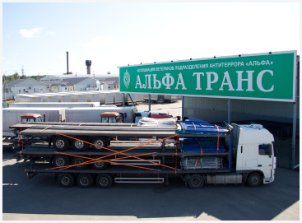
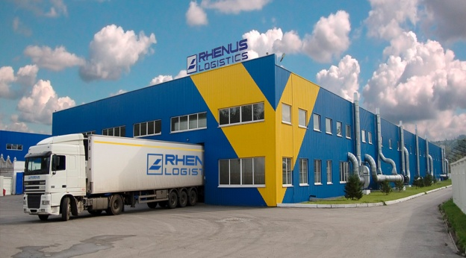
Development of logistic services
There are 14 warehouses of temporary storage in the Smolensk region. The total effective area of all the warehouses of temporary storage amounts to 100 thousand m², the total size of the adjacent area exceeds 175 thousand m². Five warehouses of temporary storage have the status of customs logistic terminal (CLT):
CLT “Krasninsky” (“Renus Logistics”)
CLT “Stabensky” (“Alfa Trans”)
CLT “Krasnoy” (“Alfa Trans”)
CLT “Rudnyansky” (“Evrotransservis”)
CLT “Smolensky” (“Katynsky Terminal”)
www.smolinvest.com

Slide 14
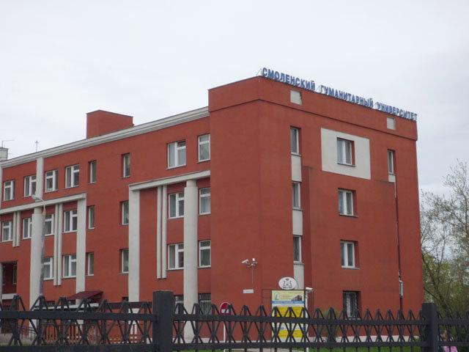
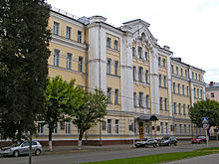
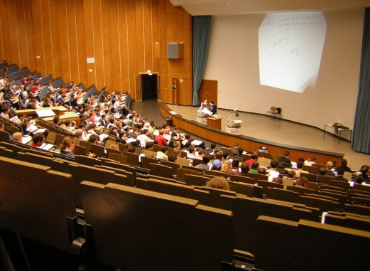
Availability of free highly skilled
human resources
Institutions of vocational training
Number of educational institutions – 83, number of students is over 66 000 people, 41 degree programs, 167 professional majors.
The main professional majors of the intermediate vocational training:
specialists in the field of machinery manufacturing, tool engineering, multifunctional machine operators, lathe operators, milling machine operators, welding operators, specialists in electrical technology, specialists in construction and architecture.
The main professional majors of the higher professional training:
specialists in the field of electric power industry, electric engineering, radio engineering and information technologies, automotive industry and transportation, construction, communal services, agriculture, livestock breeding, plant breeding, mechanization;
- obstetricians, gynecologists, anesthesiologists, resuscitators, surgeons, infectious disease specialists, oncologists, neurologists, microbiologists, physiotherapists, pharmacists, histologists, orthopedists, otolaryngologists, pediatricians, pediatric dentists, pediatric surgeons;
- specialists in the field of economics, trade, computer studies, legal studies, sociology, linguistics as well as specialists of state administration, management, land development, tourism and service.
www.smolinvest.com

Slide 15
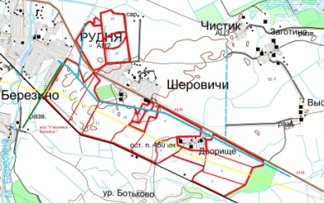
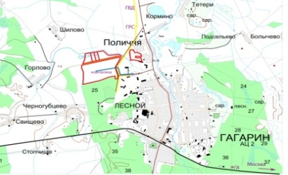
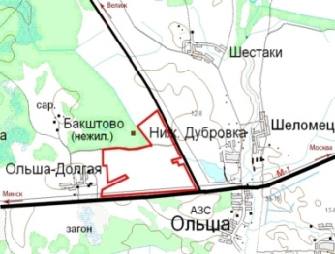
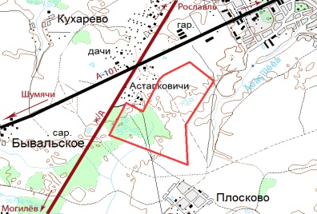
Free investment zones
There are more than 350 investment sites with the total acreage over 25 000 ha
www.smolinvest.com

Slide 16
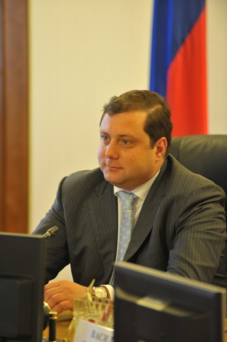
The best guaranties for investors
The Governor of the Smolensk Region guarantees proper protection of any investment as well as the rights and interests of all investors:
- equal attitude to all investors;
- right to participate in the decision-making process and their subsequent assessment at the administrative level for all investors;
- free access to any public information of the executive authorities of the Smolensk region for all investors;
- no restrictions that might hinder investment project implementation within the frames of the federal and regional legislation;
- complete security of any entrepreneur or investment activity;
- protection of all capital investment;
- protection of all investors’ rights;
- laissez fair and nonintervention of the public authorities in concluding contracts, choosing business partners and determining obligations.
www.smolinvest.com

Slide 17
State support for investors
Forms
of state support
Provision of investment sites with all the necessary elements of the transport, energy and engineering infrastructure
Consistent project support
Tax incentives
Providing subsidies for small and medium-sized enterprises
Methodical, information and organization support of the entities involved in investment activities
Involvement of the authorities in the development, expert evaluation and implementation of investment projects
Providing subsidies for entities of the industry sector
www.smolinvest.com

Slide 18
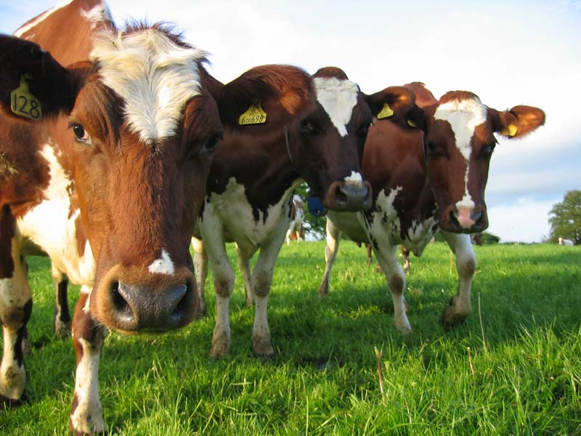
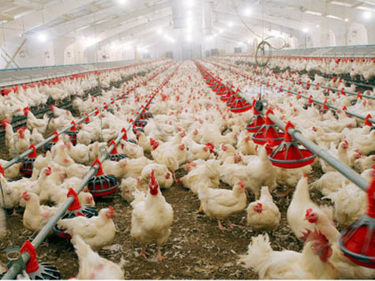
Agriculture development
Agroindustrial complex is a strategic sector of the regional economy
The main sectors:
Livestock breeding (beef and dairy stock farming)
Plant breeding (cultivation of grain, legume and forage crops)
Agricultural land exceeds 1 mln ha in the Smolensk region
The region is beneficial for breeding fiber flax, rape, potato and vegetables
www.smolinvest.com

Slide 19
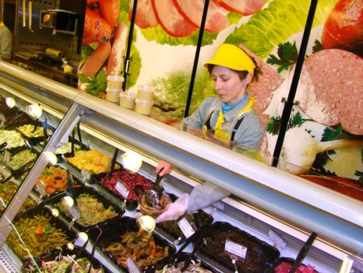
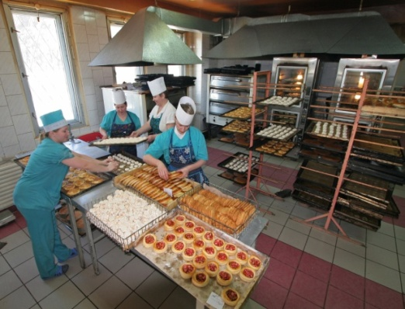
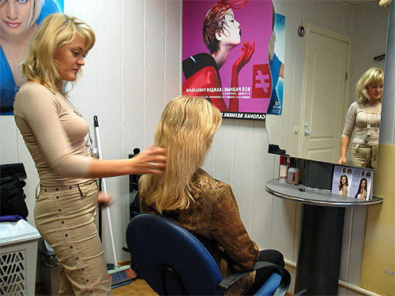
Small and medium-sized enterprises
Small and medium-sized enterprises make up a dynamically developing sector of the regional economy.
More than 36 500 entities of small and medium-sized enterprises successfully function on the territory of the Smolensk region. This sector embraces over 142 thousand people.
www.smolinvest.com

Slide 20
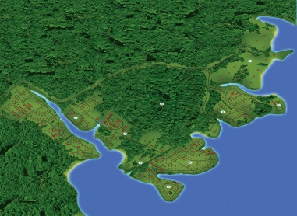
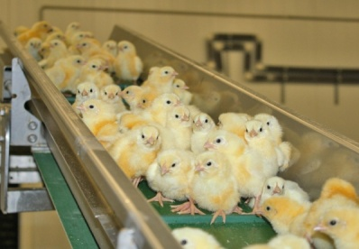
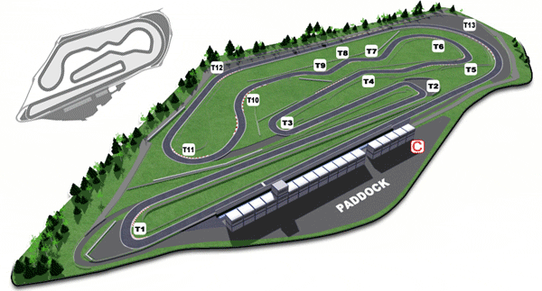
Investment projects
Establishing mass production of the manufacturing of
glass-comprising fittings
Establishing production of photovoltaic, display glass and glass for architecture and construction
Creating an eco resort “Vazuza & Yauza Park”
Building a complex for breeding broiler chicken
Building a motor-racing track “Smolensk Ring”
www.smolinvest.com

Slide 21
Investment portal:
Information on the potential of the Smolensk region
Offers on setting up your business
Updated information on all preferences offered to investors
Investment declaration of the Smolensk region
Updated information on prioritized investment sites
Opportunity to apply for setting some business
Opportunity to apply for a free investment site
Program documents in the field of investment
Details on the land use planning in the Smolensk region
Important updates on the tax and tariff systems
Detailed information on technical connection to the technical and engineering networks
www.smolinvest.com

Slide 22
Institutes of the development of the Smolensk Region
Smolensk Regional Fund for Business Support
Corporation of the Regional Development of the Smolensk Region
Euro Info Correspondent Center – the Smolensk Region (EICC)
Center for Youth Innovative Creativity
Business Incubator “ARS”
Co-working center
www.smolinvest.com

Slide 23
Contacts
Economic Development Department of the Smolensk region
Head of the Department – Victor Kozhevnikov
Phone/fax: +7 (4812) 38-65-40, 38-67-18
E-mail: ekon@admin.smolensk.ru
First deputy head of the Department – Rostislav Rovbel Phone: +7 (4812) 29-24-06
E-mail: development@admin.smolensk.ru
Investment Policy Division
Head of the Division – Margarita Goncharova
Phone: (4812) 38-77-90, 29-24-79, fax: 29-24-81
E-mail: business@admin.smolensk.ru, invest-smolensk@yandex.ru
Division for State support of investment activities
Deputy head of the Division – Svetlana Merkushova
Phone: (4812) 38-65-67, 29-24-80, fax: 29-24-81
E-mail: business@admin.smolensk.ru, invest-smolensk@yandex.ru
Division for investment support and project presentation
Head of Division – Irina Lazarenkova
Phone: +7 (4812) 38-66-42
E-mail: invest@admin.smolensk.ru

Slide 24
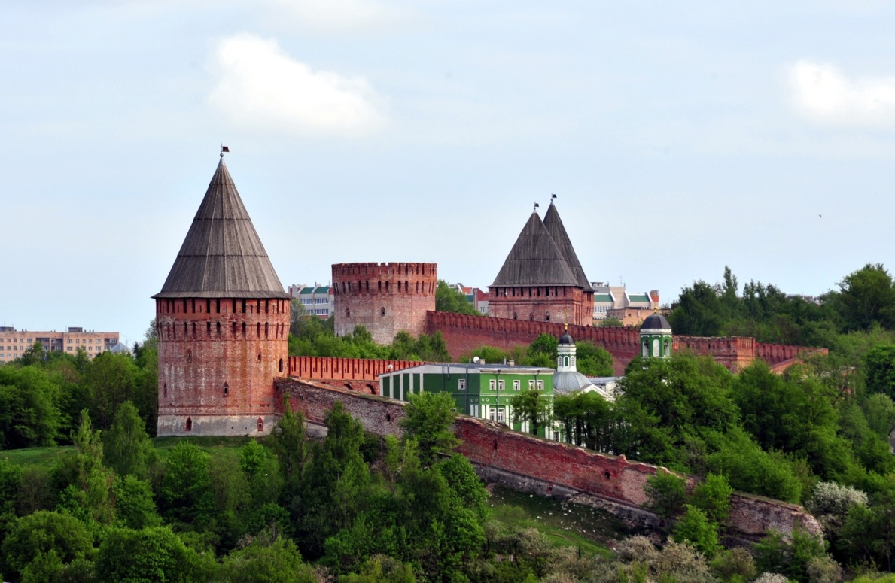
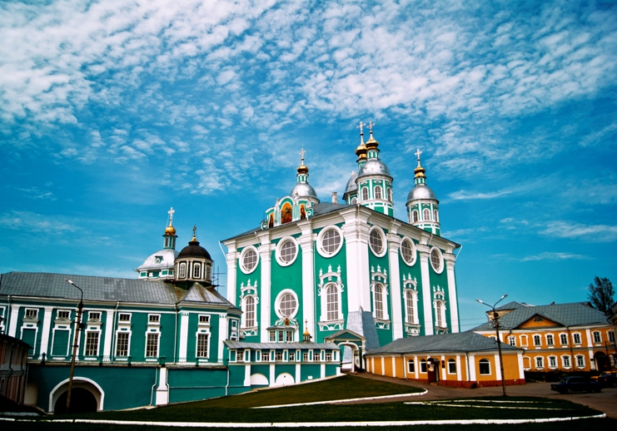
Welcome to the Smolensk Region!
www.smolinvest.com

