Slide 1
S.pine P.rotection A.t T.ransportation

Slide 2
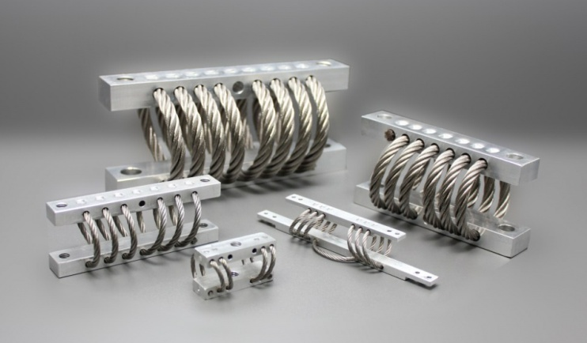
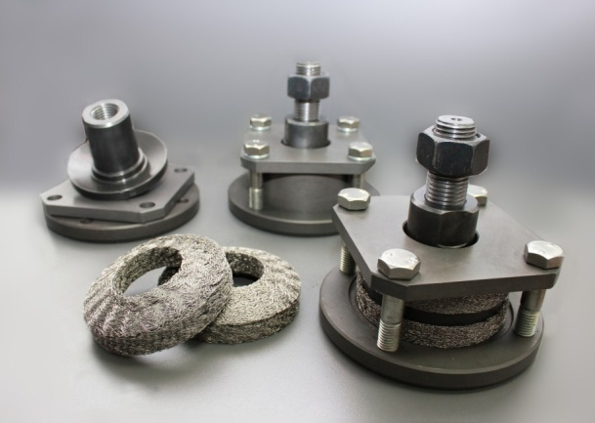
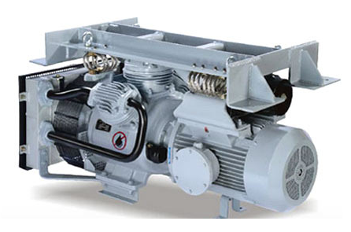
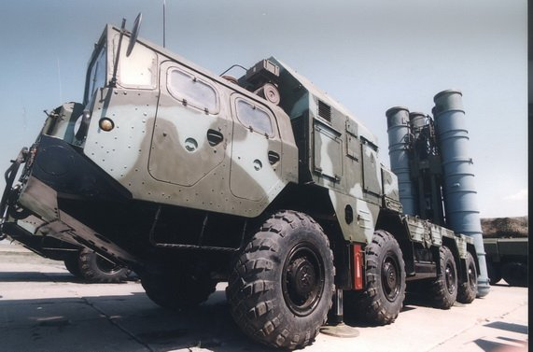
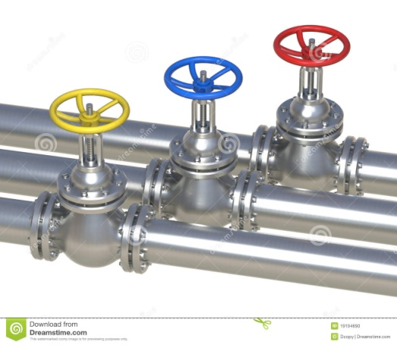
We are working in vibration sphere
Wire rope isolators
Damping supports
railway air compressors
electronic equipment for military applications
technological pipelines

Slide 3
THE PROBLEM IS THE PAIN
Operation of motor boats
is always associated with
many weak and strong impacts
Strong impacts may exceed 10G
Constant impacts on the boat hull
transmitted through the seat to the spine
have harmful effects
Such impacts make motor boat operation
uncomfortable and even unsafe for health

Slide 4
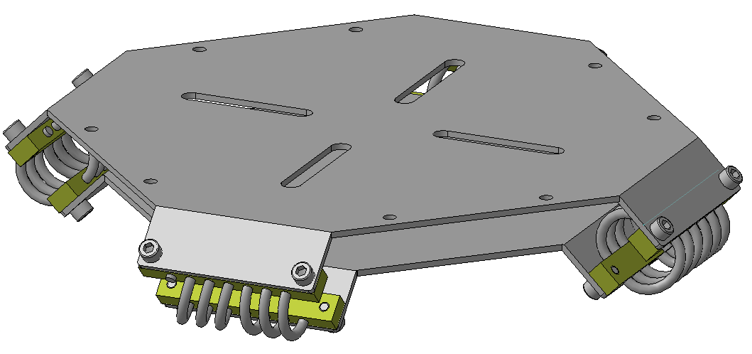
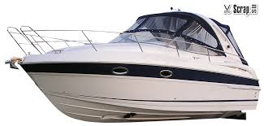
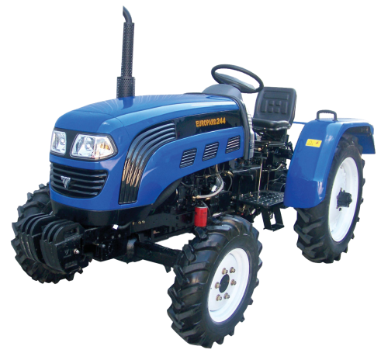
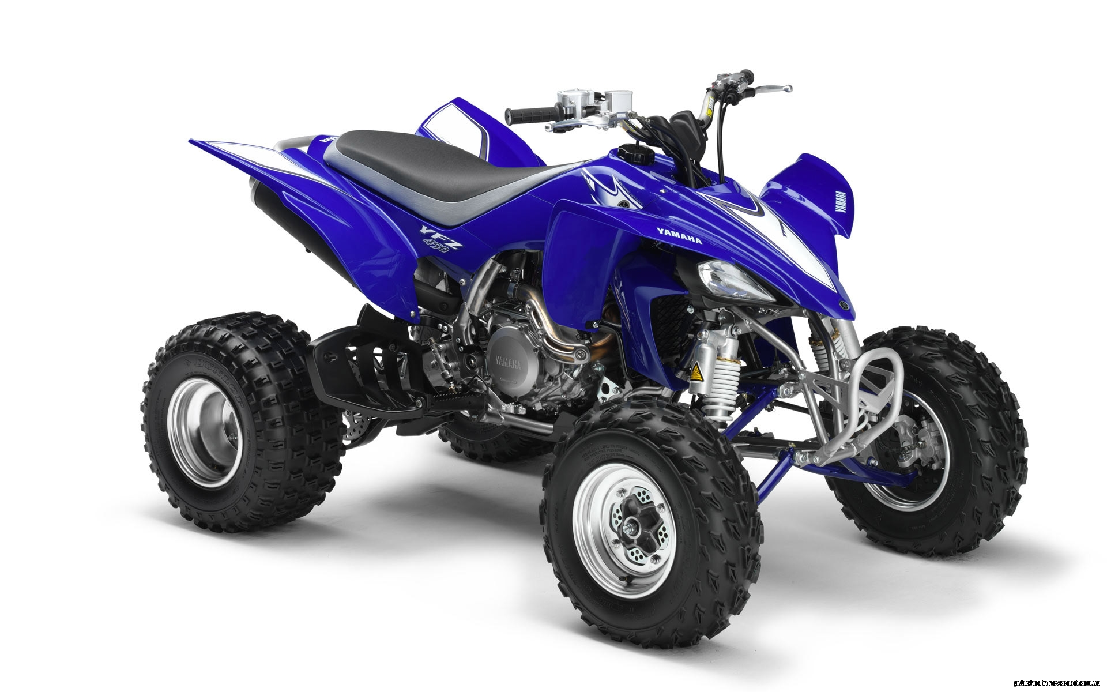
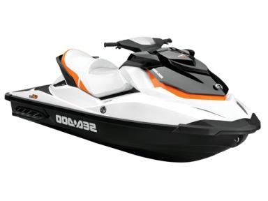
THE SOLUTION IS
S.pine
P.rotection
A.t
T.ransportation
Where is it necessary?
How does it work?

Slide 5
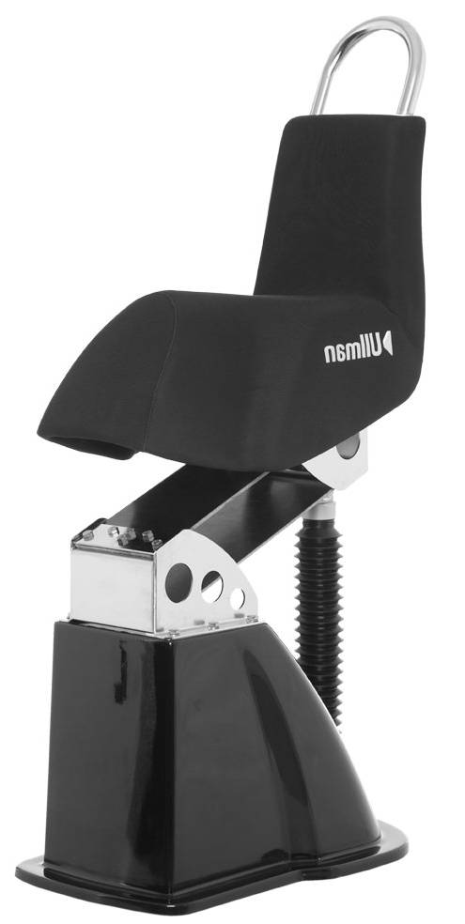
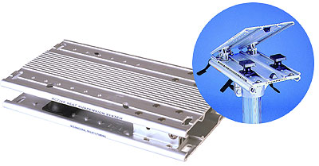
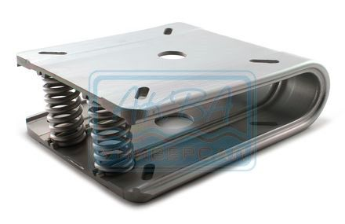
THE COMPETITORS
Performance
Marine seat suspension
€ 2 000
S.P.A.T. € 450
Non-Swivel Solo Post
€ 600
S.P.A.T. has the best
price / performance ratio
Seat base with rubber inserts
€ 200
Shock seat with springs € 100
Price

Slide 6
Technical advantages
Technical performance | Type of isolator
 | Spring | Rubber | Wire rope
 | Value of performance
Effectiveness of energy dissipation
Resource
Efficiency impact protection
Efficiency vibration isolation

Slide 7
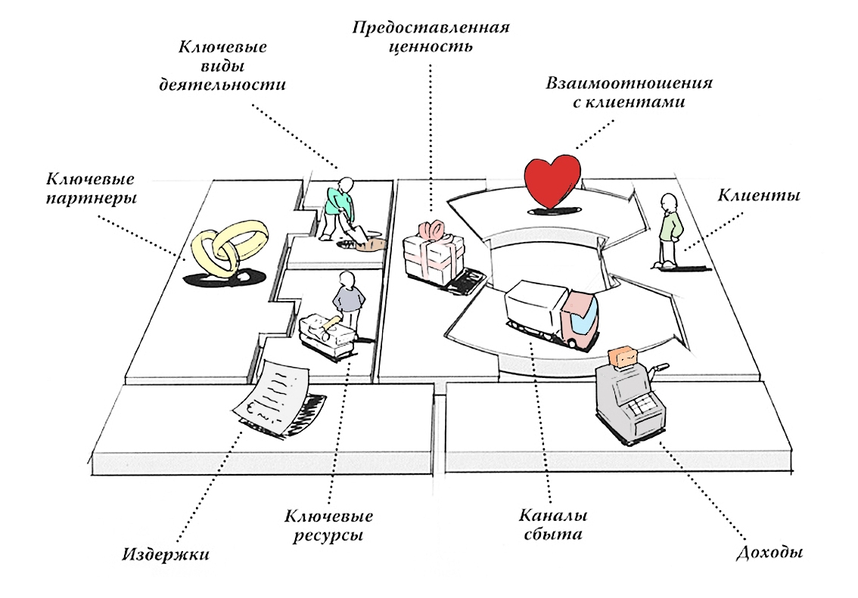
BUSINESS MODEL
Key Activities
Create joint-stock company in Finland
Get European patent
Get European quality certificate
Value Propositions
Comfort (for the 1st segment)
Competitive advantage (for the 2nd segment)
Increase revenue (for the 3rd segment)
Customer Relationships
Agreement on Cooperation
with manufacturers
ВОЛЖАНКА (RUS) and ALUCAT (FIN)
and sealer TOYVAKKA (FIN)
Key Partnerships
Suppliers
aluminum alloy
wire rope
Outsource
production bars
production platforms
Customer Segments
Owners of the motor boats
Manufacturers of the motor boats
Sealers of the motor boats
Channels
Direct sales
Optional sales
On-line sales
Cost Structure
Materials, components and salary 22%
Taxes and contributions 24%
Other expenses 6%
Profit 48%
Key Recourses
Engineering team
Patented technology
Production capacity
Smart money € 0,5M
Revenue Streams
From the 1st segment 10% 0%
From the 2nd segment 50% 70%
From the 3rd g segment 40% 30%
50%
50%

Slide 8
THE TRACKTION IS PROOF
Agreement on Cooperation
with Finnish companies
!
6 weeks
and
only € 0,5K
Produce
pilot batch (6 pcs.)
Create
3D model
of product
Create & test of finish
prototype
Test of pilot batch
with Russian company
Create & test of first prototype
Birth
of idea
1
2
3
4
6
Weeks

Slide 9
MARKET ENTRY STRATEGY
Integration with manufacturers of motor boats
Optional sales through dealers
On-line sales
Steps to implement the strategy:
Get European patent
Get European quality certificate
Create joint-stock company in Finland (presumably in Mikkeli)
Include product into international product catalogs
Create promo web site with an opportunity to purchase online

Slide 10
FINANCIAL PLAN
€
10М
20М
Capitalization
for investor
5X
Profit
Revenue
OPEX
CAPEX
€
10М
4М
8М
€
5М
€
1М
3М
€
2М
0,2М
1М
0,8М
0,5М
1 year
2 year
3 year
4 year

Slide 11
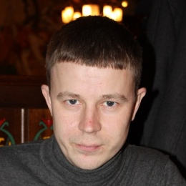
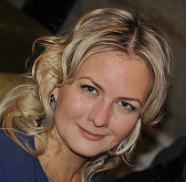
team of professionals
Developing
Andrey Evsigneev
founder, CEO
10 years in technical
8 years in management
Kirill Miroshkin
development director
12 years in development
Maria Ovchinnikova
assistant
7 years in administration
Olga Pavlova
specialist
8 years in development
R&D and production
Yuri Ponomarev
scientific consultant,
professor
over 40 years in vibration sphere
Anton Kotov
head of R&D
over 15 years in vibration sphere
Nikolay Mednikov
engineer
over 6 years in testing
Sergey Pyshkin
head of production
over 10 years in production

Slide 12
RESUME
We have good product and good team
Market volume is about €10B
it’s increasing
After 4 years we expected
revenue €20M
We need smart money € 0,5M for a 25% share

